Slide 1
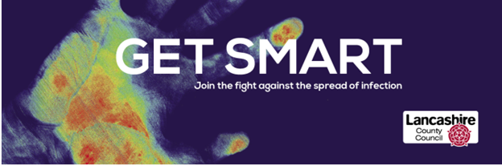
Infection Prevention and Control (IPC) Team
Tanya Shaw and Cathryn Philpott

Slide 2
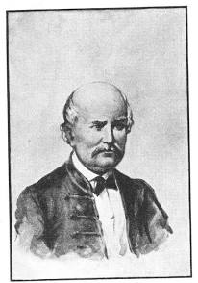
Early IPC…
Ignaz Semmelweis - Hungarian physician and scientist
‘Saviour of mothers’ after demonstrating that the incidence of infection and mortality dramatically reduced when clinicians washed their hands
Despite his success, his ideas were rejected by the medical establishment of his time
Today, hand hygiene is a cornerstone of modern infection control, and Semmelweis is recognized as a pioneer
Notes:
Tanya
Many Drs were unwilling to accept that they were responsible for their patients' deaths.
Semmelweis's career suffered, and he was eventually committed to an asylum, where he died in 1865.
His discoveries were not widely accepted until after his death, when Louis Pasteur's work on germ theory provided a scientific explanation for his findings.
Today, hand hygiene is a cornerstone of modern infection control, and Semmelweis is recognized as a pioneer in antiseptic procedures

Slide 3
Who IPC Work With…
Contracts – attend RADAR and QPIP Meetings
Adult Social Care – offer advice, respond to safeguarding queries
Care Quality Commission – share intel and respond to referrals
Integrated Care Board – close working with IPC colleagues and attend meetings re the care sector
Acute Trusts – place on the IPC Committee Meeting and share information
UK Health Security Agency – outbreak meetings, advise on guidance
Notes:
Tanya

Slide 4
Outbreaks in Lancashire and BwD Settings 2024-25
 | Q1 | Q2 | Q3 | Q4
Norovirus/Diarrhoea & Vomiting (D&V) | 50 | 31 | 74 | 50
Scabies | 16 | 29 | 24 | 16
COVID-19 | 28 | 50 | 15 | 3
Acute Respiratory Infections | 5 | 3 | 33 | 28
TOTAL | 99 | 113 | 151 | 108
Notes:
Tanya
Total of 471 outbreaks in 2024-25

Slide 5
Outbreaks in Lancashire and BwD Settings 2025-26
 | Q1 | Q2
Norovirus/Diarrhoea & Vomiting (D&V) | 41 | 19
Scabies | 19 | 30
COVID-19 | 8 | 19
Acute Respiratory Infections | 16 | 11
TOTAL | 84 | 79
Notes:
Tanya
153

Slide 6
Outbreak management- what is your role?
Early recognition of potential infection/outbreak risks
Prompt implementation of additional measures- check resources
Reporting and communication- internal and external
Line lists
Outbreak management file and contingency plan
End of outbreak procedure- terminal clean and PIR
Notes:
Cathryn
A manager's role within outbreak management involves early recognition—spotting signs of a potential outbreak and acting on this. The manager role is to lead the response—reporting cases, coordinating with IPC team and UKHSA, and making sure IPC protocols like PPE, cleaning, and isolation are followed. It also important to support staff with training and ensure clear open lines of communication, oversee contact tracing, and ensure all documentation is completed such as clear line listings documenting all symptomatic cases. Care homes should maintain a detailed outbreak management file and contingency plan that outlines early detection, response protocols, communication strategies, and recovery procedures. These documents are essential for protecting residents and staff during an outbreak. At the end of an outbreak in a care home, two critical steps are required: a thorough terminal clean and a structured post-infection review (PIR). These ensure the environment is safe and lessons are learned to prevent future outbreaks.
The IPC is currently offering post-outbreak support visit to care setting who may have experience a significant outbreak, Recurring outbreaks or Complex cases where the outbreak may have been prolonged, or poorly managed outbreak.
A post-outbreak visit from the IPC team helps review how the outbreak was managed, identify what worked and what didn’t, and strengthen future response. It supports staff, ensures compliance, and improves overall infection control.
Tasks can be delegated but there needs to be assurance and oversight from the management team.
Can delegate the tasks above but need assurance and oversight from management team- could the IPC champion be involved
Discuss why documentation is key- use examples from practice
Outbreak drills/scenarios could be a staff meeting activity
Outbreak management - Lancashire County Council

Slide 7

Outbreak File
Contact page
Latest guidance- ARI pack, D&V, Scabies
Blank line list forms
Communication sheets (internal and external)
Reflection sheet
Blank touch point cleaning schedules
Should be to hand when IPC phone
Notes:
Cathryn
An outbreak file is a critical operational resource. It enables a prompt, coordinated, and consistent response to outbreaks. By housing essential protocols, contact information, reporting tools, and communication templates in one place, it ensures that staff can act swiftly and effectively. It also supports regulatory compliance, clear documentation, and continuous learning.
Ask group who has an outbreak file in place already
Ask group who currently documents the touch point cleaning during outbreaks

Slide 8
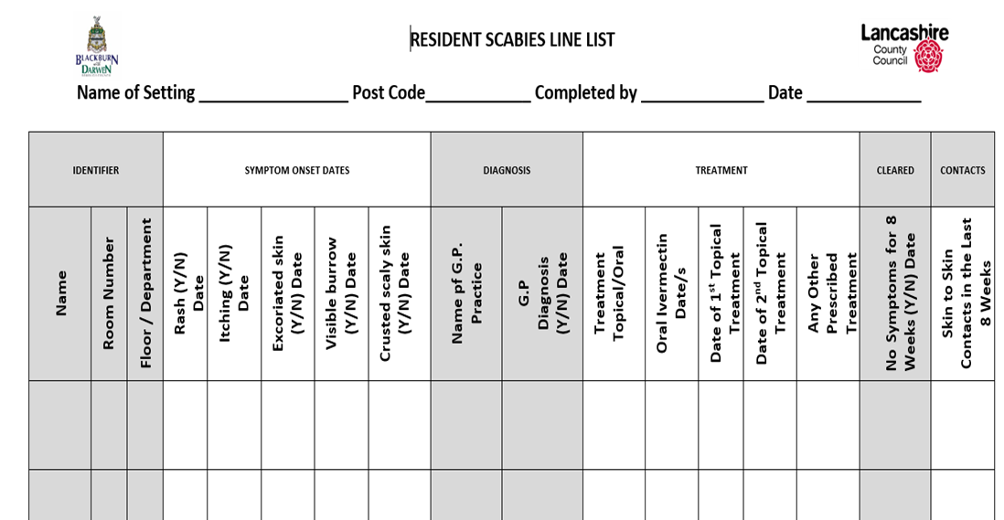

Line Lists
A line list is a table that contains key information about each case in an outbreak, with each row representing a case and each column representing a variable such as demographic, clinical and epidemiologic information (e.g., risk factors and exposures).
Notes:
Cathryn
Line lists are a simple table used during an outbreak to track each case—who’s affected, when symptoms started, test results, and isolation status. It helps spot patterns, guide infection control, and report to health teams. Keeping it updated daily is key to managing the outbreak effectively
Line lists should be returned to the IPC team following an outbreak; however, this process is not always followed, resulting in missing or incomplete information.
Line list information describes an outbreak in terms of person, place and time.
Do not always receive them.
UKHSA and ICB will ask for this information should any escalation be required.

Slide 9


astrointestinal
Standard IPC Precautions
For all infections/outbreaks, commence a line list of those who are symptomatic and those who are a contact and implement the 10 standard infection control precautions (SICPs):
1. Service user placement/assessment of infection risk
2. Hand hygiene
3. Respiratory and cough hygiene
4. Personal protective equipment (PPE)
5. Safe management of the care environment
6. Safe management of care equipment
7. Safe management of healthcare linen
8. Safe management of blood and body fluids
9. Safe disposal of waste
10. Occupational safety/managing prevention of exposure
Additional Precautions*
G
Stool sample
Ventilation
Antibiotics
E
Contact tracing
Body mapping
Antiparasitic treatment
ctoparasites
espiratory
LFD/PCR tests
Antivirals
Ventilation
Surgical face masks
R
*Please contact our team for further IPC precautions
M
Wound management
Screening
Invasive device management
Antimicrobial treatment
ulti drug organism
S
Wound management
Invasive device management
Screening
Antimicrobial treatment
kin
GERMS (2021) established by Lancashire County Council’s Infection Prevention & Control Team.
Please contact infectionprevention@lancashire.gov.uk for permission to use and for acknowledgment
Notes:
Cathryn
The IPC team are utilising the following and plan to roll out packs for each infectious agent linking these to the standard IPC Precautions and any additional precautions that may be required. By rolling theses out as structured packs helps care homes respond quickly, consistently, and confidently to infections. Boosting staff readiness, compliance, and improving resident safety.

Slide 10
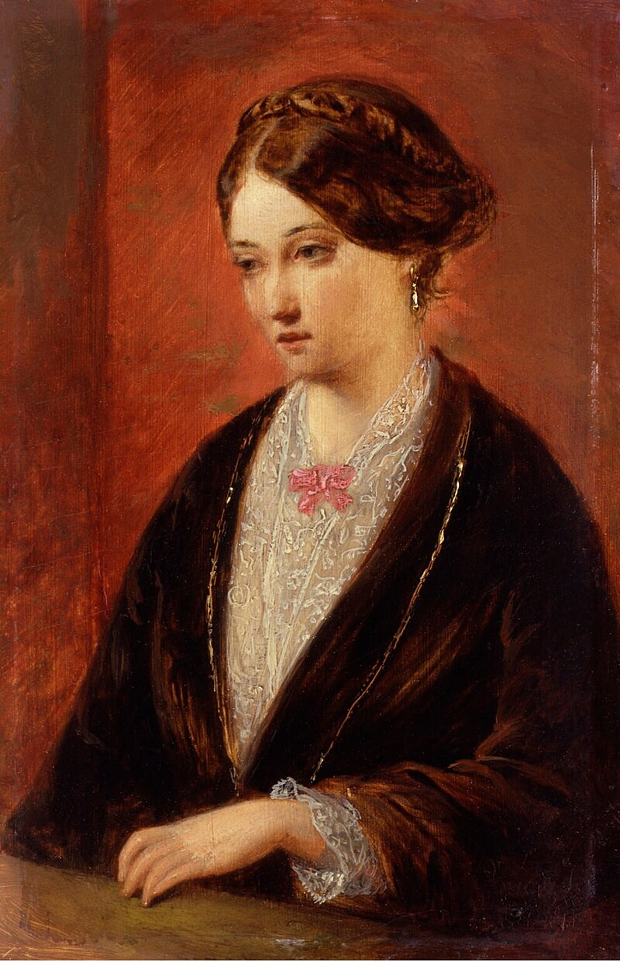
Florence Nightingale - Crimean War 1854-1856
Florence Nightingale is credited with undertaking the first audit in a healthcare setting/environment. She observed problems with British field hospitals, leading towards high mortality rates:
Chronic shortage of hospital supplies
Operations being undertaken on open wards/environments
Water supply to the hospital was contaminated
Basic sanitation needs not being met
Food supplies/quality were inadequate
42% of British soldiers admitted to battlefield hospitals died there
Notes:
Tanya.
She set benchmarks for cleanliness and her work led to institutional change for improved standards.

Slide 11

Audit Schedule
Daily
Monthly
3-6 monthly
Annually
Catheters (checking in right position, that it has been cleaned and that correct bag is attached)
Commodes
Mattress and pillow check when changing linen
Mattress and pillow - Audit and on discharge of resident
Commodes – H & S check (rust/cracks in plastic)
Hand hygiene (Observation, Q&A, Clinical Supervision)
Catheters best practice monthly
Environmental audits (RIT) - Review action plan
Review action plan
Toothbrush and dental products
Nutrition & Hydration
Full care home audit - documenting and reviewing improvements made
Notes:
Cathryn
IPC audits are vital as they help spot infection risks early, ensure staff follow safety standards, and prevent outbreaks. They also guide and support training, improve quality of care, support outbreak prevention. They align with national standards, such as the Health and Social Care Act 2008, ensuring infection control practices are legally compliant and meet essential safety requirements
Be mindful if audits are covert (hand hygiene).
Also 100% compliance – not achievable consistently.

Slide 12
Key IPC Measures in Care Homes
Standard Precautions: Follow routine IPC practices including hand hygiene, PPE use, and environmental cleaning.
Enhanced Cleaning: Increase frequency of cleaning during outbreaks, especially high-touch surfaces.
Symptom Monitoring: Conduct regular checks for residents and staff to detect new cases early.
Staff Exclusion: Symptomatic staff should stay off work for a minimum of five days until they are feeling better.
Visitor Management: Restrict or manage visits during outbreaks; follow national guidance.
Ventilation: Ensure good airflow in communal areas and resident rooms.
IPC Audits: Perform weekly audits during outbreaks to ensure compliance and identify gaps.
Training & Communication: Ensure staff are trained in IPC protocols and updated regularly.
Notes:
Cathryn
Standard Infection Control Precautions which area referred to as SICPs are based on evidence-based national guidelines, legal duties, and best practices designed to prevent infection transmission in all care settings. They are vital because they help to prevent and protect others from infections ensuring safe, consistent practices such as hand hygiene and PPE use.
Preventing and reducing the spread of ARI is key to the health & wellbeing of service users and staff in adult social care.
SICPs for reducing ARI outbreaks - in all care settings, at all times, for all service users whether infection is known to be present or not, to ensure the safety of those being cared for , staff and visitors in the care environment.
Hygiene between tasks and between service users with soap and water or alcohol-based hand rub. Ensure staff are bare below the elbow and no false nails or nail varnish should be worn by staff.
Respiratory and cough hygiene (catch it, bin it, kill it!)
Appropriate use of PPE - 4 hours for surgical masks.
Isolation- Close adherence to IPC measures for and around immunosuppressed residents is recommended. Residents may have to isolate for longer if they are deemed to be a risk for potential prolonged shedding of the virus. Discussion with the GP should be sought.
Cleaning of shared equipment, especially after use and regular cleaning of the environment paying particular attention to frequently touched surfaces and shared areas.
Staff Exclusion - Staff with confirmed COVID-19 or influenza should stay off work for 5 days. If testing isn’t available, staff with symptoms of influenza-like illness (ILI) or acute respiratory infection (ARI) should remain off work until they feel well and acute symptoms have resolved. Recovery from flu typically takes more than 3 days.
Acute symptoms include:
Fever, chills, or high temperature
Sneezing or nasal congestion
Muscle aches
Sore throat
Chesty cough, hoarseness, or wheezing
Post-viral symptoms like a dry cough or fatigue do not require time off.
You can obtain further details on SICPs and best practice accessing the link -Infection prevention and control: resource for adult social care. Please ensure that all measures to prevent and manage infections are risk assessed.

Slide 13

Lead by example
Promote a culture of safety
Provide ongoing education and support
Monitor and Audit practices
Communicate Clearly and Consistently
Notes:
Cathryn
IPC role modelling is a vital leadership responsibility for care home managers. By setting the tone and leading by example, managers can foster a culture of safety, accountability, and best practice. Managers play a vital role in infection prevention by leading by example, consistently demonstrating best practices and setting high standards. They should promote a culture of safety where infection control is prioritized, provide ongoing education and support to empower staff, monitor and audit practices to ensure compliance, and communicate clearly and consistently to reinforce expectations and drive improvement.
Lead by Example- Consistently follow all IPC protocols, including hand hygiene, bare below the elbow, PPE use, and environmental cleaning.
Be visible during outbreaks or audits. Managers and senior staff should always follow BBE standards. Be visible during care activities and model best practice.
Promote a Culture of Safety
Encourage open communication about IPC concerns or breaches without fear of blame.
Recognize and praise staff who demonstrate excellent IPC practices encourage incentives/rewards
Embed IPC into daily routines and team discussions.
Provide Ongoing Education and Support
Ensure all staff receive regular IPC training and updates.
Use scenarios to reinforce lessons learnt
Offer refresher sessions for staff who may require extra support.
Monitor and Audit Practices
Regularly observe and audit IPC practices eg, hand hygiene, PPE use, and cleaning protocols. Involve staff and delegate responsibilities promoting teamwork
Share audit results with staff and involve them in action planning.
Use data to drive improvements and celebrate progress.
Communicate Clearly and Consistently
Share updates from UKHSA, CQC, or local health protection teams promptly.
Use visual reminders to reinforce key IPC messages.
Be approachable and responsive to staff questions or concerns. Foster a “no blame” culture where IPC reminders are seen as supportive, not punitive.
Champion Resident and Family Engagement
Educate residents and families about IPC measures and why they matter.
Involve residents and family regarding IPC matters including outbreaks. Reassure them that safety is a shared priority (working together).

Slide 14
Flu Vaccine
UKHSA have confirmed that already lab detections, positivity rates and admissions for influenza have increased in North West
Staff accessing the vaccine will keep colleagues and residents safe and prevent staff sickness (implications for sick pay)
It is the responsibility of employers under the Health and Safety at Work Act to support staff to access the vaccine
Staff can get the vaccine free of charge from their GP or local pharmacy
Employers should keep a record of the staff that have had the vaccine
Notes:
Tanya

Slide 15
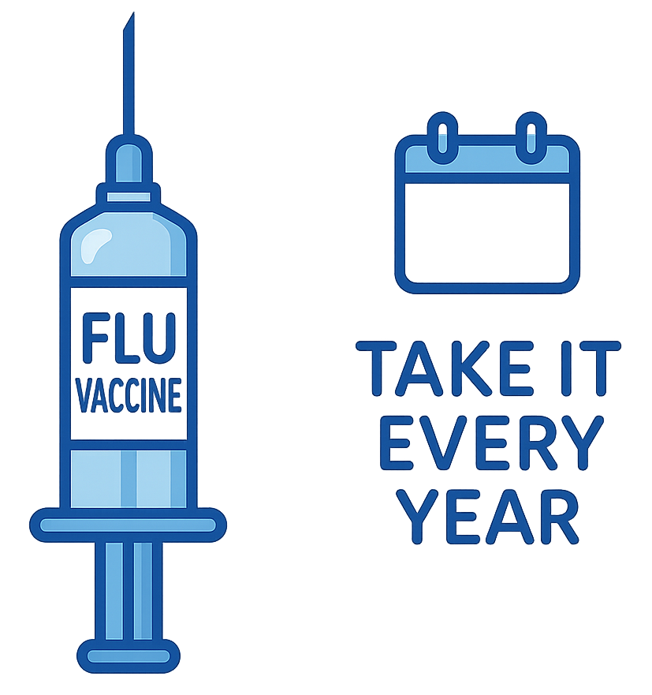
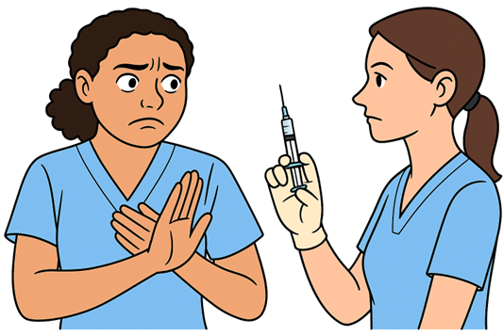




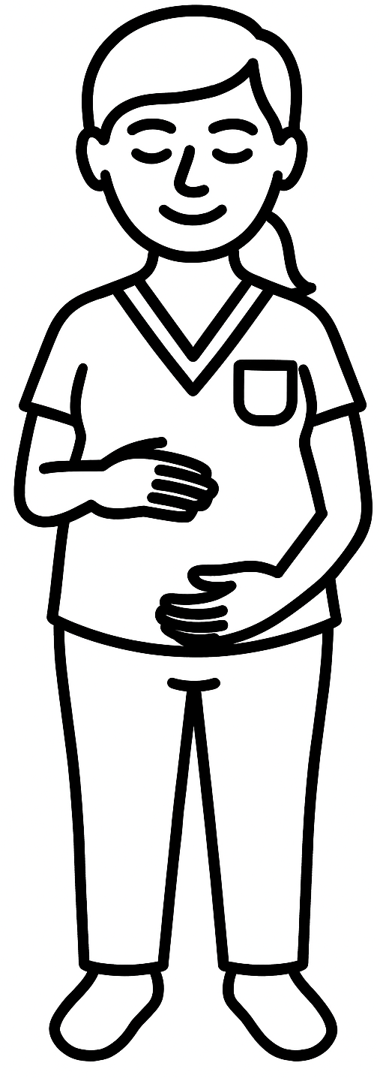
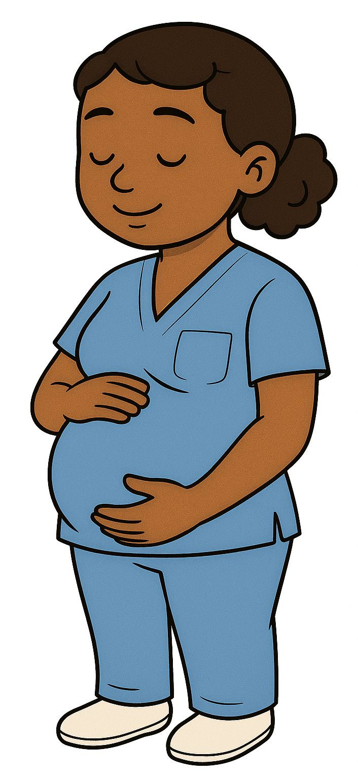
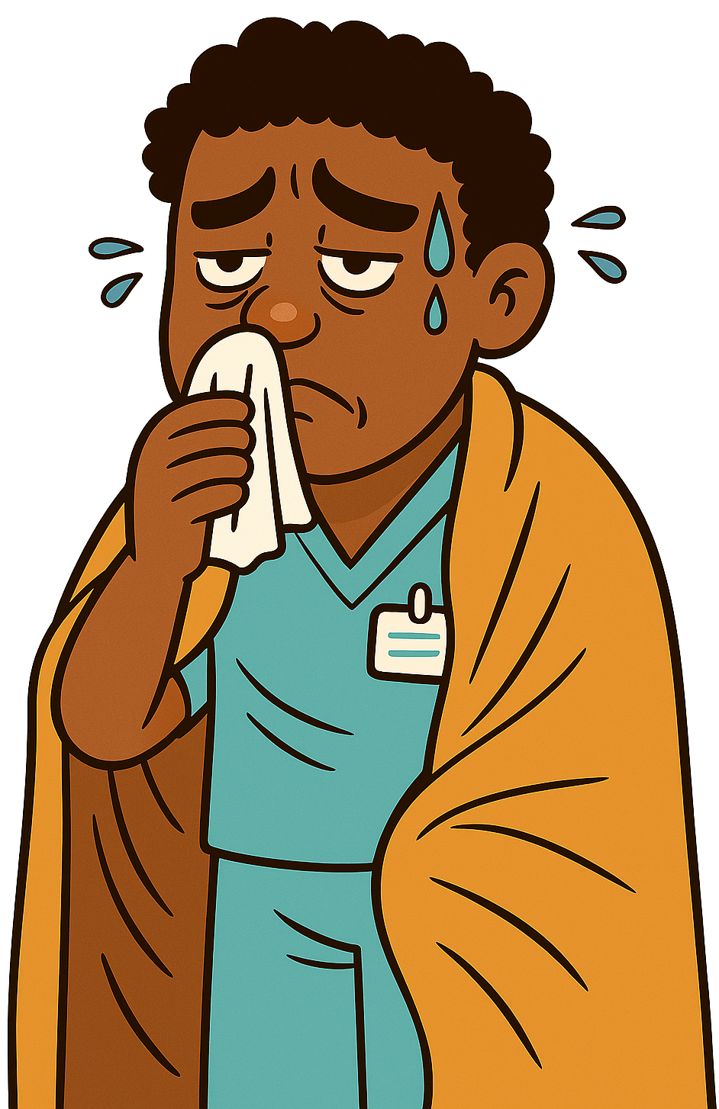

BE THE SHIELD THEY NEED - FIGHT FLU WITH YOUR VACCINE
Lancashire & Blackburn with Darwen’s Influenza Figures 2024/25
MYTH
FACT
I had the flu vaccine last year, so I don’t need it this year
You need a flu vaccine every year because the virus changes, and a new vaccine is made to match the expected strains circulating that year. Your immunity also declines over time
There are 749 adult social care settings in Lancashire and Blackburn with Darwen, providing accommodation for at risk adults. Protect them from flu by having your flu vaccine!
MYTH
FACT
ONLY 13.5% of social care workers in North West England had the flu vaccine in 2024/25. That’s the equivalent of 1.35 in 10 staff!!
I don’t need/want the flu vaccine as flu isn’t that serious
Flu can be life-threatening for vulnerable groups like older adults. As a social care worker, getting vaccinated helps protect those you care for by reducing the risk of spreading flu
MYTH
FACT
I can’t have the flu vaccine because I’m pregnant
The flu vaccine is safe during pregnancy and protects both you and your baby. Pregnant people are at higher risk of serious flu complications, which can affect your baby’s health
Acute respiratory infections (ARI) were the second most reported outbreak in social care settings in 2024/25. You can reduce flu outbreaks this year by having your vaccine!
MYTH
FACT
ARI
I got ill from the flu vaccine
Injectable flu vaccines in the UK don’t contain a live virus, so they can’t give you flu. It takes up to 14 days to build immunity, so you could still catch flu if exposed during that time
D&V
Scabies
Notes:
Tanya
Flu myth – busting for adult social care staff.

Slide 16
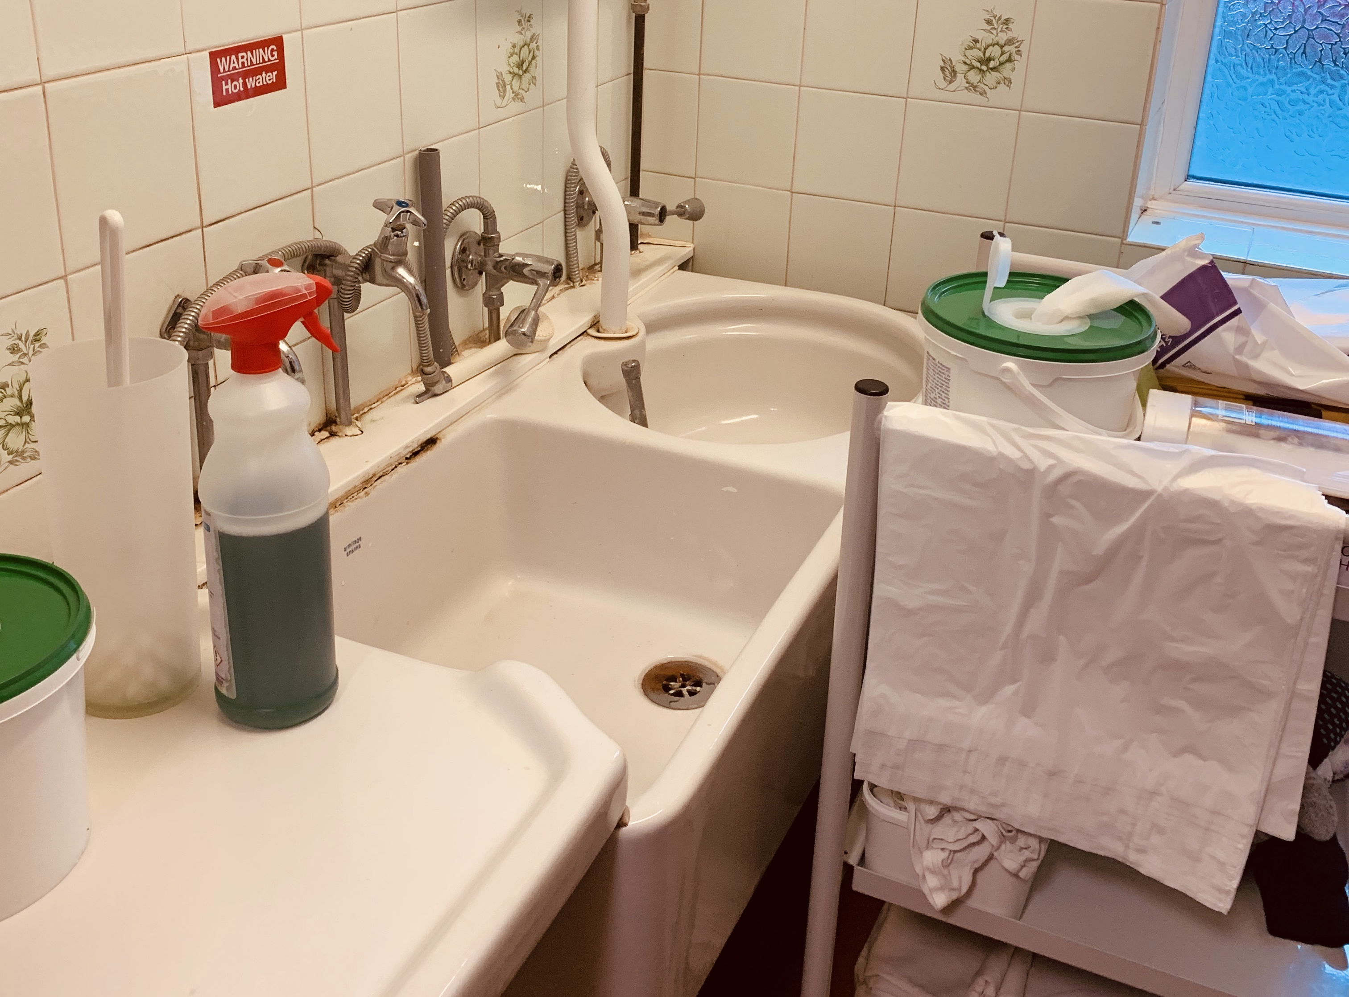
Notes:
Tanya
Toilet brush used to clean commode pans – we have a procedure on our webpage detailing how to manually clean a commode pan.
Clean aprons over a clean linen trolley – the sluice is classed as a ‘dirty’ room. Therefore should be free from vases, clean linen trolley, open PPE.
Rust at the back of the sink. Anything rusty cannot be cleaned effectively.

Slide 17
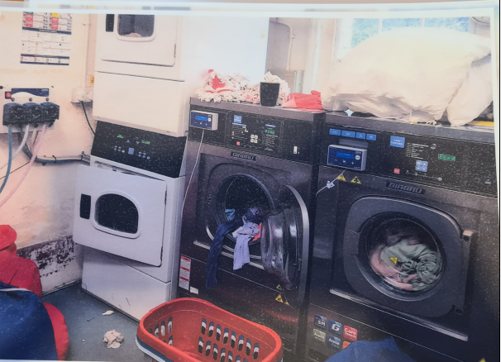
Notes:
Tanya
Cluttered laundry.

Slide 18
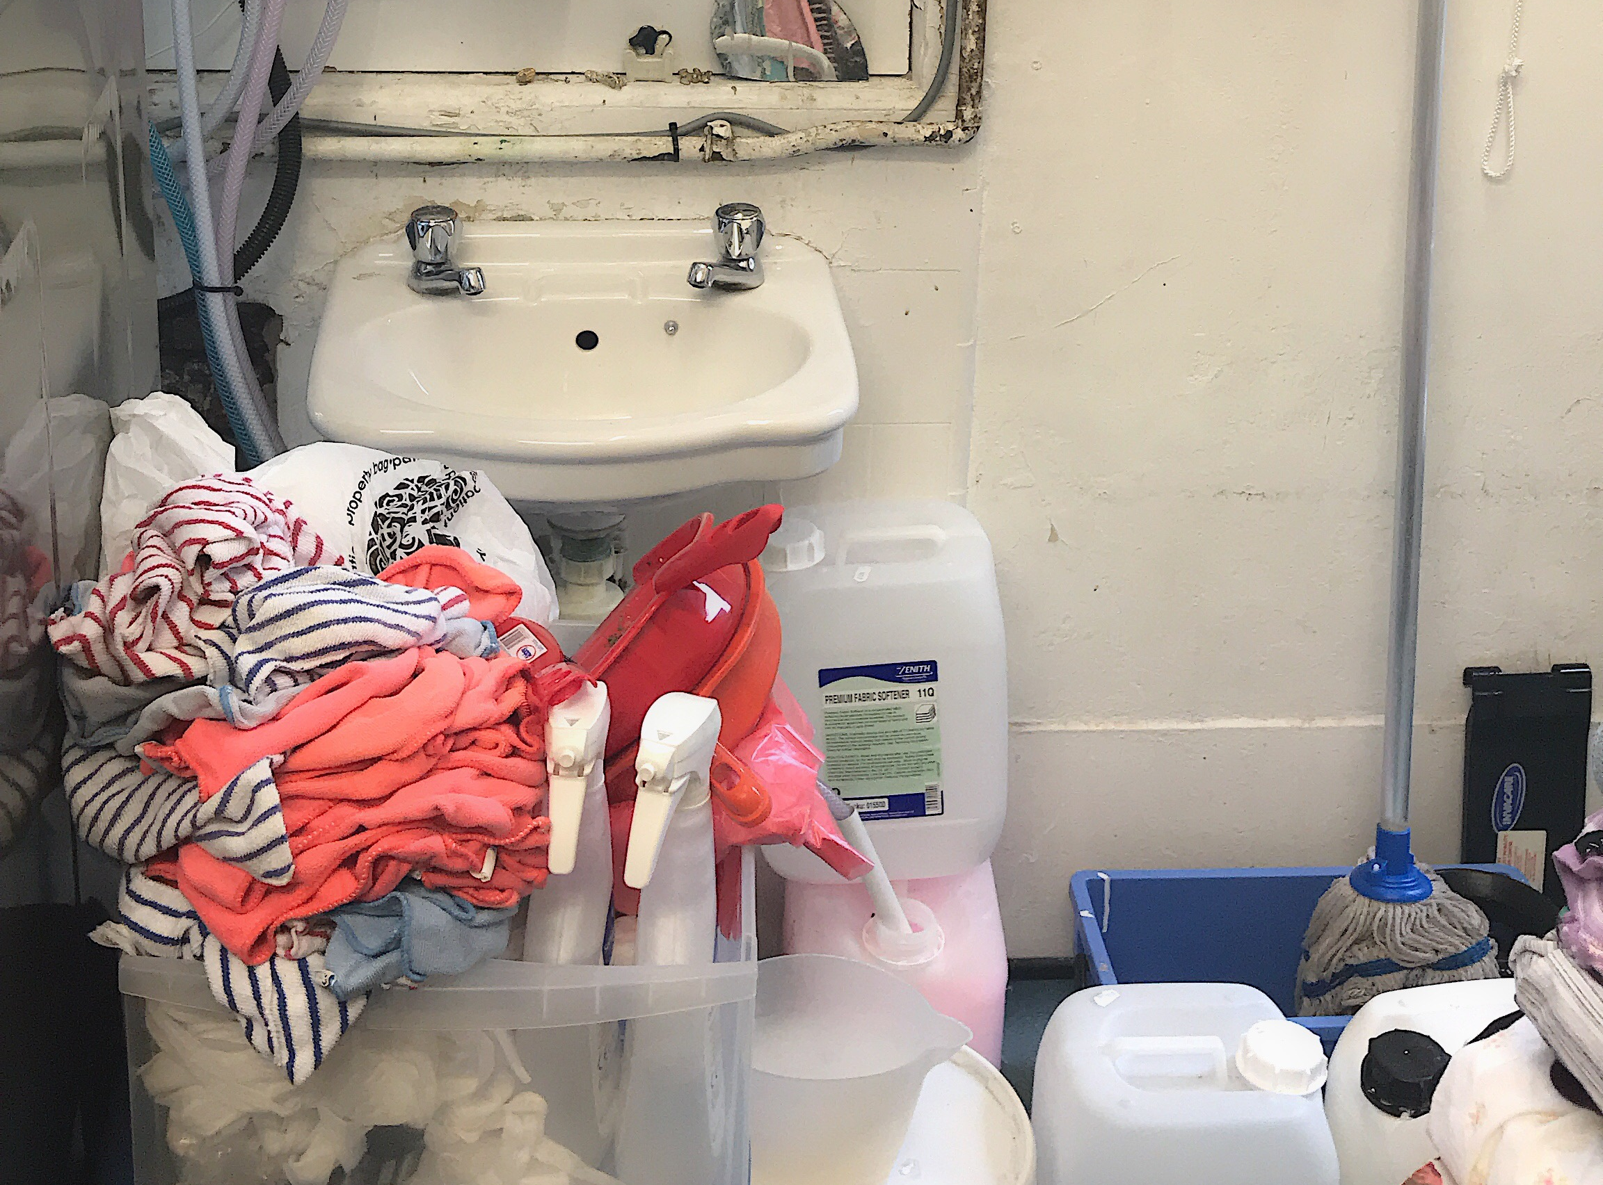
Notes:
Tanya
Hand hygiene sinks obstructed.
Inappropriate items stored in a laundry.

Slide 19
IPC Team Offer…
Outbreak Support Visits
IPC Teams Drop In (monthly)
Forums – both face to face and via webinar
Resident IPC Awareness Visits – Q4 2025-26
RESTORE2 Training – monthly
UTI Training for homes with increased rates
Quarterly newsletter
Quality Improvement Training
Bespoke IPC Fundamentals Training
Notes:
Tanya
Outbreak Support Visits – can request

Slide 20

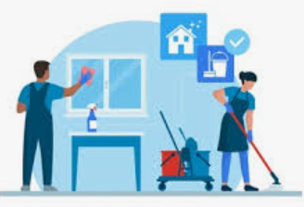
IPC Care Champion (IPCCC)
Are they the most appropriate person?
Notes:
Domestic, Front line, Manager

Slide 21

Thank You
infectionprevention@lancashire.gov.uk

