Slide 1
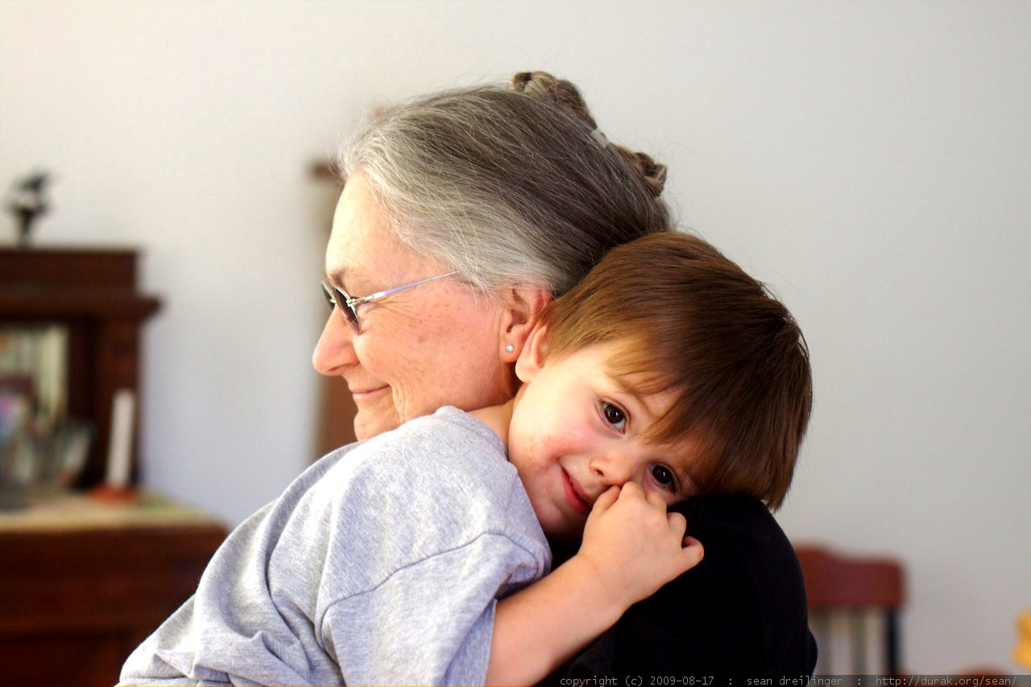
Regulation 9A - Visiting
Gavin Bainbridge, Tracey Airey, CQC
April 2026
This Photo by Unknown Author is licensed under CC BY-SA-NC
Notes:
1

Slide 2
Timeline
Late March 2024
Guidance for providers agreed by ET and the Board and published on our website
19 December 2023 Regulation agreed by Parliament
January – Mid February 2024
CQC consultation on the guidance for providers
6 April 2024
Regulation comes into force

Slide 3

The Legislation
The Health and Social Care Act 2008 (Regulated Activities) (Amendment) Regulations 2023
Introduction of the new Fundamental Standard Regulation 9A

Slide 4
Aims of the Regulation
The regulation aims to ensure:
people staying in a care home, hospital or hospice can receive visits from people they want to see
people living in a care home are not discouraged from making social visits outside the home
people attending appointments in a hospital or hospice, which do not require an overnight stay, can be accompanied by a family member, friend or advocate if they want someone with them.

Slide 5
Exemptions
Supported living, DCAs, GP practices, management and supply of blood products, transport services, remote triage and medical advice services
Detainees under the Immigration Acts
People detained in prison or other institution to which the Prison Act 1952 applies or the equivalent in Scotland and Northern Ireland
Residential and/or detoxification services for substance misuse

Slide 6
Exceptional circumstances
  Visiting / accompaniment should only be restricted in exceptional circumstances, such as where a visit would pose a serious risk to the health, safety or welfare of the person using the service or other people on the premises.
  It should be exceptional and will be rare
  At the heart of the guidance is our Human Rights approach

Slide 7
What does this mean for different service providers?
Care Homes – visiting in
Consider the person's preferences and risk assess using human-rights based decision making
Where needed, take precautions (PPE etc) so the visit can go ahead
Good communication with people and visitors (where appropriate)
Take the least restrictive option to mitigate any exceptional risks
Keep detailed records
Any restrictions should be time limited and frequently reviewed. Keep the decision under review and reduced or removed asap.

Slide 8
Care Homes – visiting out
Providers must not discourage visits out e.g – unreasonably long periods of isolation.
Regulation 9 may be more appropriate regarding going out into the community generally
Any restrictions must be the least restrictive option, risk assessed and recorded
No additional requirement regarding staffing and transport - this regulation seeks to ensure providers enable and encourage people to be accompanied.

Slide 9
Applying Regulation 9A using the Single Assessment Framework
Use a proportionate and measured approach to assessing the independence, choice and control Quality Statement
Specific breach of Regulation 9A most likely under the ‘Caring’ key question

Slide 10
Ongoing assessment against Regulation 9A
Business as usual processes
Monitor information we receive and assess risk
No requirement to notify CQC
9A will be considered during any comprehensive assessment
Normal civil enforcement process

Slide 11
Registering against Regulation 9A
Registration will need assurance the applicant is aware of the requirement, understands their responsibilities, and has processes in place to meet Regulation 9A

Slide 12
Review and useful Links
Review of Regulation 9A: visiting and accompanying in care homes, hospitals and hospices - GOV.UK
The Health and Social Care Act 2008 (Regulated Activities) (Amendment) Regulations 2023
Regulation 9A: Visiting and accompanying in care homes, hospitals and hospices - Care Quality Commission
Our updated human rights approach - Care Quality Commission (cqc.org.uk)
Mental Capacity Act 2005 (legislation.gov.uk)
Mental Health Act code of practice here
Right Support, Right Care, Right Culture guidance

Slide 13

Questions

