Slide 1
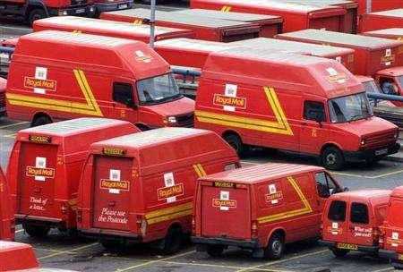
Parcel Post
Maximum weight | Price
2kg | £4.41
4kg | £7.06
6kg | £9.58
8kg | £11.74
10kg | £12.61
20kg | £14.69

Slide 2
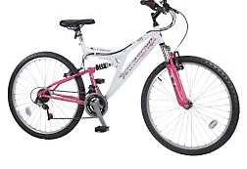
SALE
was £129 now £115
or pay
£1.42 per week for 104 weeks
or
£2.39 per week for 52 weeks

Slide 3
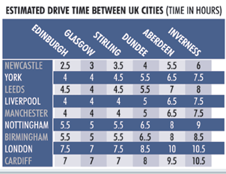

Slide 4
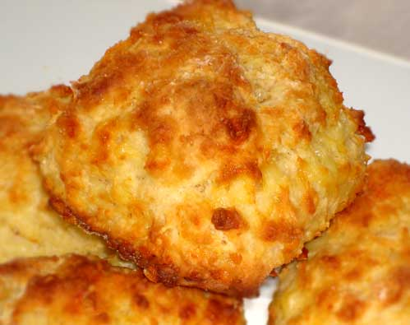
Ingredients for Cheese Scones
225g / 8oz self raising flour
pinch of salt
55g / 2oz butter
25g / 1oz grated cheddar cheese
150ml / 5fl oz milk
Makes 10 scones

Slide 5
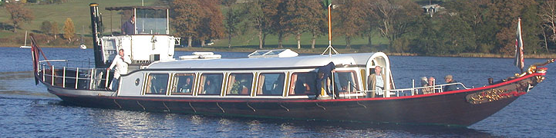
Coniston Steam Yacht
Timetable and Fares
Coniston Pier | Brantwood | Monk Coniston | Coniston Pier | Sailing days
10.30 | 10.55 | 11.05 | 11.15 | Daily except Sunday
11.30 | 11.55 | 12.05 | 12.15 | Daily
13.30 14.30 | 13.55 14.55 | 14.05 15.05 | 14.15 15.15 | Saturday, Sunday, Tuesday, Wednesday and Friday
15.30 | 15.55 | 16.05 | 16.15 | Daily
16.30 | 16.55 | 17.05 | 17.15 | Daily in June, July and August only.
 | Full Fare for round trip | Con. to Brant | Brant . to Con | Con to MC | Brant to MC | MC to Con | MC to Brant
Adult | £8.50 | £5.00 | £5.00 | £7.50 | £3.00 | £3.00 | £7.50
Child | £4.50 | £3.00 | £3.00 | £3.00 | Free | Free | £3.00

Slide 6






Exchange Rates
 | United Kingdom | £1.00
 | United States | $1.52
 | European Union | €1.13

Slide 7




Weekdays after 5.00pm and weekends
Badminton Court per hour | £ 8.30
Bowls per lane per hour | £ 7.20
Full Sports Hall per hour | £ 80.00
Half Sports Hall per hour | £ 40.00
Table Tennis per person per hour | £ 2.60
Squash Courts per 40minutes | £ 7.00
Weekdays 10am - 5pm
Half Sports Hall per hour | £ 28.00
Practice Hall per hour | £ 20.00
Table Tennis per person per hour, | £ 2.20
Squash Courts per 40minutes | £ 6.00

Slide 8
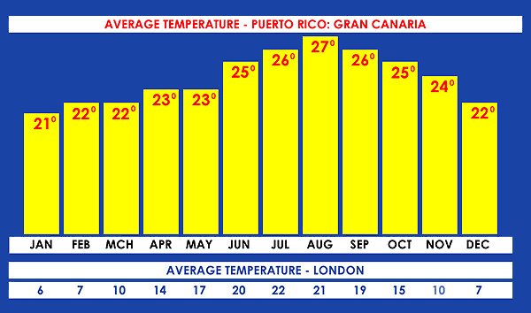

Slide 9
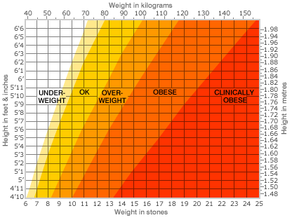
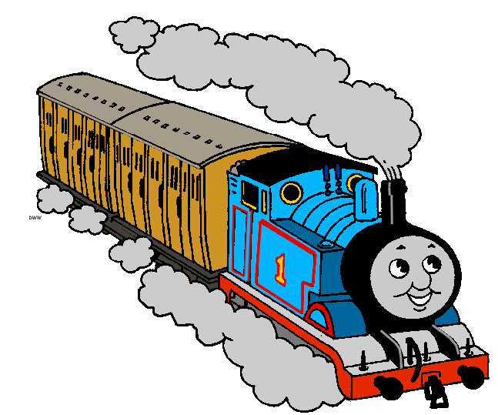
Steam Train Trips
First Class | Standard Class
Adult Return £ 10.00 | Adult Return £ 8.00
Child Return £ 5.00 | Child Return £ 4.00
Concession Return £ 9.00 | Concession Return £ 7.00
Embsay (depart) | 10.30 | 11.10 | 12.00 | 12.40 | 13.30
Bolton Abbey (arrive) | 10.45 | 11.25 | 12.15 | 12.55 | 13.45
Bolton Abbey (depart) | 11.10 | 12.00 | 12.40 | 13.30 | 14.10
Embsay (arrive) | 11.25 | 12.15 | 12.55 | 13.45 | 14.25
Embsay (depart) | 14.10 | 15.00 | 15.40 | 16.30
Bolton Abbey (arrive) | 14.25 | 15.15 | 15.55 | 16.45
Bolton Abbey (depart) | 15.00 | 15.40 | 16.30 | 17.00
Embsay (arrive) | 15.15 | 15.55 | 16.45 | 17.20

Slide 11
Poster Printing
Number of copies | A3 size | A2 size | A1 size
1 to 5 | £3.75 each | £7.50 each | £15.00 each
6 to 10 | £3.50 each | £7.00 each | £14.00 each
11 and over | £3.25 each | £6.50 each | £13.00 each
Post and Packing
A3 £2.75 + 75p for each copy.
A2 £2.95 + 85p for each copy.
A1 £3.50 + £1.00 for each copy.

Slide 12
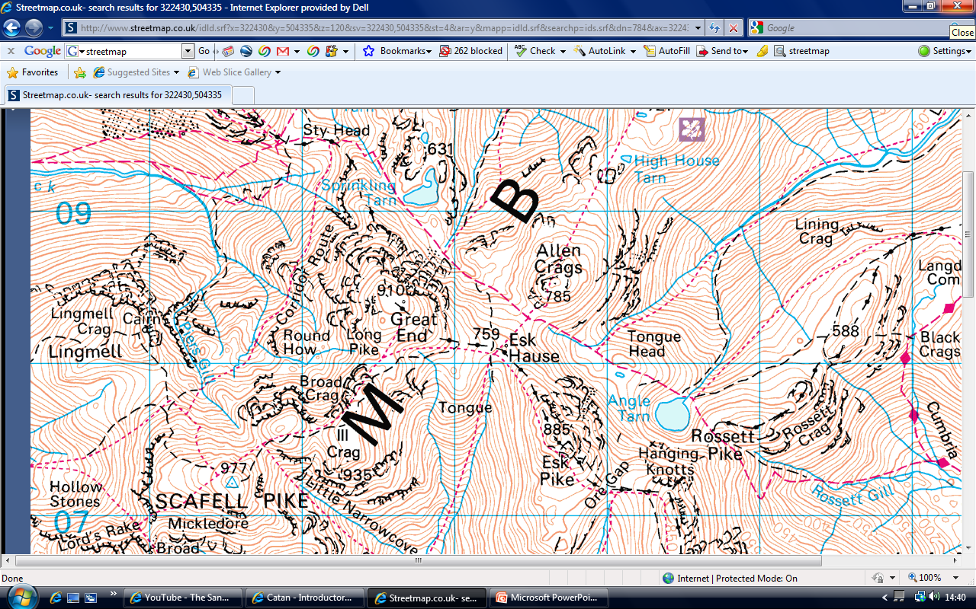
Naismith's Rule
Allow
1 hour for every 3 miles (5 km) walked,
plus
½ hour for every 1000 feet (300 metres) of ascent.

Slide 13
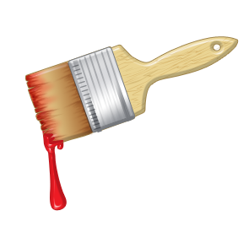

Paint
Area covered by 1 litre |  | Price
Matt Emulsion | 12.5 -16 m² | 2.5 litres for £7.50
Silk Emulsion | 11-16 m² | 2.5 litres for £7.50
Eggshell | 15 -16 m² | 750 ml for £9.00
Gloss | 15 -16 m² | 750 ml for £9.90

Slide 14
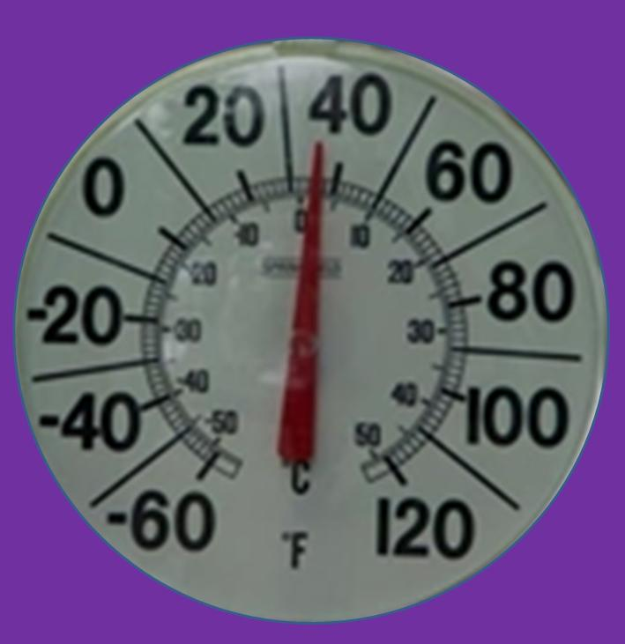


Changing °Fahrenheit to °Celsius
C = 5 ( F – 32 )
9

Slide 15



Cook for 20 minutes, plus 20 minutes for every 500g (1lb) of the bird’s weight

Slide 16
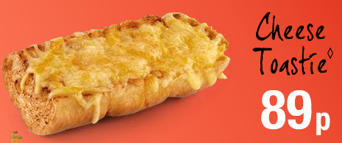
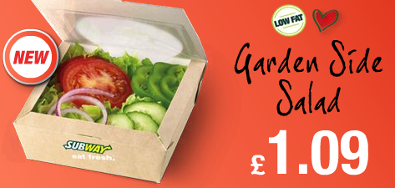
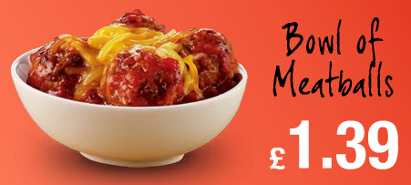
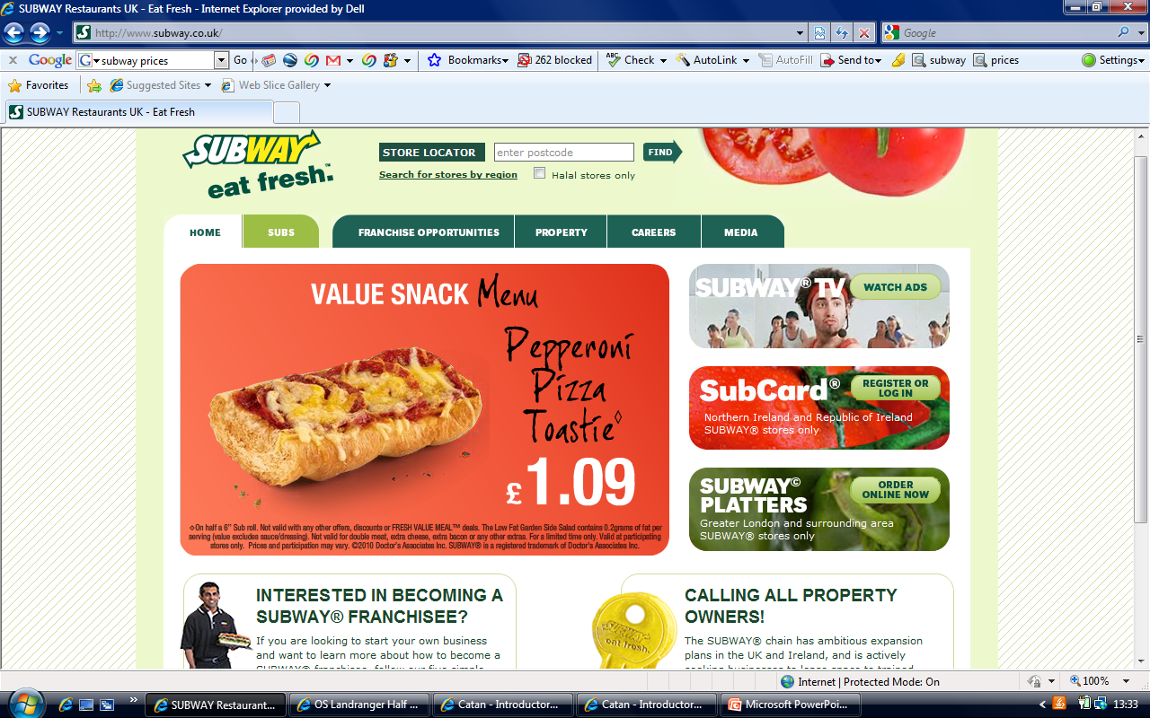
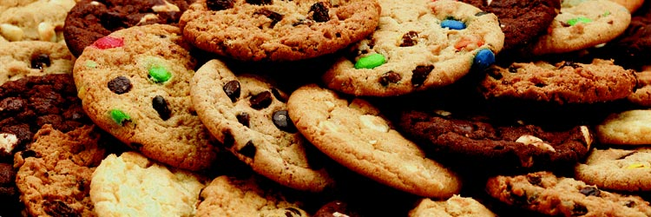
 | Small | Regular | Large
Soft Drink | £1.09 | £1.29 | £1.49
Coffee |  | £1.49 | £1.79
Tea |  | £0.99 | £0.99
Cookies
£0.49 each
3 for £1.19
12 for £3.99

Slide 17

Adults: Balcony £5.50 Stalls £4.50
Children: Balcony £4.50 Stalls £3.50.
Family 2 Adults, 2 children £14 ,00
or 1 Adult, 3 children

Slide 18

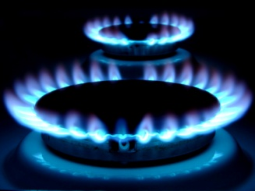


Gas Prices | Cost per unit | Daily standing charge
With standing charge | 2.97p | 26.85p
Without standing charge | 5.08p | 0.0p
Electricity Prices | Cost per unit | Daily standing charge
With standing charge | 12.04p | 7.03p
Without standing charge | 14.85p | 0.0p

Slide 19
10 Pin Bowling
Off Peak – before 6pm on any weekday
Adult | Peak | £4.50
 | Off Peak | £2.75
Junior (Under 16's) | Peak | £3.50
 | Off Peak | £1.95
Family Ticket (1 Game) | Peak | £14.00
 | Off Peak | £8.00
Family Ticket (2 Games) | Peak | £22.00
 | Off Peak | £12.00
Over 55 | Off Peak | £1.80
Student (Aged 16 – 19) | Off Peak | £1.95
Opening Times
Sunday to Thursday 10am - 11.30pm
Friday - Saturday 10am - Midnight

Slide 20
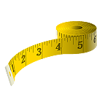
Body Mass Index = Mass in kilograms
(Height in metres)²
1 inch ≈ 2.54 centimetres
1 pound ≈ 0.54 kilograms

