Slide 1
2025 KS1 Reading
Non-statutory

Slide 2
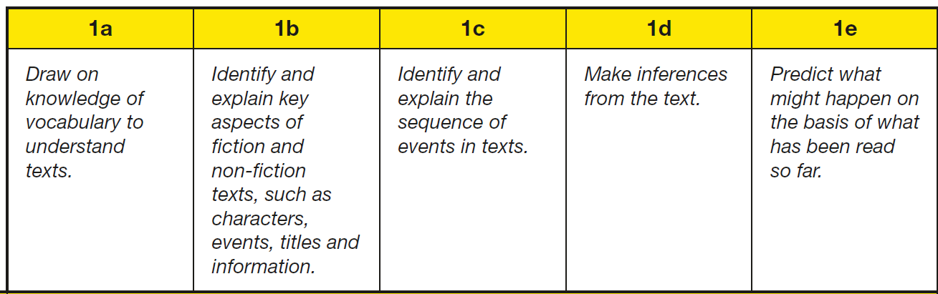
2025 Non-statutory Reading Test Key Stage 1
Content Domain Coverage - Paper 1 only
3 | 10 | 0 | 7 | 0
15% | 50% | 0% | 35% | 0%
85% of questions assessed retrieval and inference.
Year 1
Note: Some questions assess more than one area of the content domain. Any secondary content domain references are indicated in the mark schemes.
(2025 KS1 English Reading Test Mark Schemes, STA, pp4-5)

Slide 3
2025 Non-statutory Reading Test Key Stage 1
Content Domain Coverage - Paper 2 only
3 | 13 | 0 | 4 | 0
15% | 65% | 0% | 20% | %
85% of questions assessed retrieval and inference.
Year 1
Note: Some questions assess more than one area of the content domain. Any secondary content domain references are indicated in the mark schemes.
(2025 KS1 English Reading Test Mark Schemes, STA, pp4-5)

Slide 4
2025 Non-statutory Reading Tests Key Stage 1
Content Domain Coverage - Papers 1 and 2 combined
6 | 23 | 0 | 11 | 0
15% | 57.5% | 0% | 27.5% | 0%
85% of questions assessed retrieval and inference.
Year 1
Note: Some questions assess more than one area of the content domain. Any secondary content domain references are indicated in the mark schemes.
(2025 KS1 English Reading Test Mark Schemes, STA, pp4-5)

Slide 5
Compared to previous years …

Slide 6
2024 Non-statutory Reading Test Key Stage 1
Content Domain Coverage - Paper 1 only
3 | 13 | 0 | 4 | 0
15% | 65% | 0% | 20% | 0%
85% of questions assessed retrieval and inference.
Year 1
Note: Some questions assess more than one area of the content domain. Any secondary content domain references are indicated in the mark schemes.
(2024 KS1 English Reading Test Mark Schemes, STA, pp4-5)

Slide 7
2024 Non-statutory Reading Test Key Stage 1
Content Domain Coverage - Paper 2 only
2 | 10 | 0 | 8 | 0
10% | 50% | 0% | 40% | 0%
90% of questions assessed retrieval and inference.
Year 1
Note: Some questions assess more than one area of the content domain. Any secondary content domain references are indicated in the mark schemes.
(2024 KS1 English Reading Test Mark Schemes, STA, pp4-5)

Slide 8
2024 Non-statutory Reading Tests Key Stage 1
Content Domain Coverage - Papers 1 and 2 combined
5 | 23 | 0 | 12 | 0
12.5% | 57.5% | 0% | 30% | 0%
87.5% of questions assessed retrieval and inference.
Year 1
Note: Some questions assess more than one area of the content domain. Any secondary content domain references are indicated in the mark schemes.
(2024 KS1 English Reading Test Mark Schemes, STA, pp4-5)

Slide 9
2023 Reading Test Key Stage 1
Content Domain Coverage - Paper 1 only
2 | 13 | 0 | 5 | 0
10% | 65% | 0% | 25% | 0%
90% of questions assessed retrieval and inference.
Year 1
Note: Some questions assess more than one area of the content domain. Any secondary content domain references are indicated in the mark schemes.
(2023 KS1 English Reading Test Mark Schemes, STA, p4)

Slide 10
2023 Reading Test Key Stage 1
Content Domain Coverage - Paper 2 only
3 | 12 | 1 | 3 | 1
15% | 60% | 5% | 15% | 5%
75% of questions assessed retrieval and inference.
Year 1
Note: Some questions assess more than one area of the content domain. Any secondary content domain references are indicated in the mark schemes.
(2023 KS1 English Reading Test Mark Schemes, STA, p4)

Slide 11
2023 Reading Tests Key Stage 1
Content Domain Coverage - Papers 1 and 2 combined
5 | 25 | 1 | 8 | 1
12.5% | 62.5% | 2.5% | 20% | 2.5%
82.5% of questions assessed retrieval and inference.
Year 1
Note: Some questions assess more than one area of the content domain. Any secondary content domain references are indicated in the mark schemes.
(2023 KS1 English Reading Test Mark Schemes, STA, p4)

