Slide 1
Is your setting a vocabulary rich environment? What does that look like?
The environment reflects the teaching that has taken place offering the children lots of opportunities to revisit key stories, concepts and skills within the indoor and outdoor classroom. All provision has been planned, modelled and discussed with the children.
We develop lots of small challenges that enable the children to engage in tasks around the environment and develop and use the key vocabulary.
We plan for the focused activities to take place at the same time using a group system with the teacher and TA’s. This way all staff are available to support provision time play. Having adults around to model language and play and support children with their independent learning is wonderful. It allows children to engage in high quality back and forth conversations with an adult and develop relationship within the classroom.
The environment has lots of cosy spaces for the children to go into and build confident when talking.
We have a story station where props and resources from this weeks story are kept. These can include the book, sequencing cards, puppets, character masks, story stones or story spoons and a writing focus. These are then placed in our story corner so the children can continue to revisit when we move onto a new text.
We use ‘Tales toolkit’ to aid story telling. It includes symbols to represent the characters, setting, problem and solution. This is modelled during our retell sessions then added to the provision areas.
We add large rolls of paper to provision for children to develop their own stories based on the ones they hear.
We use a curiosity cube to develop interest in our focussed learning and encourage the children to ask question related to what they see.
We use Mr Men and Little Miss characters to develop characteristics of effective learning within the environment. These are displayed on the wall and referred to when a child is effectively using the classroom.
MY TOP TIPS
How do you engage parents in the teaching of vocabulary in your setting?
We send home a termly newsletter with details of the learning taking place in school. This includes ideas for chats at home.
We send home observation links using, ‘Evidence me’ of their child talking about activities they have undertaken in school.
We encourage parents to send us videos of their child talking in the home which can sometimes surprise staff.
We send parents ‘YouTube’ links using ‘Evidence me’ so that children and parents can listen to the story again at home. We have also sent home songs, poems and suggested activities.
Chat, play read links are sent home to all children before they start school. More are available on our school website.
Anne Marie Deacon
What resources do you use?
In the Autumn term we use Talkboost activities during key group time for three mornings each week. We find this to be effective with improving listening and attention skills as well as a language intervention. Tizzy the tiger sits to watch us on the carpet with his picture cue reminder cards.
We then assess the children using WellComm and run interventions in the Spring term.
We carry out SALT interventions for identified children.
We use ‘Evidence me’ to record observations and find making short videos rather than a photograph effective for assessment purposes.
We use games like, ‘Freeze play and hot seating to revisit stories.
We also develop Pie Corbett actions into our retell sessions to aid independent retelling.
How do you plan for explicit vocabulary in your setting? How does that look on your planning?
Our EYFS curriculum has been carefully planned to meet the expectations of the Early Learning Goals.
We have half termly plans that reflect the key text we will use and language we will focus on.
A weekly plan shows the key text and activities taking place to develop language skills and how we will enhance provision play to reflect this.
Before we start a new term we plan together as a class using floor boxes. This gives me the opportunity to assess the children’s levels of understanding and use of language relating to the themes I am going to teach. My plans can then be adapted to target areas needed.
How do you capture and live new vocabulary?
As a school we add ‘in the moment’ key words to a bottle that can be revisited over time to ensure sticky learning.
In EYFS we write these words onto a A4 bottle sheet. This is added to and revisited during the half term. It will then be moved to the story area for the children to revisit individually.
How do you share vocabulary for the adults in your setting?
Plans are displayed on the classroom wall for all staff to view.
Having all staff present during story session where vocabulary is modelled with the children means that all staff are also listening too.
All staff help to add key vocabulary to provision tasks.
All staff make observations of the children during provision time ensuring that the children use the correct vocabulary.
We meet as a team one afternoon a week to discuss any issues.
How do you plan for children to remember and apply vocabulary that you have taught?
Core text key words are modelled during our story sessions then added to provision play. These can be handwritten words on card and or laminated printed words with a pictorial representation.
We have a Floorbook in our story area which we add key stories to. This is available for the children to look back on their learning.
What CPD have your staff had for developing CLL/vocabulary?
All staff have undertaken ‘Developing vocabulary across the wider curriculum’ training.
All staff have undertaken ‘Talkboost’ training.

Slide 2

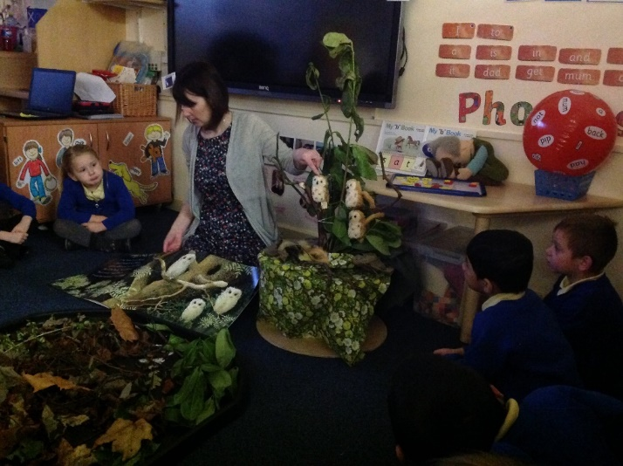
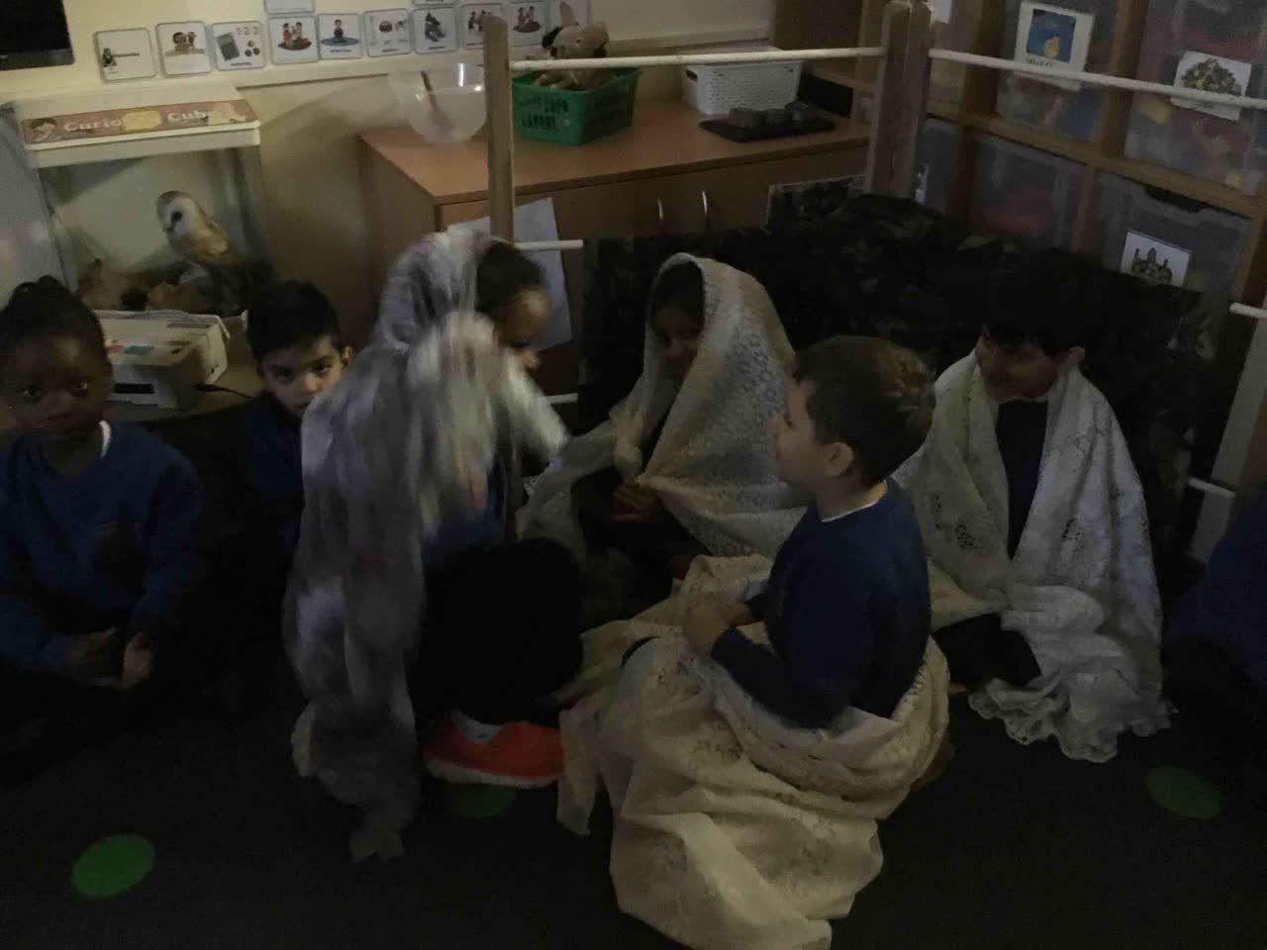
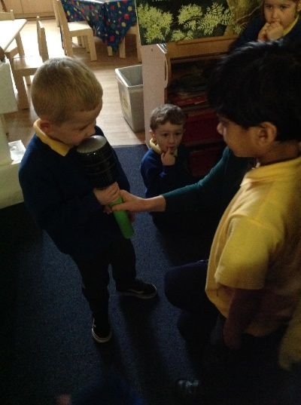
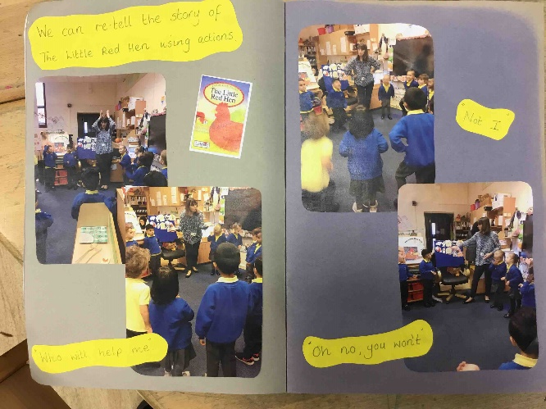
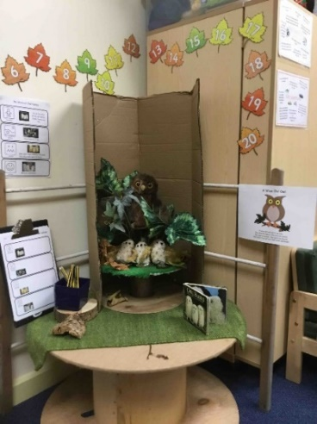
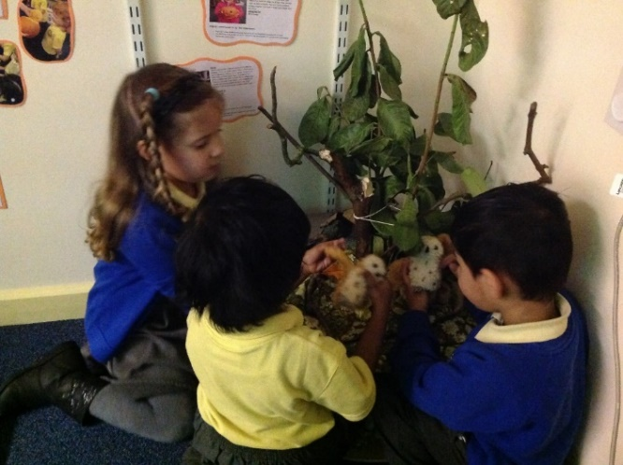
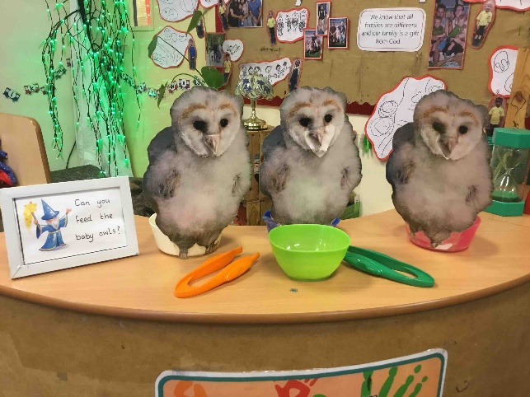
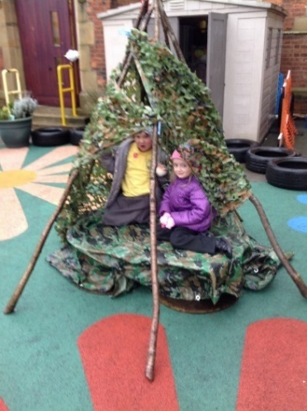
Key text introduced
Re told using props
Retold using interactive activities
Added to indoor and outdoor provision with key vocabulary, Tales toolkit and challenges.
Added to Floorbook. So children can revisit.

Slide 3
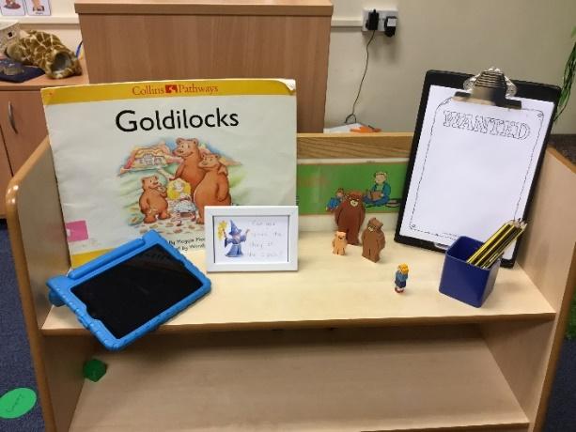
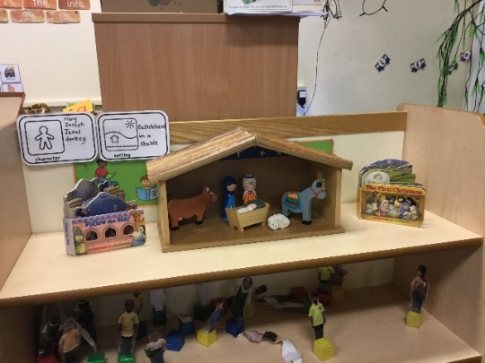
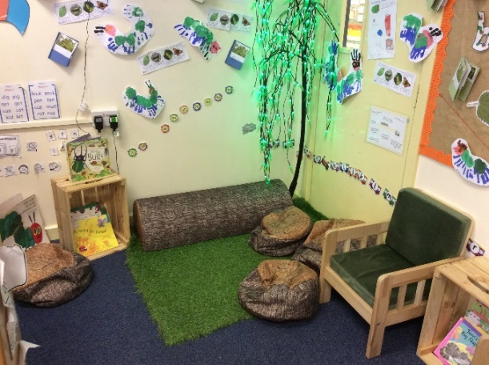
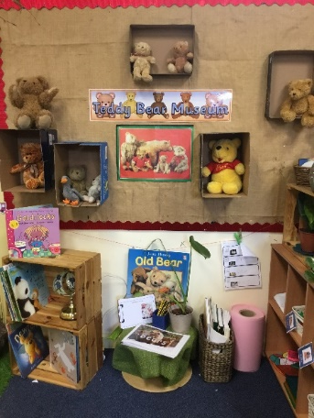
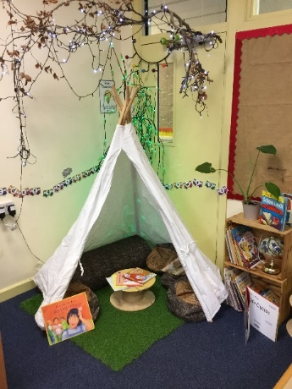
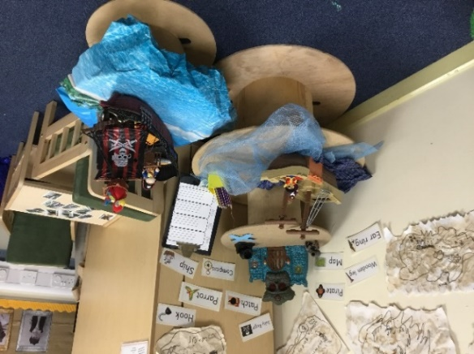
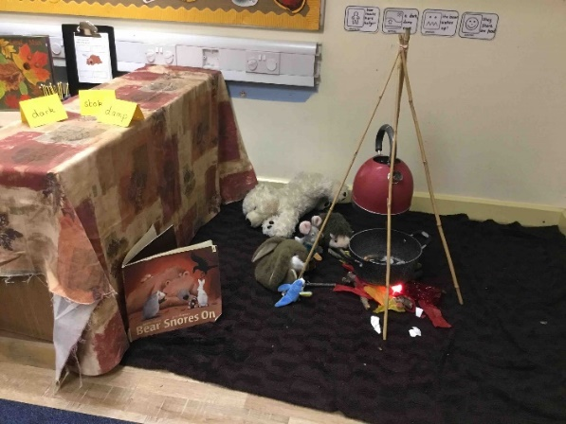
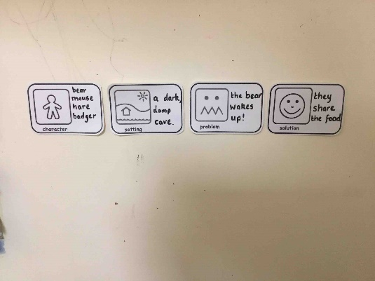
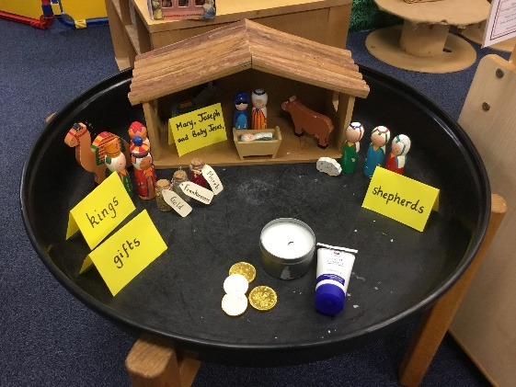
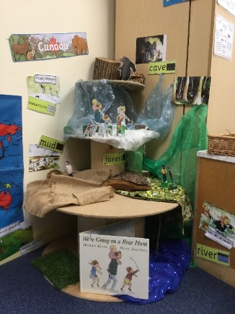
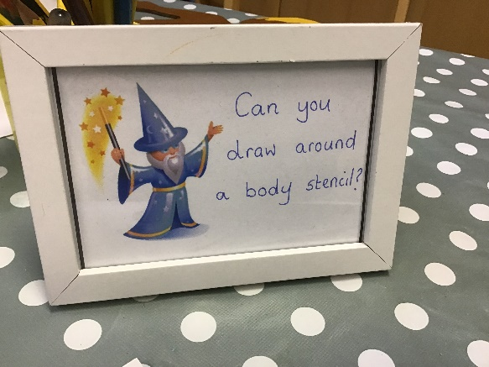
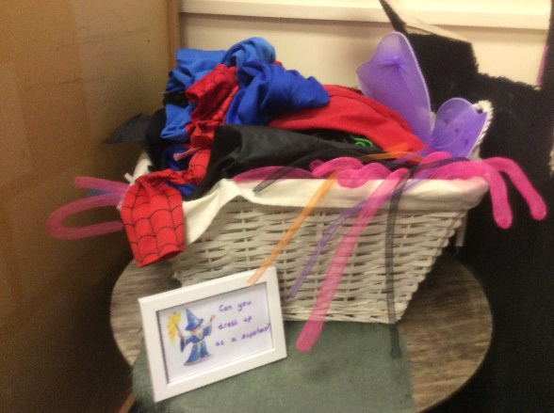
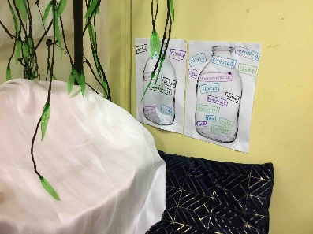
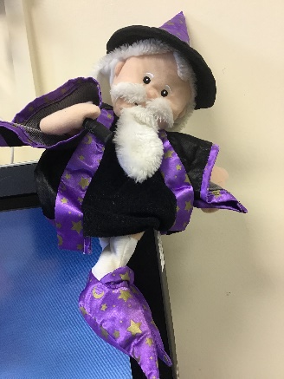
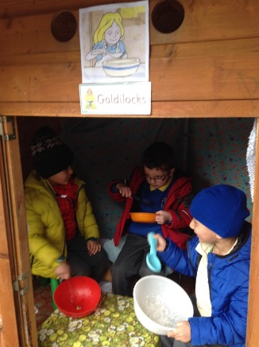
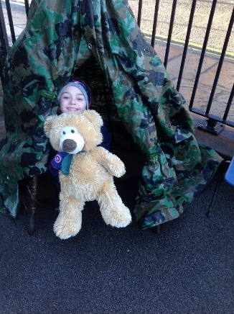
Cosy spaces
Story station
Cosy spaces
Tales toolkit
Key vocabulary
Indoors and outdoors
Challenges
In the moment key vocabulary

