Slide 1
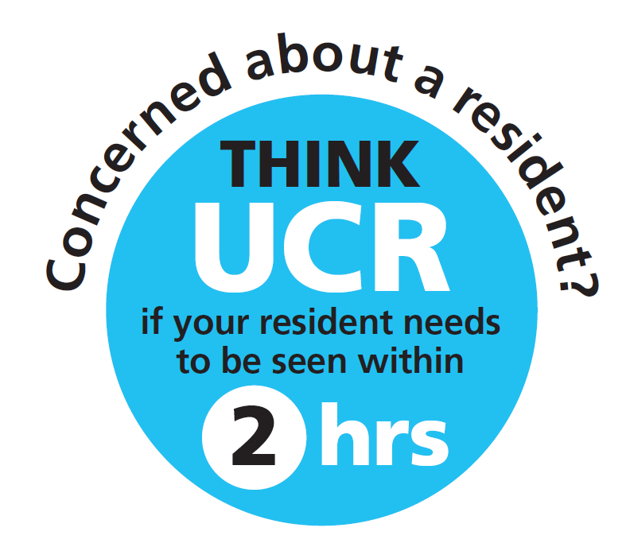

Care Home Information Pack
Concerned about a resident in Lancashire & South Cumbria?
Accessing the right response at the right time for people living in care homes
Winter 2025/26

Slide 2
Care Home Information Pack
Contents
Introduction
How do I determine if my resident is deteriorating?
What is Urgent Community Response (UCR) and how can I access this service?
My resident is being admitted to a virtual ward (VW), does that mean?
What do I do if my resident has had a fall?
How do I improve my residents’ safety through Safety Huddles?
Proactive Care for residents living in a care home
How do I improve my residents’ safety through Safety Huddles?
3
5
10
15
19
25
31

Slide 3
Care Home Information Pack
Introduction
Welcome to our Care Home Information Pack.
Care home residents’ health needs are likely to be complex in nature: the majority will be living with
a form of dementia, be in receipt of seven or more medications and a significant proportion live with depression, mobility problems, incontinence, and pain.
This pack has been developed to both support care home staff and raise awareness of the services to contact when you are concerned about your resident, including when to refer to Urgent Community Response (UCR) services.
The pack provides links to training materials, good practice examples and the contact details of services that are available for care home staff to refer residents to for additional support and treatment, especially where residents have shown signs of deterioration but could be treated in their normal place of residence.

Slide 4
Care Home Information Pack
“Hospitals are not always the best
places for older people who could have worse outcomes associated
with hospital admissions including
increased frailty and deconditioning.”
NHS England North West (2024)

Slide 5

Care Home Information Pack
How do I determine
if my resident is deteriorating?

Slide 6
Care Home Information Pack
What do we mean by ‘Deterioration?’
Deterioration:
“When a resident moves from their normal clinical state to a worse clinical state”.
This increases their risk of illness, sepsis, organ failure, hospital admission, further disability and even sometimes death.
As a carer, you often know your residents really well , what their day time routines are their sleeping patterns and favourite things to do. Its important to understand what is normal for them as when we see changes in habit or routine this may be a sign of deterioration
To improve resident outcomes it’s important to focus on:
1 Recognition – Spot the early signs that a resident is deteriorating
2 Response – Think what actions do I need to take?
3 Communicate – Escalate your concerns and ask for help from other healthcare staff
(e.g. GPs, community nurses, tele triage, 111 and 2 hour UCR)
Why do we need to spot deterioration early?
Responding early will ensure that the resident receives ‘The right care, at the right time by the right person’
Prompt treatment and care will enhance the resident’s comfort and promote recovery
We can avoid some hospital admissions which may not be in the resident’s best interest or wishes

Slide 7
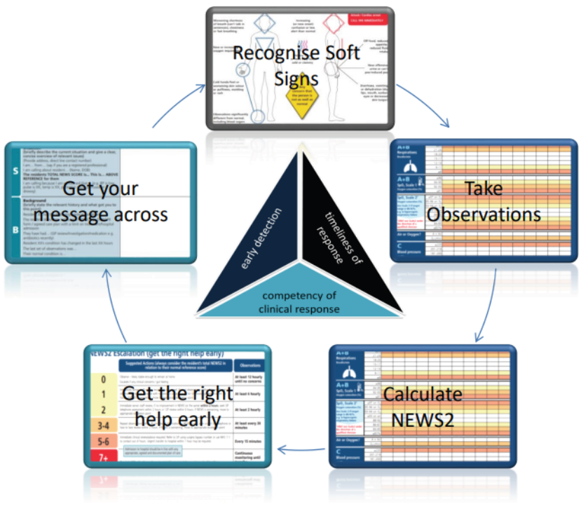

Care Home Information Pack
RESTORE2
Restore2 is an example of a physical deterioration and escalation tool for care/nursing homes
which includes the National Early Warning Score (NEWS2) and promotes a standardised response to the assessment and management of unwell residents.
Staff should feel confident and competent when using
Restore2 to recognise and respond to deterioration.
Training and resources are available to support this.

Slide 8
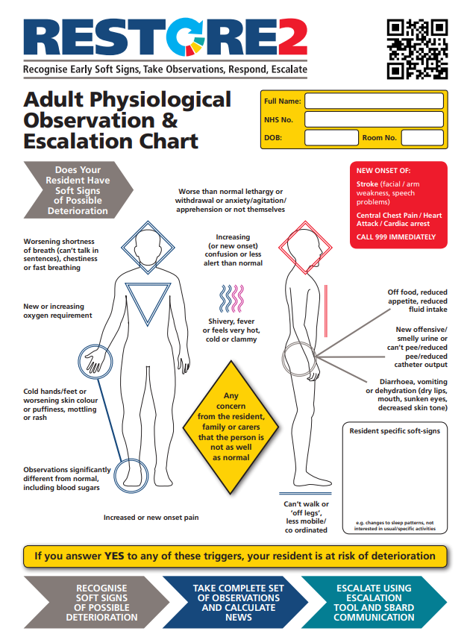
Care Home Information Pack
Know your resident and what is normal or not normal for them
Understanding what is normal for your resident helps you detect any changes
Important signs can be spotted by everyone who comes into contact with residents (care staff,
support staff, relatives, residents themselves)
Looking at the ‘soft signs’ such as ‘he’s off his legs’,
not eating and drinking as much or seems more
breathless than normal can all indicate
early deterioration
The tool is designed to support your ‘Gut Instinct’
and help you explain to colleagues why you
are worried, so better care decisions can be
made earlier
Ask your resident - how are you today?
If yes to one or more of the triggers - take action and escalate your concerns!
To download a copy of Restore2 assessment tool go to: RESTORE2

Slide 9
Care Home Information Pack
Further information and resources
Here are some links to advice, further reading and training that might be useful
Wessex Patient Safety Collaborative have recorded training sessions for RESTORE2 and RESTORE2mini which can be delivered virtually to support the implementation of these tools in your care setting. The video presentations can be viewed on the Wessex AHSN YouTube channel at:
Restore 2 training video
Restore 2 mini Training video
RESTORE2™ official :: NHS Hampshire and Isle of Wight (icb.nhs.uk)
Restore 2 Presentation Slides from Training Webinar
Other resources
React To Deterioration | Advance Care Planning | Frailty Information and Training | React To
Health education England have produced a set of online training videos to support staff working in care homes to support residents at risk of deterioration
NEWS what is it?
Calculating and recording NEWS score
Structured communication and escalation
Treatment escalation plans and resusitation
Introduction to sepsis and serious illness
Soft signs of deterioration
Measuring the respiratory rate
Measuring oxygen saturations
Measuring blood pressure
Measuring heart rate
Measuring level of alertness
How to measure temperature

Slide 10

Care Home Information Pack
What is Urgent Community Response and how do I access it?

Slide 11
Care Home Information Pack
Urgent Community Response services
Urgent Community Response (UCR) services provide urgent assessment, treatment and support to residents if they are at risk of being admitted to hospital within the next two to twenty-four hours.
UCR services:
Often work as a multidisciplinary team, including the likes of district nurses, clinical practitioners, physiotherapists and paramedics.
Can order tests, diagnose, prescribe medication and order equipment.
Aim to respond to most referrals within two hours.
Operate from 8.00am - 8:00pm, 7 days a week 365 days a year, including bank holidays.
Typical conditions suitable to refer for UCR response:
Falls.
Increasing frailty or reduced function and mobility.
Urgent equipment provision.
Confusion/delirium, or acute worsening of dementia and/or delirium.
Urgent catheter care, diabetes and respiratory conditions.
If you think a resident might be admitted to hospital unless they are seen within two hours, call your UCR team.
If you have seen general signs of deterioration, think about adding your resident onto the weekly home round for a review to prevent further deterioration.

Slide 12
Care Home Information Pack
Benefits of using UCR
The benefits of UCR services include:
Rapid assessment, treatment and support within two hours where this is possible / appropriate
Support to residents to remain safely and comfortably in the place they call home wherever possible, when they are unwell or have had a fall
Reduction of risk associated with being admitted to hospital, which could result in further deconditioning
How can you make a referral?
Contact your local UCR service directly or through your normal access routes for your area
The UCR service will complete an initial triage and clinical assessment to understand the residents' needs.
See slide 14 for contact information to refer to your local UCR team

Slide 13

Care Home Information Pack
Key Messages
THINK
Could my resident benefit from referral into an Urgent Community Response service?
ASK
What are the contact details for my local UCR service?
DO
Contact the UCR service if your resident is in a crisis and needs intervention within two hours to stay safely in the care home and avoid admission to hospital
Use a deterioration tool such as Restore 2 or Restore2mini to aid the clinical assessment
Consider using a structured communication tool when communicating your concerns
For life threatening emergencies contact 999
Find out more
Find UCR NHS publications at:
https://www.england.nhs.uk/community-health-services/urgent-community-response-services/
Visit the Community Health Services Future NHS platform:
https://future.nhs.uk/communityhealthservices/
Further information and tools and resources that can support your work.
Email: communityhealthservices-manager@future.nhs.uk

Slide 14

Care Home Information Pack
2-hour Urgent Community Response services
Referral Contact Details:
Area | Contact
Blackpool, Fylde and Wyre 8am-8pm 7 days a week | 01253 951068
East Lancashire & BwD ICAT Team is available 24/7 | 01282 805989
Chorley, South Ribble and Preston 8am-8pm, 7 days a week | 01772 777999
Morecambe Bay 8am-8pm, 7 days a week | 01539 715888 (or through normal access routes for District Nursing Services)
West Lancashire 8am – 8pm, 7 days a week | 0300 2470011

Slide 15
Care Home Information Pack
My resident is being admitted to a virtual ward – what does that mean?

Slide 16
Care Home Information Pack
Virtual Ward services
A virtual ward is a safe and efficient alternative to NHS bedded care. Virtual wards support patients who would otherwise be in hospital to receive the acute care and treatment they need in their own home.
This includes either preventing avoidable admissions into hospital, or supporting early discharge out of hospital.
Virtual Ward services:
Are a multidisciplinary team, who will oversee residents Acute care needs whilst they remain at their usual place of residence..
Can order tests, diagnose, prescribe medication and order equipment.
Will provide in-person and remote health care which has been personalised to the needs of the individual
Operate from 8.00am - 8:00pm, 7 days a week 365 days a year, including bank holidays and will ensure that patients under their care have a clear and robust management plan.
Typical conditions suitable for management on Virtual Wards:
Increasing frailty or reduced function and mobility.
Acute Respiratory Infections
Heart Failure management and monitoring
Confusion/delirium, or acute worsening of dementia and/or delirium.
If you think a resident might wish to remain at their usual place of residence; speak to your local Healthcare professionals (UCR, GP etc..) to discuss the potential of admissions onto a virtual ward.

Slide 17
Care Home Information Pack
Benefits of using Virtual Wards
The benefits of Virtual Wards services include:
Provision of Acute level care and a personalised management plan which supports residents to remain safely and comfortably in the place they call home wherever possible
Reduction of risk associated with being admitted to hospital, which could result in further deconditioning
How can you make a referral?
Speak to your GP and/or the UCR service who can complete an initial triage and clinical assessment to understand the residents' needs and can facilitate referral onto virtual ward teams.
Find out more
Find Virtual ward NHS publications and patient stories at: NHS England » Virtual wards

Slide 18
Care Home Information Pack
Virtual Ward services available for your care home in each locality
Locality | Pathway | Service Name & Tel No
East Lancashire Hospitals NHS Trust (ELHT) | Generic | IHSS 01282 805 989
University Hospitals of Morecambe Bay NHS Foundation Trust (UHMBFT) | ARI Frailty IV | Urgent Community and Frailty Coordination Hub 01539 715 888
Lancashire Teaching Hospitals NHS Foundation Trust (LTHFT) & Lancashire and South Cumbria Foundation Trust (LSCFT) | ARI Frailty Acute Medicine Specialty | Care Connexion Hub 01772 777 999 Email: virtualwardhub@lthtr.nhs.uk
Mersey & West Lancashire Teaching Hospitals NHS Trust (MWLTHT) & HCRG Care Group | Generic | HCRG Care Coordination Hub 0300 247 0011
Blackpool Teaching Hospitals NHS Foundation Trust (BTHFT) | ARI Frailty Paediatrics End of Life IV Therapy | Telephone referrals or clinician to clinician conversation available prior to referral if unsure 01253 958758

Slide 19

Care Home Information Pack
What do I do if my resident has a fall?

Slide 20
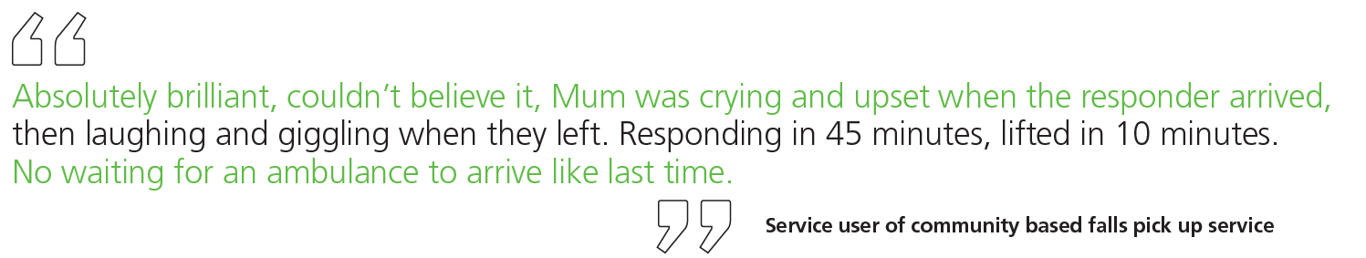
Care Home Information Pack
Managing falls
The reaction of care home staff at the time of a fall is critical to a resident’s wellbeing and recovery.
‘A long lie’ after a fall can have serious consequences, especially where the resident is unable to move. If your policy states ‘call an ambulance after a fall’ it’s likely that your resident will experience a long waiting time. Not all falls in care homes result in serious injury meaning that residents
don’t always need to go into hospital.
Level one and two falls as described in Falls Response Governance Framework for NHS Ambulance Trusts (AACE: Association of Ambulance Chief Executives) can be supported by care home staff or responded to by community based falls response services such as falls pick up lifting services or 2 Hour Urgent Community Response within the care home environment.

Slide 21
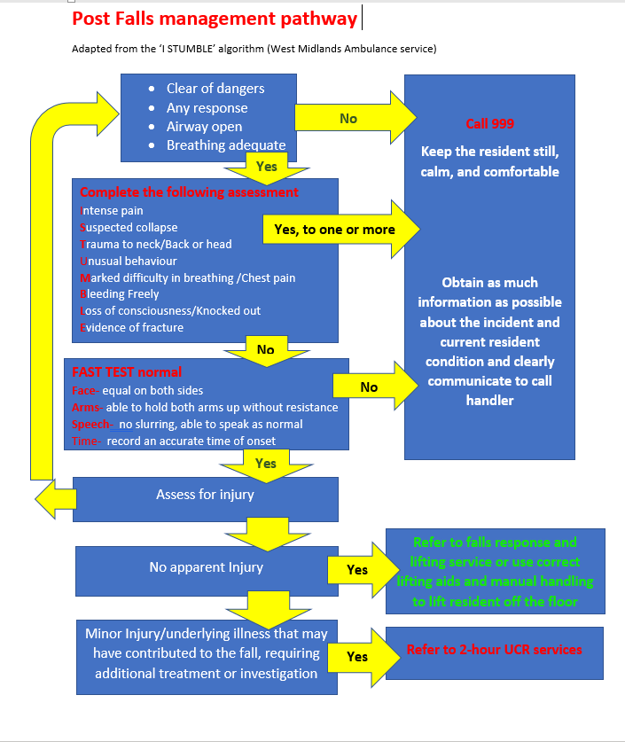
Care Home Information Pack
Falls management pathway
The use of a:
post falls assessment tool,
care home training and,
Access to falls pick up equipment/or a local falls response lifting service
Has demonstrated positive outcomes for care home residents in reducing long lies and avoiding the need to go into hospital which we know is not always the right place for frail older people

Slide 22
Care Home Information Pack
Key Messages
THINK
Risk of falls, has my resident had a Falls - risk assessment and is it up to date?
Is there a falls prevention plan in place?
What is the care home’s post fall management policy?
ASK
Have I followed the post falls management tool?
If the resident has no injury, what equipment does the care home have to support
the resident off the floor?
What are the contact details for the falls response and lifting service in my area?
What are the contact details for the 2 Hour Urgent Community Response service?
DO
Keep calm and make the resident comfortable
Complete the post falls management pathway. Call 999 if appropriate
Support your resident to get off the floor if safe to do so
No apparent injury – consider falls response/falls lifting service
Think UCR if resident has minor injuries after a fall > > > >

Slide 23
Care Home Information Pack
Falls Response services
Referral Contact Details:
Area | Location & Contact Telephone Numbers
Progress – Across Lancashire And South Cumbria | In the event a resident has a fall and there is no obvious injury call the Progress Lifeline alarm response centre on: 01772 436 783 (Service available 24/7 – 365day/year)
Vitaline – Blackpool Area Only | Contact details for referrals: 01253 477678 (Service available 24/7 – 365day/year)

Slide 24
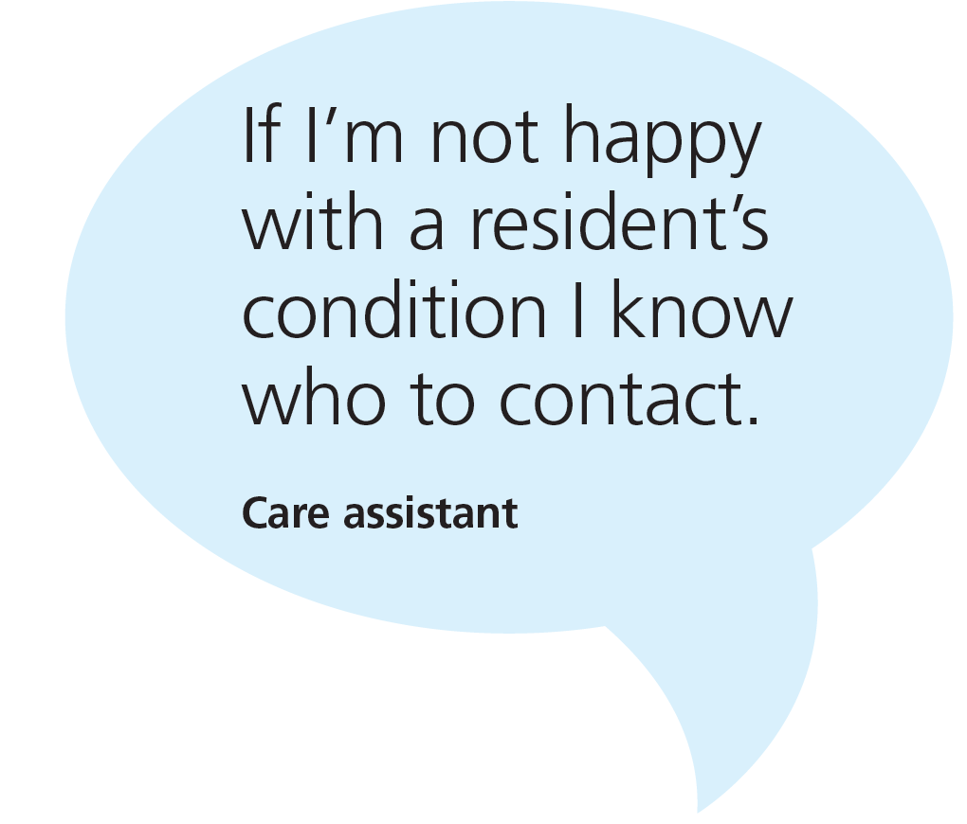
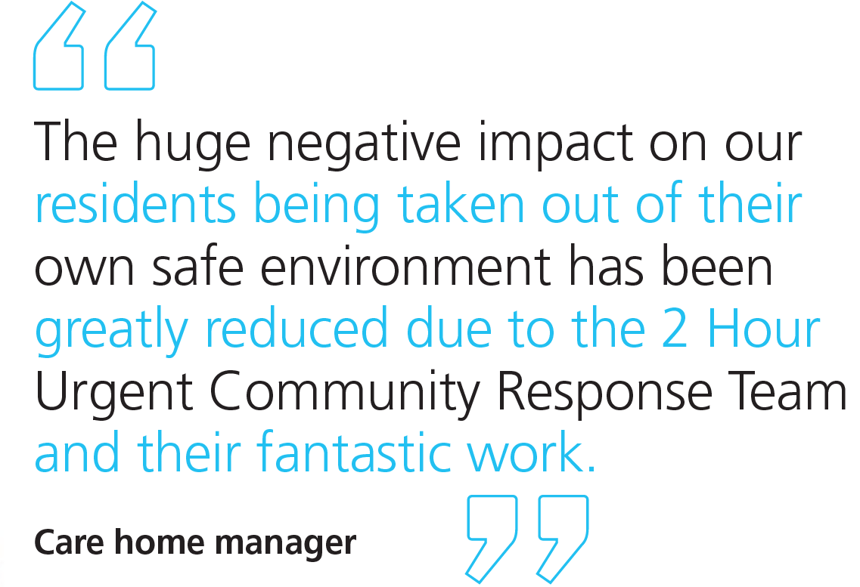
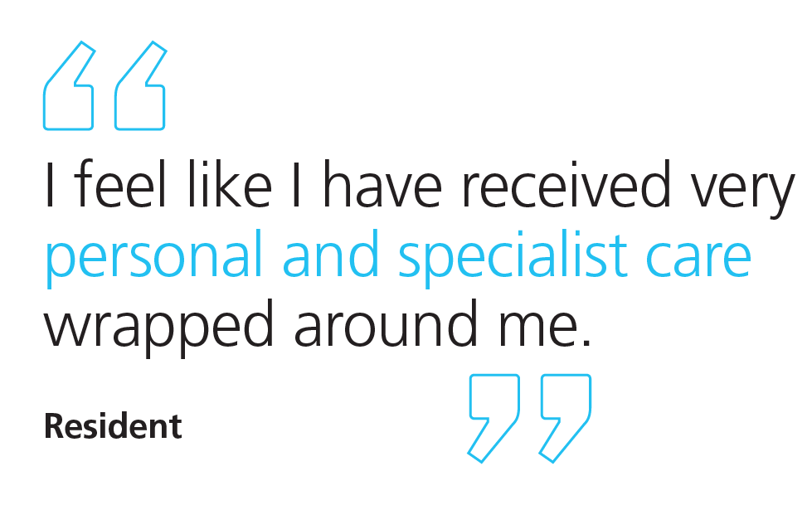
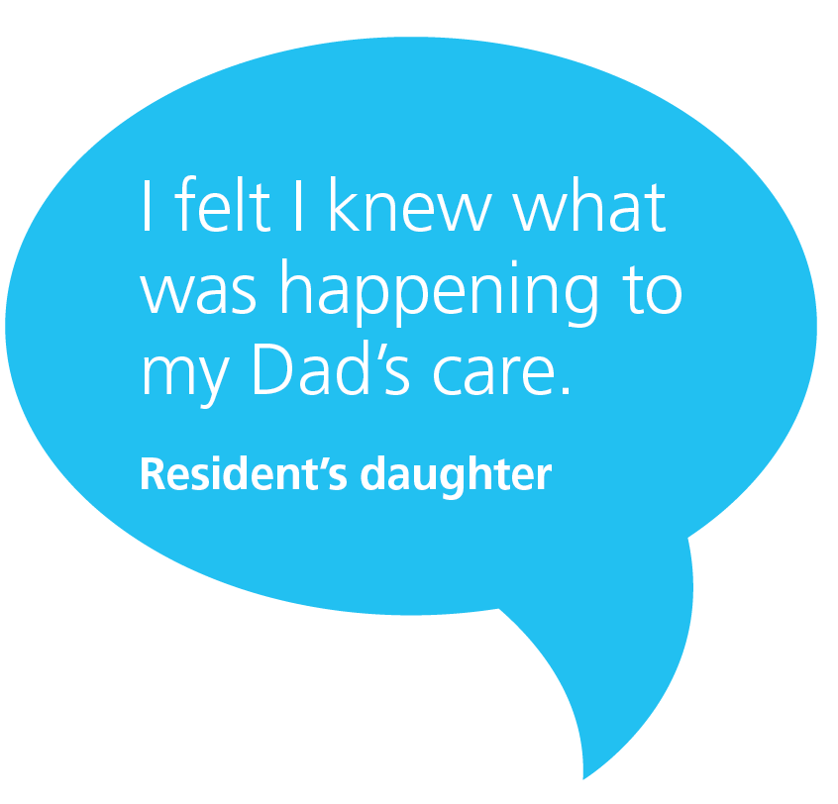
Care Home Information Pack
What do care home staff and residents say about UCR and Falls Lifting Services?
The service was great, the young man that came to lift me off the floor was very kind and friendly. (Lancashire Resident)
The staff are very pleasant and efficient. Without Vitaline I could have been on the floor for hours (Lancashire Resident)
Staff find it so easy to request a responder just by calling through anytime, it’s much quicker than waiting for an ambulance. We have previously had to wait up to 6 hours (for an ambulance), which has a huge impact as staff stay with the residents and therefore aren’t available to support other residents.
(Lancashire Care Home staff)
Having a responder arrive quickly and the resident back on their feet, reduces the risk of injury due to long periods on the floor and lets staff attend to other residents.
(Lancashire Care Home Staff)

Slide 25

Care Home Information Pack
How do I improve my residents’ safety through Safety Huddles?

Slide 26
Care Home Information Pack
Resident safety is everyone’s business
What is a safety huddle?
A safety huddle is a brief, focused and structured exchange of information about potential or existing safety risks which may affect residents, staff and any person accessing the care home. It is not a formal meeting or handover.
Huddles are held at the same time and place each day and provide a non-judgemental, safe space where all team members can speak up and work together on any safety concerns.
Key features of a safety huddle:
Short, stand-up meeting – 10 minutes of focused time using the same agreed format
Facilitated – every huddle requires a huddle leader to facilitate
All staff involved – a multidisciplinary approach to care and risk identification
Focus on high-risk activities and residents that you may be concerned about– raise safety concerns and focus on high-risk activities such as medication rounds, infection control, deterioration and new admissions
Share knowledge – share knowledge, appreciate teamwork and celebrate success
Safe space – staff are encouraged to raise safety issues without fear of being viewed negatively

Slide 27
Care Home Information Pack
Key principles of a safety huddle
The key principles of a safety huddle are to ensure that all residents that you are worried about are discussed daily; to ensure important information is shared with staff; to agree actions; and to celebrate success in reducing harm.
Everyone that works in the care home to support residents should be involved, including care staff, housekeeping, maintenance and kitchen staff.
Benefits of safety huddles
Improved information sharing
Increased accountability, empowerment, and sense of teamwork
Increased staff awareness of safety
Improved culture of safety
Reduction in harm, adverse events and near misses
The safety huddle is a space to discuss any residents that you are worried about and agree on a plan to reduce any risks to them. It’s a space to address staff concerns and explore any issues affecting residents most at risk. This may include:
Medication safety issues
Equipment failures
Falls
Infections
Identification of deteriorating patients

Slide 28
Care Home Information Pack
Key Messages
THINK
Could safety huddles in our home work to keep residents at risk safe?
What is the best time each day to get everyone involved?
ASK
Who are we worried about today?
Are there any residents at risk?
What can we do as a team to support the resident?
DO
Involve all members of the team
Hold safety huddles at the same time each day
Use visuals to track progress
Consider adding your resident onto the weekly home round for a clinical review.
Report any concerns to your GP/ community nurses and other members of the MDT to support person centred planning to reduce resident harms
Contact the 2 Hour Urgent Community Response Team if your resident needs more immediate care or is in a crisis and needs intervention within two hours to stay safely at home/usual place of residence and avoid admission to hospital

Slide 29
Care Home Information Pack
Safety huddle prompt sheet
Reducing falls
How many days since our resident fell?
- Celebrate milestones 1, 10, 30, 60 days
- If recent, what was the learning?
- Could we have done something different?
- Use visuals and data to demonstrate progress
Who are we worried about today?
What are we going to do as a team to prevent them falling?
Review the ‘bigger picture’ – location of resident, timings, staffing, cohorting
Are there any other residents of concern today?
Useful links
Safety Huddles - Improvement Academy
NHS England » Improving patient safety by introducing a daily Emergency Call Safety Huddle
Using safety huddles at Rathgar care home on Vimeo
Reducing falls through safety huddles in care homes

Slide 30
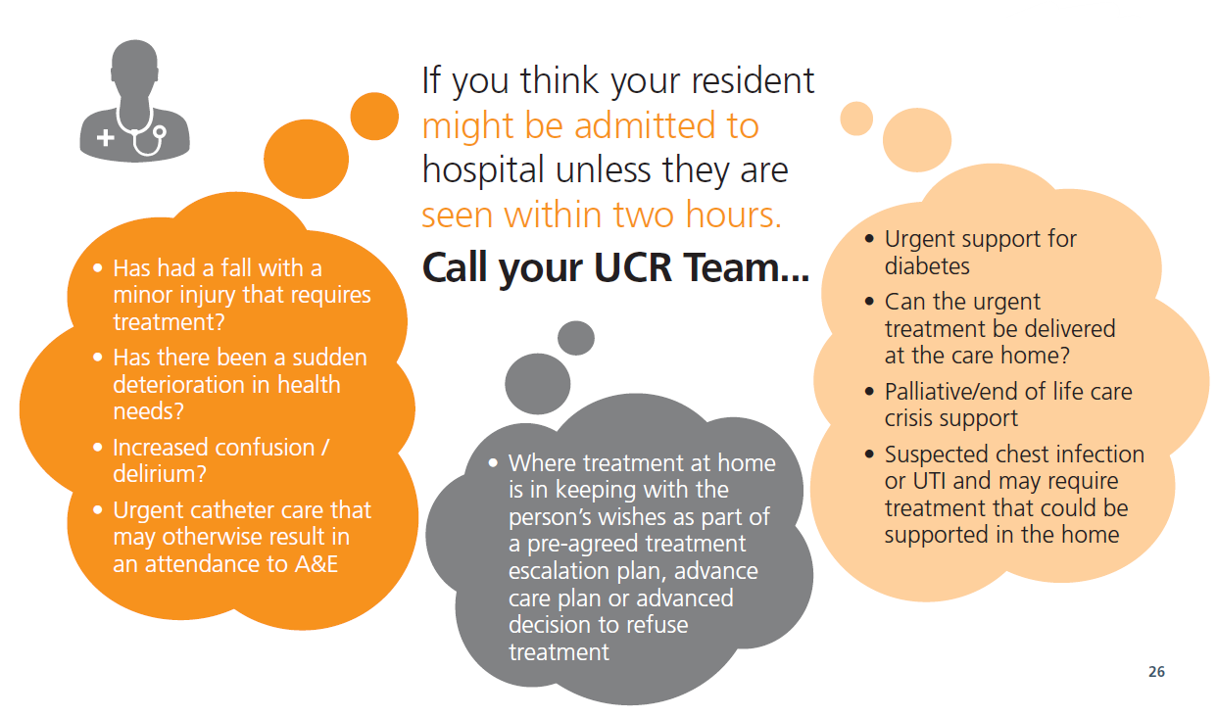
Care Home Information Pack
Think Urgent Community Response (UCR)…

Slide 31
Care Home Information Pack
Proactive Care for residents living in a care home

Slide 32
Care Home Information Pack
What is proactive care for my care home residents
The Enhanced Health in Care Homes framework sets out the principles for delivering proactive, personalised care for people living in care homes including those with learning disabilities or autism, mental ill-health or rehabilitation needs.
The framework was updated recently to reflect best practice and new ways of working since the COVID-19 pandemic including the use of digital technology to improve integrated working and information sharing across health and social care teams.
The framework expands on priority clinical areas such as structured medicine reviews, nutrition and hydration, falls prevention, skin and wound care, leg and foot ulcers, mental health, dementia and palliative and end of life care .

Slide 33

Care Home Information Pack
Enhanced Health in care Home Framework (EHCH)
Three principle aims:
Deliver high quality proactive personalised care within care homes
Care home residents have access to the right care at the right time in their choice of place
Enable effective use of resources by reducing unnecessary ambulance conveyances and admissions to hospital, whilst ensuring the best care for residents.
What does it do?
Sets out contractual standards for PCNs and NHS standard contract
Describes evidence-based practice
Contractual requirements (PCN DES) and NHS standard contract to enable EHCH
 | Every care home Aligned to a primary care network Has a named clinical lead (who is responsible for overseeing implementation of the framework) Has a weekly home round supported by the care home MDT has established protocols between the PCN, care home and system partners for information sharing, shared care planning, use of shared care records and clear clinical governance. Every resident within seven days of admission or readmission Has a comprehensive assessment of need completed by a member of the MDT Has their proactive, personalised care and support plan(s) developed by a member of the MDT The network contract DES provides for care home residents to have a structured medication review
Further information can be found at A Registered Managers Guide to EHCH

Slide 34
Care Home Information Pack
Benefits of EHCH framework
EHCH provides proactive care that is centred on the needs of individual residents, their families and care home staff. Such care can only be achieved through the whole system working together through Multidisciplinary team working.
The benefits of EHCH services include:
Through working across organisations in a co-ordinated way our residents will:
Receive better, more co-ordinated and proactive care, delivered where they live.
Support better outcomes for people through better management of their long-term condition(s)
Support a reduction in unplanned hospital admissions
Supports residents to be cared for in their preferred place
The weekly home rounds could be used as an alternative to calling UCR if you don’t think the resident might be admitted to hospital if not seen in 2 hours, care home rounds are helpful when a resident needs to be clinically reviewed if they are gradually deteriorating
Find out more
The minimum standards for this service are outlined in the GP Network Contract Directed enhanced service - which describes the responsibilities of PCNs, and the NHS Standard contract - which describes the responsibilities of providers of community services.

Slide 35
Ageing Well Team:
england.nwageingwell@nhs.net
Care Home Information Pack
Concerned about a resident?
Accessing the right response at the right time for people living in care homes

