Slide 1

Thriving In Residential Care
My Home Life conducted one of the largest ever qualitative research studies on older people’s experiences of living in residential care, speaking to older people, families and care teams across the UK.
‘Thriving in Residential Care’ research published in 2024 identifies some challenges but reveals proportionally many more benefits of living in a care home.
It shines a light on six key ways that older people can thrive in a care home, if the conditions are right.
Thriving in Residential Care - My Home Life England
Notes:
Good afternoon
I’m Sue and together with Adam, Julie and Karen we work in the contracts and quality team
and in our role we see every day the good work that goes on in care homes.
This short session on Thriving in Residential care Homes really starts from that place.
The My Home Life research report on Thriving published in 2024 is a recommended read and the link is included.

Slide 2
Six Dimensions of Thriving
Thrive is a way of thinking about everyday life in care homes
It’s not about doing more — it’s often about doing things slightly differently.
Thriving is measured
Relationally,
Actively,
Inclusively,
Securely,
with Dignity,
and Healthily
Notes:
So what do we mean by Thrive?
The ideas raised in the My Home Life Reseach are about helping people live well.
With a focus on these six key areas.
We know these areas matter because when we talk to people who live in care homes, what they describe as making the biggest difference is very often the small, human things – relationships, purpose, feeling known, feeling valued and safe.
Thrive is fundamentally a way of thinking and talking about every day life in care homes.

Slide 3
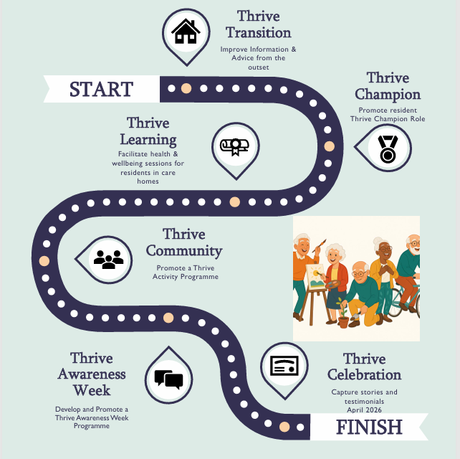
Drive to Thrive 2025
Activity forums
Thrive Training with Lancashire Adult Learning
Thrive Campion Role
Thrive activity week
Thrive resources
Notes:
So what have we done?
Through our Drive to Thrive work in Lancashire we have been working with partners and particularly activity forms for nearly 12 months now and we’ve seen some great examples of Thrive coming to life in really practical ways – Thrive Awareness Weeks, meaningful activities, residents influencing daily life and activity staff feeling more confident to try out their ideas.
Its not about doing more – its more often about doing things slightly differently.

Slide 4
Thrive Report - What we learned
Supporting transition in/out of care is key
Training is impactful
Incorporate confidence building and wellbeing support
Whole home activity programme
Peer activity forums are a strength for improving practice
Notes:
So what have we learned?
We have produced a short report which outlines a little more about our Drive to Thrive journey and learning along the way. We’ll ask to have this included with the forum notes and we hope it will be of interest.
My key take away is to think of Thrive not as an extra inspection framework or a good practice checklist. It’s a shared language for quality of life in care homes.
Julie is there anything you would like to add?
Karen is there anything more from your experience?
Adam over to you….

Slide 5
What we would like from you today!
think about your care home as a whole — not one person or one activity.
please think about Thriving, particularly relationally, inclusively, and securely.
On your card, jot down either:
something your home already does that supports that domain well, or something you want to strengthen or do differently as a leadership team.
It doesn’t need to be polished!
Notes:
We’re going to spend the next 10 minutes thinking about Thrive from a whole home perspective – particularly the role that managers and leaders play.
Under your chair you’ll find a coloured index card and a pen. Please can you pick these up.
On your card jot down…
If your happy to have a quick conversation with someone near you – just share what you’ve written and why it matters
Theres no expectation for everyone to feedback.

Slide 6
Thrive relationally – build friendships and improve family relationships.
Thrive inclusively – embrace diverse cultures, foods, languages, and identities.
Thrive securely – feel safe, supported, and protected from harm or poor housing.
Thank you
✓
Notes:
Is anyone happy to share something their home does to support relationships – between residents, staff, families and the wider community?
Would anyone like to share how inclusion shows up in everyday home life?
Any examples where your care home practice has enhanced people feel safe or supported – emotionally or practically.
If you’re happy to, we’d really value collecting these cards at the end of the forum.
They’ll help us understand what care homes across Lancashire are already doing – and what you’re aiming to develop.
Thank you.

