Slide 1
Lancashire’s new market stewardship strategy
Provider Briefings

Slide 2
Agenda
Overview of the analysis and approach
Findings
Discussion: Setting Priorities for Market Stewardship
Closing summary and next steps

Slide 3
Delivering better lives in Lancashire

Slide 4
What we did?
The analysis provides the a comprehensive, up-to-date and district-specific view of Lancashire’s care market to date, bringing together demand, supply, pricing and risk data to inform commissioning and system reform.
Scope of the analysis
Methods and outcomes
The analysis covered six core areas to understand current market conditions, pressure points, and opportunities for system-wide improvement:
Adult Social Care Services
Focus on Older People’s Residential Care, Short-Term Beds, Homecare, and Under-65 LD provision, Mental Health and Shared Lives.
Supply & Demand Mapping
District-level analysis of provision, capacity, occupancy, and unmet need across all major care types.
Financial Pressures
Comparison of unit costs, pricing trends, and market pressures (e.g. inflation, self-funders, NHS divergence).
Provider Market Dynamics
Review of consolidation trends, market exits, geographic fragility, and third-party provision risks.
Workforce Constraints
Identification of areas where staffing shortages are limiting usable capacity (notably in rural and complex care markets).
Market Interface Mapping
Analysis of interdependencies with NHS, including ICB-commissioned placements, discharge flows, and pricing misalignments.
Methods used to support the analysis include:
Quantitative modelling (capacity, occupancy, care hours, cost)
District-level heatmaps, analysis and geographic visualisation
Provider feedback and qualitative insights
Cross-referencing Council and NHS commissioning datasets, and review/validation of relevant third-party data (i.e. ONI, PANSI, NHS, CMH etc)
Interviews and discussion with County staff and stakeholders.
Where to from here?
The outputs from this analysis are now actively informing a series of strategic and operational priorities, including:
The ASC Market Management Plan
ICB engagement and joint commissioning structures
In-year commissioning interventions
Provider market oversight and investment decisions

Slide 5
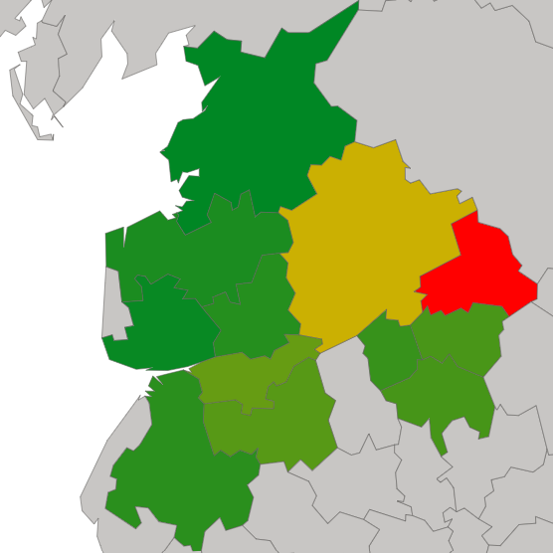
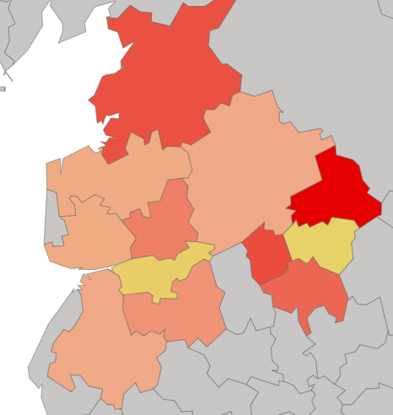
State of the Lancashire Care Market – Strategic Headlines
The analysis provides the a comprehensive, up-to-date and district-specific view of Lancashire’s care market to date, bringing together demand, supply, pricing and risk data to inform commissioning and system reform.
Highlights
Residential & Nursing Bed Supply Relative to Older Population (65+) by District
High and Rising Occupancy in Key Districts
Residential care beds in districts like Wyre, South Ribble, and Chorley are running above 92% occupancy, leaving little flex to manage hospital discharges, transitions or seasonal pressures.
Uneven Supply and Rural Fragility
While total capacity appears sufficient at county level, provision is unevenly distributed. Ribble Valley, Pendle, and parts of West Lancashire face significant gaps, particularly in complex care and double-handed packages.
Workforce Shortages Reducing Usable Capacity
Providers report staffing gaps, particularly in homecare and short-term services, that limit delivery despite headline contract volume, leading to underutilised hours and growing unmet need.
Self-Funders and Price Pressures Distorting Market Dynamics
The self-funder market is larger than previously captured, particularly in OP Resi, influencing provider location, pricing, and placement decisions, with implications for council-funded availability.
NHS and ICB Commissioning Divergence
NHS spot placements are priced substantially above equivalent Council rates, particularly in LD and complex homecare; undermining joint leverage and distorting local price signals.
Short-Term Care Bed Provision per 1,000 Residents Aged 65+, by District
Takeaway message
Lancashire’s care market is at a tipping point; stabilising supply and aligning commissioning across the system are essential to avoid unmanaged failures, rising costs, and deepening inequality of access.

Slide 6
Spotlight on demand – OP Residential Care and Nursing
Demand for OP Residential Care in 2025 is at an all time high…
… and is expected to grow by 5.7% through to 2030
Current demand projections suggest that, across Lancashire, roughly 4% of people aged 65 and over require residential care, with an estimated 0.28% needing dementia-specific care - this translates to between 760 and 1,320 people per district, depending on the size and age profile of the population.
The model assumes a base residential care need of 4% of the 65+ population, and a 7% dementia prevalence, of which a small proportion is estimated to require residential support (4% of 7%). These assumptions are based on national benchmarks and reflect typical service utilisation rates today.
It is important to note that not everyone over 65 needs residential care because many older people live independently, rely on unpaid carers (like family), or access support through home care services. Cultural preferences, funding limitations, and health status all influence whether someone enters a care home.
Sources: ONS Population data, NHS Dementia Profile data, LCC Data
Overall demand for older people’s residential and dementia care is projected to increase across most Lancashire districts by 2030, reflecting underlying demographic trends, including population ageing, rising life expectancy, and rising prevalence of age-related conditions such as dementia.
In a small number of districts, projected demand appears flat or declining - notably Lancaster, Preston and Wyre - which is attributable to static or falling over-65 populations, influenced by historical mortality patterns, net outmigration, or a younger demographic base. These areas may nonetheless face pressure from increased acuity and care complexity.
The projections are based on fixed utilisation rates applied to population forecasts (e.g. 4% of the 65+ population requiring residential care), and may therefore understate future demand in areas where needs intensity, dependency ratios, or access constraints change over time.
Sources: ONS Population data, NHS Dementia Profile data, LCC Data

Slide 7
Key risks and emerging challenges
The market is showing signs of structural imbalance, with both consolidation and fragmentation creating systemic risks across different districts and service types.
Key risks
Consolidation Risk
In districts like Fylde and Chorley, a small number of large providers now control a significant share of capacity. This supports economies of scale but also concentrates risk; a single provider failure could disrupt multiple pathways.
Fragmentation and Complexity
In areas like West Lancashire and Pendle, the market is fragmented, with many micro-providers delivering small volumes. This increases commissioning complexity and reduces overall resilience during system shocks (e.g. hospital surge or weather events).
Exit and Volatility Risk
Smaller providers in rural areas are increasingly at risk of market exit due to inflation, workforce scarcity, and limited commercial sustainability. This is particularly acute in homecare and short-term bed markets.
Disjointed Commissioning Models
The coexistence of spot, block, and framework contracting across different services - often layered between Council and NHS purchasers - is creating misaligned incentives and reducing strategic leverage.
Data Visibility Gaps with NHS-Commissioned Care
The Council has limited visibility of care commissioned directly by the ICB or acute trusts, especially in LD and complex homecare. This impairs market oversight, inflates prices through parallel commissioning, and risks double-purchasing or capacity misallocation.
Takeaway message
Lancashire’s care market is at a tipping point; stabilising supply and aligning commissioning across the system are essential to avoid unmanaged failures, rising costs, and deepening inequality of access.

Slide 8
Understanding Lancashire’s self-funder market
Self-funders appear to play a significant and often underestimated role in Lancashire’s adult social care market. While the County directly commissions the majority of care, private-paying individuals are quietly shape the pricing, sustainability, and investment decisions of providers.
 | Est. % Self-Funded | Strategic Impact | Commentary
OP Residential Care | 35 - 45% | High | This has a significant impact on price-setting, and may drive provider decisions on bed mix, investments and market entry.
OP Nursing Care | 25 - 35% | Moderate to High | Influences expectations on fee uplifts and limits visibility in high-cost (i.e. rural) districts.
Homecare | 15 - 20% | Moderate | Creates untracked demand, and further compounds competition for workforce supply and scheduling.
Supported Living (LD/MH) | <5% | Low | Limited influence on commissioning or cost model design.
Shared Lives | ~0% | Low | No market leverage or pricing relevance.
Key insights
Self-funders make up 30–45% of older people’s residential placements, with concentrations in more affluent districts such as Fylde, Ribble Valley, and Wyre.
Their purchasing power and service expectations heavily influence provider fee setting, admission policies, and capital investment decisions.
The number of private payers in homecare is increasing, driven by NHS discharge delays and limited local authority availability, many bypass brokerage systems, creating a hidden layer of demand.
The Council has limited visibility over self-funder volumes, pricing, or care characteristics, weakening its ability to forecast demand or set benchmarks.
Even within Council-contracted beds, top-up arrangements blur public/private funding lines, masking unmet need and complicating access monitoring.
Self-funders hold strategic leverage: they shape how providers structure services, determine fee baselines, and influence whether providers engage with Council frameworks or prioritise private-pay clients.
In high self-funder districts, providers may withdraw from block contracts or avoid lower-paying frameworks, reducing local authority commissioning influence and risking access inequality.
Takeaway message
Self-funders are not just a parallel market; they actively shape provider behaviour, pricing, and access across the entire system. Without better visibility and engagement, the Council risks losing leverage in core service areas.

Slide 9
Lancashire is adopting a new, evidence-based approach to setting care fees
Price reform is not a technical exercise but a structural one - redefining how the County stewards its market, controls cost growth and drives outcomes. A modern framework must balance fairness to providers with affordability for ratepayers.
Workforce costs now represent c.70% of total provider expenditure and are rising faster than uplifts - eroding viability and capacity.
Over 1 in 5 providers in England report sustained losses; unplanned exits risk immediate capacity gaps and long-term instability.
Today
Future
Impact
PRICE-SETTING DIRECTION OF TRAVEL
Annual, reactive negotiations and inconsistent uplifts
Fragmented rates across LCC, ICB and self-funders
Weak data and reactive decisions
Funding that follows history
Formula-based pricing anchored in verified cost of care
Aligned price governance and shared methodology
Continuous cost and market intelligence
Funding that follows purpose and efficiency
Predictable, transparent fees that restore provider confidence
Reduced duplication and clearer system incentives
Evidence-driven adjustment and fiscal control
Better value for public investment and improved sustainability
A disciplined, evidence-based price model will give Lancashire greater cost control and a credible platform for market stewardship.
Divergent rates across health, care and self-funders inflate costs and create perverse incentives within shared pathways.

Slide 10
Discussion: Setting Priorities for Market Stewardship

Slide 11
Framing questions for shaping our approach to market stewardship
Purpose and ambition
Tools and capabilities
Shifting from commissioning to stewardship
What do you want our new Market Strategy to help you do that you can’t do today?
If the plan were successful, what would look or feel different in 12–24 months?
How do we balance practical short-term needs (e.g. capacity, pricing) with longer-term market shaping?
What tools or decision aids would be useful to manage your business operations and partnership with LCC?
Where do you feel underpowered — e.g. data, pricing levers, provider influence?
What types of tools would make your commissioning work more proactive and less reactive?
What does “market stewardship” mean to you in practice?
Where are we still too transactional in how we manage relationships and capacity?
What should we do as a Commissioning agency to move from 'procurement' to 'relationship-led' commissioning?
As we develop the plan, we want to understand what matters most to you - what’s working, what’s missing, and what tools or support will help you shift from commissioning to stewardship.
Insight, intelligence and risk
Integration and place-based Working
What market information do you trust — and what are you flying blind on?
Are our market signals (fee uplifts, framework entry, etc.) clear and consistent?
How comfortable are you with your business knowledge and performance?
What would a “good” market dashboard or district profile look like to you?
How should we reflect local (district) differences in the plan while still having a consistent county-wide approach?
What relationships with ICB or housing teams are essential to steward the market effectively?
What’s missing from our commissioning governance or local delivery structures today?

Slide 12
Where to from here?

Slide 13
Where to from here?
This analysis provides a clear mandate for coordinated action; translating insight into targeted commissioning, system collaboration, and long-term market shaping.
Summary reflections
Next steps
Lancashire enters this next phase of transformation from a position of relative strength — with strong provider relationships, and a clear-eyed understanding of market dynamics.
However, the system remains fragile beneath the surface:
Residential care is operating near full occupancy, limiting responsiveness during pressure periods.
Rural districts face chronic shortfalls in home care provision, particularly for complex and double-handed packages.
Workforce instability and provider consolidation are reducing resilience and increasing systemic risk.
Under-65 services remain fragmented, with inefficiencies in delivery models and access to specialist support.
Integration with the ICB remains underdeveloped, leading to pricing divergence, duplication, and lost commissioning leverage.
The analysis identifies a window of opportunity to reshape the care market around long-term resilience, earlier intervention, and place-based delivery. Lancashire is well positioned to lead nationally in shaping this future — with clear levers available through targeted market shaping, earlier provider engagement, improved use of commissioning intelligence, and a strategic pivot to neighbourhood models that integrate health, care and housing provision.
The analysis provides a clear roadmap for moving from insight to action — enabling the Council and its partners to stabilise the current system and shape a more resilient, locally responsive care market.
Finalise and adopt the ASC Market Strategy, embedding district-level priorities and service-specific actions into commissioning strategy.
Share analysis outputs with internal teams, providers, and system partners through tailored briefings, enabling shared understanding and coordinated delivery.
Initiate joint commissioning conversations with the ICB and acute trusts, focusing on pricing alignment, budgets, and streamlined discharge pathways.
Use provider engagement and commercial due diligence to target fragile or thin market areas and support sustainable provision, especially in homecare and under-65 residential models.
Develop district-led market development plans in priority areas to attract new provision, consolidate fragmented supply, and align local incentives.
Strengthen intelligence infrastructure, including self-funder visibility, provider data returns, and market dashboards to support dynamic decision-making.
Embed place-based neighbourhood working as the organising principle for future commissioning and market-shaping activity.

Slide 14
The time for tactical fixes has passed: Lancashire now has the evidence base to lead a coordinated, long-term approach to shaping a care market that is equitable, resilient, and financially sustainable.

