Slide 1
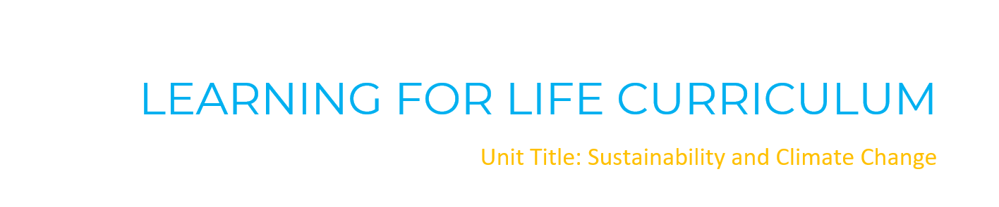


Slide 2
Teacher Slides
Remember to revisit the ground rules with the children prior to beginning the lesson so they are aware of expectations.
Potential triggers: research indicates that lots of children are experience some eco-anxieties as they are increasingly aware of negative impacts that climate change is having on their world.
They are worried about the impact that this is having on animals and the weather and what this means for their futures.
It is important to remind children that steps are being taken to make changes and that they can be a positive force for change and impact their future too.

Slide 3
Teacher Slides
Be mindful when teaching not to take a negative/ ‘doom and gloom’ approach to the teaching of climate change and sustainability and encourage children to be the change that they wish to see in the world.
According to Laura Tobin in her book ‘Everyday Ways to Save Our Planet’ (pg.19):
“The science of climate change is Simple, the impacts are Serious, but the problem is Solvable.”
Encourage children when completing the workbook confidence tracker to indicate how confident they already feel about the topic and where possible, elicit from them WHY they have given the score that they have.
Throughout the unit look for opportunities to explore their interests in the facts and discussions and provide opportunities for them to take ownership on how they can impact change across school and the wider community by leading on this.

Slide 4
Sustainability and Climate Change
Session 1: Pollution

Slide 5
Group Agreement
Type in your agreed ground rules here:

Slide 6
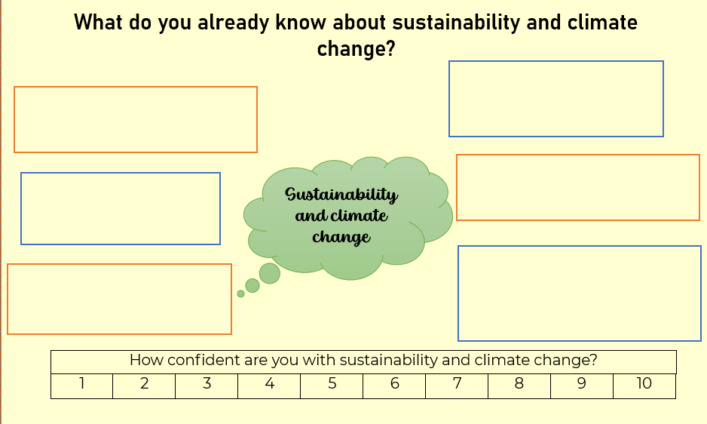
Task 1- check-in

Slide 7
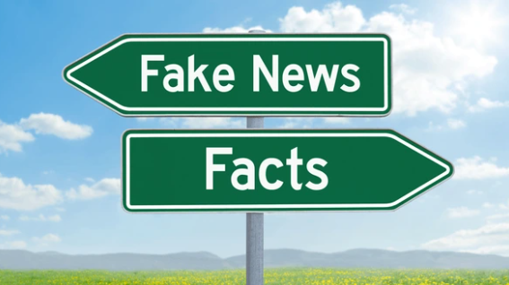
Task 2-

Slide 8
Teacher Slides
This activity is a PRACTICAL activity.
Choose an area in the room for fact news and an opposite area for fake news.
Children decide if they feel the fact is fact or fake and make their way (physically) to that part of the room.
The slides are animated to reveal the correct answer when clicked.
Fake news will then be corrected with the true fact.

Slide 9
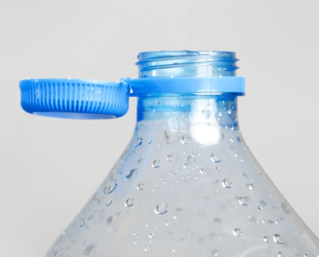
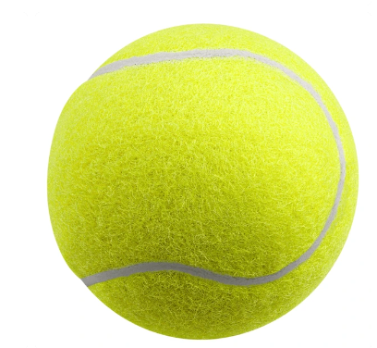
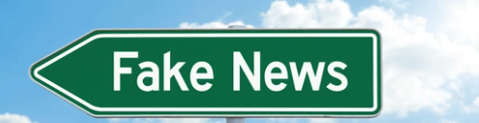
Fact or Fake News?
Individual bottle caps on their own can be recycled.
NO! Nothing smaller than a credit card can be recycled as they are often too small to be picked up by recycling machines at the recycling centres.
Notes:
This is why the new bottles that we are seeing in shops have been re-designed in many cases to keep the bottle tops attached to the main bottle. This is due to individual lids becoming lodged in equipment and creating cross-contamination issues. If the cap can be recycled, it will be attached to the lid. If it is not attached, it is likely that it cannot be recycled and it is best to throw it in the bin.
If you have tinfoil, save up the scraps and wait until you have enough to roll into the size of a tennis ball before putting it into the recycle bin. One suggestion that could be made to children is that if they have packed lunches, when eating in the dinner hall they can make a dinner hall tennis ball before being recycled.

Slide 10
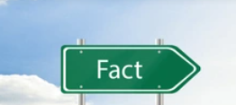
Fact or Fake News?
Half of all plastic is designed to be used only once and then thrown away?

Slide 11
Fact or Fake News?
The average household in the UK throws out 98 items of plastic every week.
The actual figure is
128 items!

Slide 12
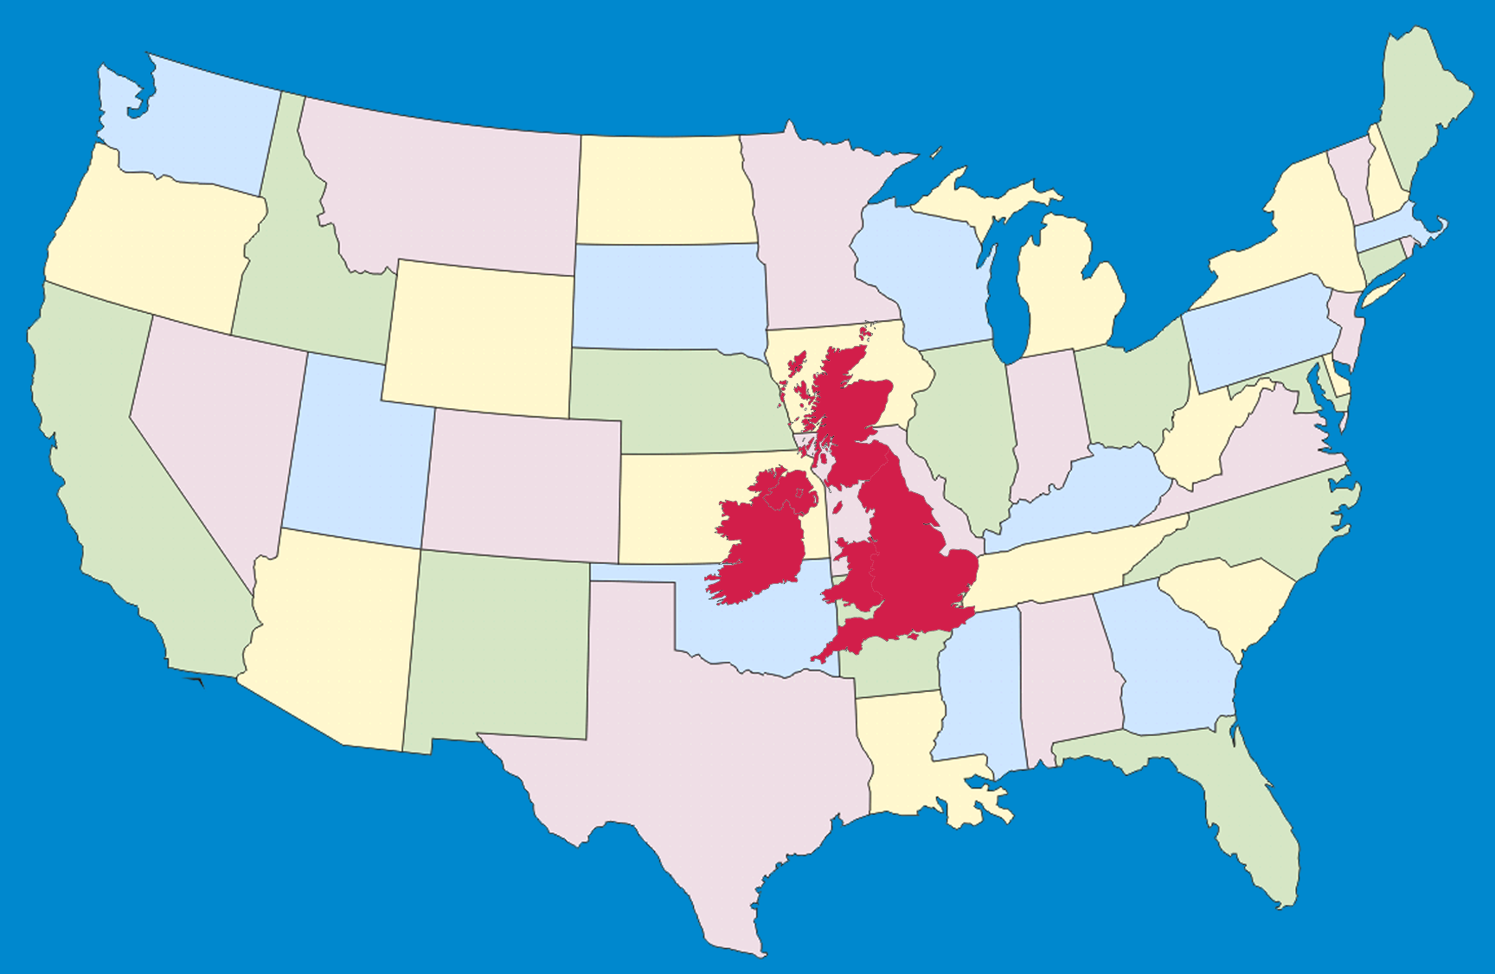
Fact or Fake News?
China is the second biggest producer of plastic waste per person in the world, behind America.
The 2nd biggest producer is the UK!
Notes:
Draw attention to the comparative sizes of the two countries and then discuss the wider implications of this.

Slide 13
Fact or Fake News?
Globally, 91% of waste plastic is NOT recycled.

Slide 14
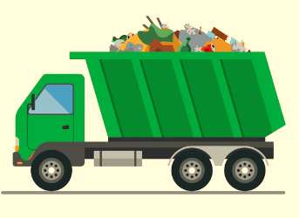
Fact or Fake News?
A rubbish truck’s worth of plastic gets dumped into the ocean every hour.
It is actually EVERY SINGLE MINUTE!

Slide 15

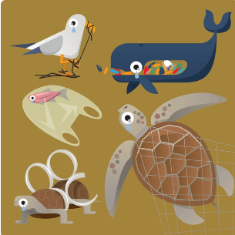

Fact or Fake News?
More than 1,000,000 sea birds and 100,000 marine mammals (including whales and dolphins) die from plastic pollution every year.

Slide 16
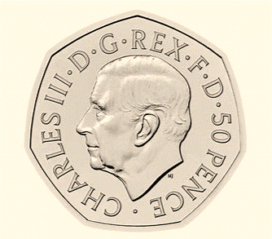
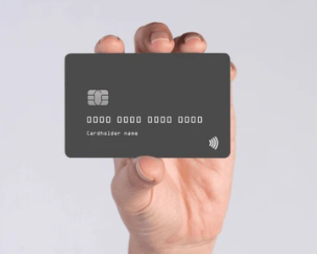
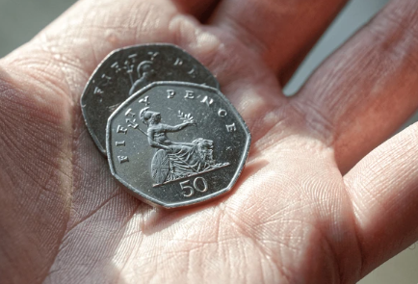
Fact or Fake News?
We eat the equivalent to a 50p sized amount of plastic every week.
It is a credit-card sized amount.
Notes:
Tiny particles of plastic can be found in the air we breathe and the water we drink-especially the water from plastic bottles. It is estimated that the average person eats 70,000 pieces of micro-plastic each year! Encourage children to use a re-usable drinks/water cup wherever possible. Microplastics and fibres have been found in fish, honey, beer, sea salt plus bottled and tap water. We also breathe in tiny plastic particles from our clothes, carpets and other textiles.
Such small amounts are difficult to detect, and some are so tiny they cannot be seen by the naked eye. Although the long-term health implications are not yet known about the consumption of microplastics, it is important to reiterate to the children that there is not anything that can be done to prevent this currently. Remind children that it is still necessary and safe to drink water and that the benefits outweigh the risks of not remaining hydrated.

Slide 17
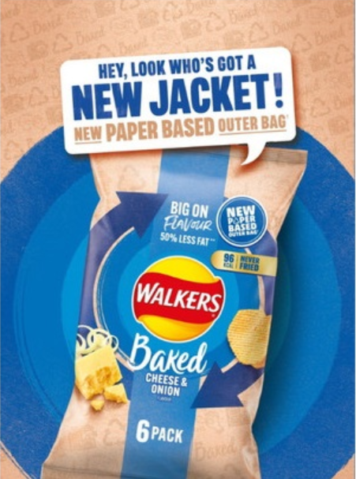
Fact or Fake News?
Brits get through an average of 209 crisp packets per person in a year.
Good News: Some companies are now working hard to reduce their plastic waste by using paper packaging where possible.

Slide 18
Teacher Slides- in class discussion
In groups with five whiteboards- children write the five words with one word per board.
  Reduce
  Recycle
  Reuse
  Repair/recover
  Dispose
This is an inverted pyramid with the best impact at the top and the least impact on the environment at the bottom.
Share the definitions and ensure that the children are fully aware of what they mean and generate some examples of each so that children are clear. For example: repair refurbished electronic devices (phones and consoles) or recovering oil from McDonald’s to refuel their trucks with bio-diesel etc…

Slide 19

Task 3- Waste Hierarchy Pyramid
Best for the environment
Worst for the environment

Slide 20
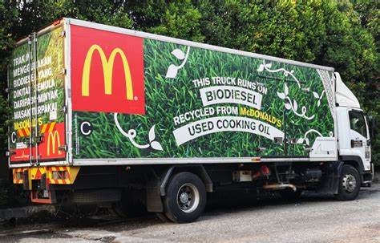
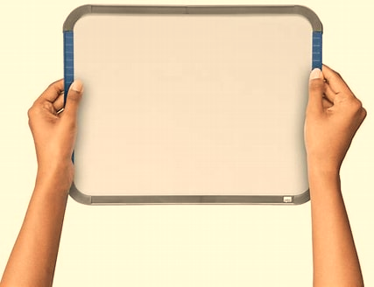
Task 3- Waste Hierarchy Pyramid
Write JUST the words onto your whiteboards! ☺
Word | Definition
Repair/recover | Repair- to mend, refurbish or recondition items. Recover- to recover energy from waste and transform into heat, electricity or bio-fuel.
Reduce | To use LESS and cut down usage.
Reuse | To use again instead of throwing them away.
Dispose | To throw and get rid of without recycling once all other options are exhausted. Ensuring proper containment and treatment methods when dealing with non-recyclable and hazardous waste.
Recycle | The process of collecting and processing materials so that they can be turned into new products.
Notes:
Children write the words onto their whiteboards and then discuss to create their own pyramid.
AFTER the discussion share with the children:
In terms of sustainability- their first thought may be that re-cycling is the best option as it enables things to be turned into something else and used again. Highlight the implications of element of PROCESSING this takes. It requires collecting, processing, using machinery, transport, fuel and energy etc… to be able to produce something into something new.

Slide 21
Teacher Slides- Practical- ideally outside (weather permitting)
In groups with five whiteboards- children write the five words with one word per board to take outside with them.
Children in their teams/groups to set up two of the same-coloured cones a distance apart (between 10-50m apart- teacher to decide depending on fitness levels). All teams should have the same distance as per the diagram. Whiteboards to be ordered vertically 1-5 with best impact on the environment at the top.
Children to run as a relay and remain in the same order running one at a time. Each child to be responsible for one of the words on a whiteboard. On the first go, children run and place their whiteboard in a chosen vertical order 1-5 where they think it should go. They cannot move another whiteboard. 1 (at the top) = best environmental impact and 5 (at the bottom) = worst environmental impact.
Allow children to continue running in a relay style to swap no more than two boards at a time to amend the order as they individually wish for time (set by the teacher) and remaining in the same relay order. This should promote healthy discussion and teamwork amongst the groups.
Pause the game and allow the children to have 2 minutes to decide on what their final order should be and then complete the relay once more to then put the words the final order.
Decide in the team who will be a spokesperson for sharing why they have placed them in the order and talk it through.
Then return to class and share the pyramid slide.

Slide 22
Task 3- Practical
1
1
2
2
3
3
4
4
5
5
1= best environmental impact
5= worst for the environment

Slide 23
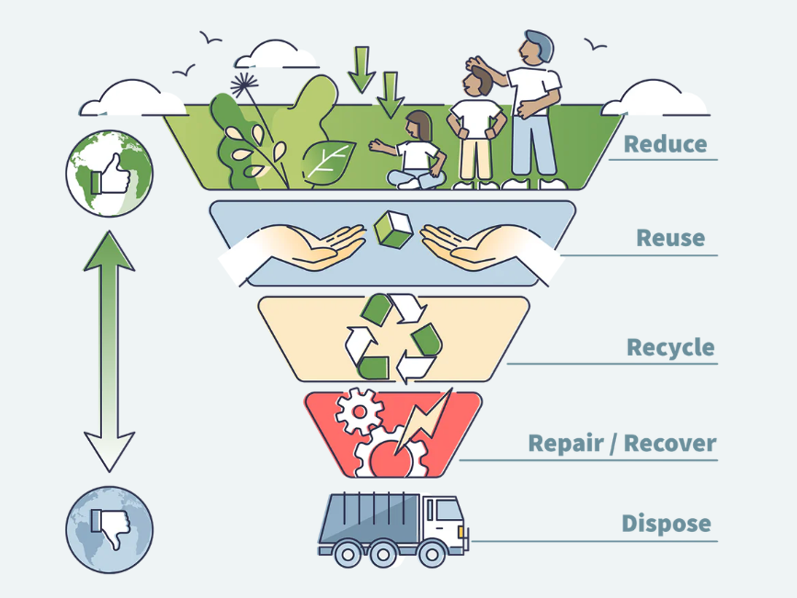
Task 3- Waste Hierarchy Pyramid
What changes could we make in school or at home to reduce our waste?
How does this differ to your final order, why do you think this is?
What considerations must be made when disposing of different items; can everything ‘else’ just go in the bin?
What reasons can you think of as to why ‘recycle’ is so low down on the hierarchy?
Notes:
AFTER the discussion share with the children:
In terms of sustainability- their first thought may be that re-cycling is the best option as it enables things to be turned into something else and used again. Highlight the implications of element of PROCESSING this takes. It requires collecting, processing, using machinery, transport, fuel and energy etc… to be able to produce something into something new.

Slide 24
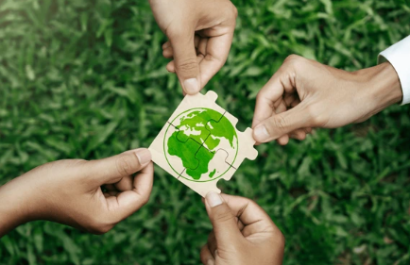
Task 4-
OUR POLLUTION PLEDGES:
Notes:
Pledges may include things such as organising a litter pick in school; a recycling competition; cutting down on single use plastics; using bamboo alternatives; sharing the message more widely (e.g. class assembly/ share with governors/ community); speak to school kitchen about food waste; re-using school equipment; collect smaller waste in school tinfoil to be recycled etc… etc…. Remind children that SMALL and SUSTAINABLE changes will make the most impact.

Slide 25
Teacher Slides
Remember to revisit the ground rules with the children prior to beginning the lesson so they are aware of expectations.
Potential triggers: research indicates that lots of children are experience some eco-anxieties as they are increasingly aware of negative impacts that climate change is having on their world.
They are worried about the impact that this is having on animals and the weather and what this means for their futures.
It is important to remind children that steps are being taken to make changes and that they can be a positive force for change and impact their future too.

Slide 26
Teacher Slides
Be mindful when teaching not to take a negative/ ‘doom and gloom’ approach to the teaching of climate change and sustainability and encourage children to be the change that they wish to see in the world.
According to Laura Tobin in her book ‘Everyday Ways to Save Our Planet’ (pg.19):
“The science of climate change is Simple, the impacts are Serious, but the problem is Solvable.”
Encourage children when completing the workbook confidence tracker to indicate how confident they already feel about the topic and where possible, elicit from them WHY they have given the score that they have.
Throughout the unit look for opportunities to explore their interests in the facts and discussions and provide opportunities for them to take ownership on how they can impact change across school and the wider community by leading on this.

Slide 27
Sustainability and Climate Change
Session 2: Active Travel

Slide 28
Group Agreement
Type in your agreed ground rules here:

Slide 29
Task 1-Check-in
On a typical day, how do you travel to school?
Notes:
See lesson plan to find out how to amend the data for your class.

Slide 30
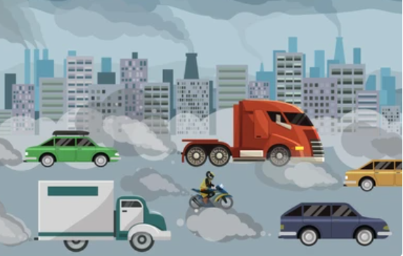
Transport accounts for 27% of the UK’s total emissions-making it the MOST polluting sector!
Notes:
Discuss ideas, what is active travel

Slide 31
Task 2- What is active travel?
Active travel refers to modes of travel that involve a level of activity such as: walking, wheeling and cycling.
These modes of travel are most beneficial to the environment and reduce emissions.

Slide 32
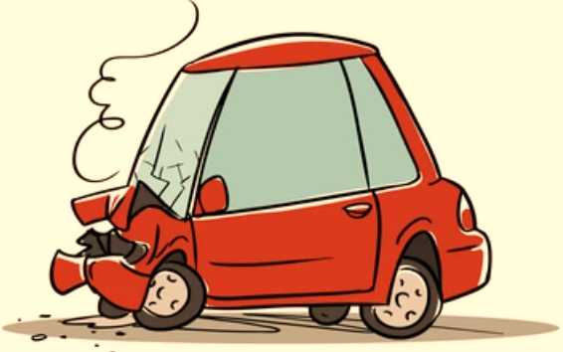
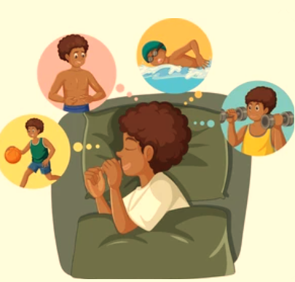
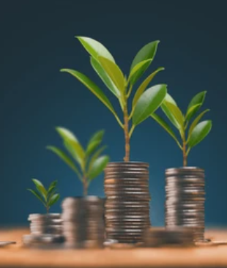
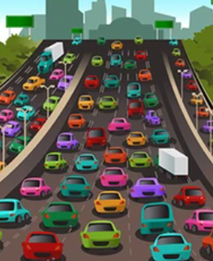
What are the benefits of active travel?
Less collisions
Less congestion
Improves sleep quality
Saves money

Slide 33
How does active travel benefit:
Families?
The Planet?
Individuals?
Communities?

Slide 34
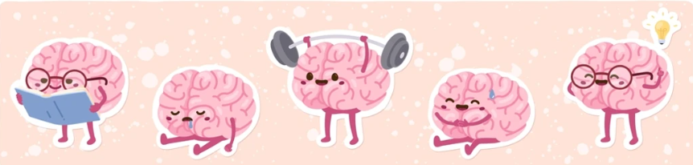
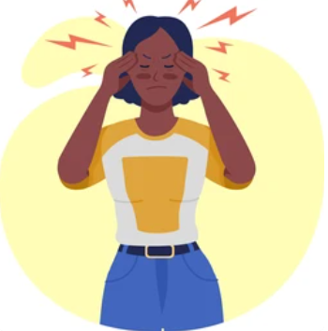
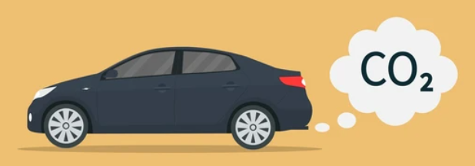
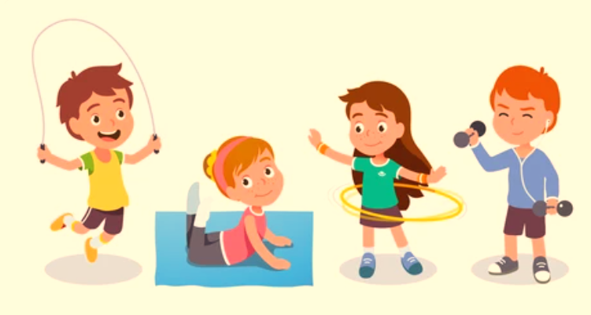
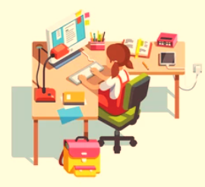
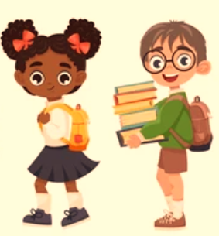
What are the benefits of active travel?
Lower economic cost to the NHS
Improves concentration
Less collisions
Reduces carbon emissions
Increased spending in local shops
Increased independence
Improved health benefits
Improved academic performance in school
Less noise pollution
Reduces stress and anxiety
Saves money
Improves sleep quality
Reduced social isolation
Improves relationships
Less congestion

Slide 35
Task 3- Obstacle Alley
Think about your journey to school and make a list of any ‘obstacles’ that you may face/pass on the way.
Plot out the main obstacles you all face along your route in a flow chart:
Cross the zebra crossing
Left over the roundabout
Cross the main road
Down the steps
Cross the zebra crossing

Slide 36
Task 3- Obstacle Alley
Now, with your group, look for the most common/interesting obstacles to create a group route.
Cross the zebra crossing
Left over the roundabout
Cross the main road
Down the steps
Cross the zebra crossing

Slide 37
Task 3- Obstacle Alley
Cross the zebra crossing
Left over the roundabout
Cross the main road
Down the stairs
Cross the zebra crossing
Plan active moves or obstacles for each of these, up to a maximum of 5 obstacles:
Gallop between the cones
Step through the hoop
Tightrope walk along the line
Step over the hurdles
Gallop between the cones

Slide 38
Task 4- Obstacle Alley Practical
Create the obstacle course that you have designed in your space and practise it to make sure it is safe and possible.
Cross the zebra crossing
Left over the roundabout
Cross the main road
Down the stairs
Cross the zebra crossing
Gallop between the cones
Step through the hoop
Tightrope walk along the line
Step over the hurdles
Gallop between the cones
Write the sequence on your whiteboards.
Notes:
Complete the obstacle course without any distractions and the team who have made it to explain what they need to do.
Then consider pairing up and explain how to do it blindfolded/impaired visually with DIY goggles/reading a book aloud/carrying an egg and spoon. This will simulate not being fully aware of senses.
DO NOT TELL THE CHILDREN WHY THEY ARE DOING THE ADAPTED ROUTES YET!

Slide 39
Task 5- Review
Why do you think we practised our obstacle course with different adaptations?

Slide 40
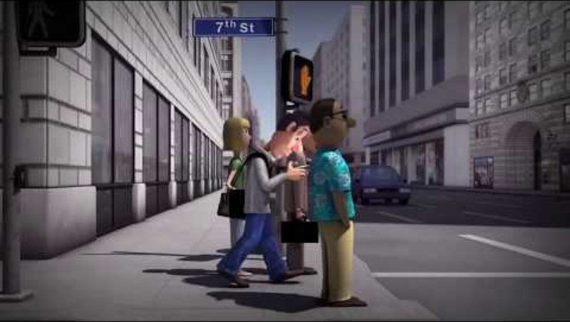
Task 5- Review

Slide 41
Teacher Slides
Remember to revisit the ground rules with the children prior to beginning the lesson so they are aware of expectations.
Potential triggers: research indicates that lots of children are experience some eco-anxieties as they are increasingly aware of negative impacts that climate change is having on their world.
They are worried about the impact that this is having on animals and the weather and what this means for their futures.
It is important to remind children that steps are being taken to make changes and that they can be a positive force for change and impact their future too.

Slide 42
Teacher Slides
Be mindful when teaching not to take a negative/ ‘doom and gloom’ approach to the teaching of climate change and sustainability and encourage children to be the change that they wish to see in the world.
According to Laura Tobin in her book ‘Everyday Ways to Save Our Planet’ (pg.19):
“The science of climate change is Simple, the impacts are Serious, but the problem is Solvable.”
Encourage children when completing the workbook confidence tracker to indicate how confident they already feel about the topic and where possible, elicit from them WHY they have given the score that they have.
Throughout the unit look for opportunities to explore their interests in the facts and discussions and provide opportunities for them to take ownership on how they can impact change across school and the wider community by leading on this.

Slide 43
Sustainability and Climate Change
Session 2: Healthy Food Choices

Slide 44
Group Agreement
Type in your agreed ground rules here:

Slide 45
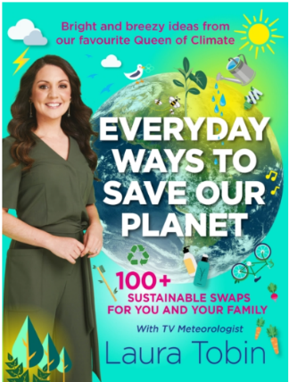
Task 1- check-in
"Everything we eat has an impact on the planet" (Laura Tobin, 2022)
What do you think this means?

Slide 46
Task 1-check-in
Just like the energy used to heat our homes, the food we fuel our bodies with has a significant carbon footprint.
Food production from the land, water and resources used to grow our food to the way it is transported, packaged and disposed of accounts for:
Stand up if you think it is: ¼ of greenhouse gases
Sit down if you think it is: ¾ of greenhouse gases
STAND UP:
¼ of greenhouse gases!

Slide 47
Task 1-check-in
SIT DOWN:
½ of all habitable land!
Food production takes up …
Stand up if you think it is: ¼ of the world’s habitable land
Sit down if you think it is: ½ of the world’s habitable land

Slide 48

Food Waste- how much is thrown away every day?
Potatoes | Bread | Milk | Bananas | Salad
5.8 million whole potatoes | 17 million slices | 3.7 million glasses | 1.2 million bananas | 490,000 bags
OR | OR | OR | OR | OR
2.1 million whole potatoes | 24 million slices | 5.8 million glasses | 1.4 million bananas | 1.2 million bags
Notes:
Hands up to the ceiling if you think it is the higher number or touch the floor if you think it is the smaller number. The click will reveal the correct number.

Slide 49
Task 2- Practical
Small items: tennis balls, beanbags, quoits etc…
Medium items: bibs, dodgeballs etc…
Larger items: hoops, netballs, tennis racquets etc…

Slide 50
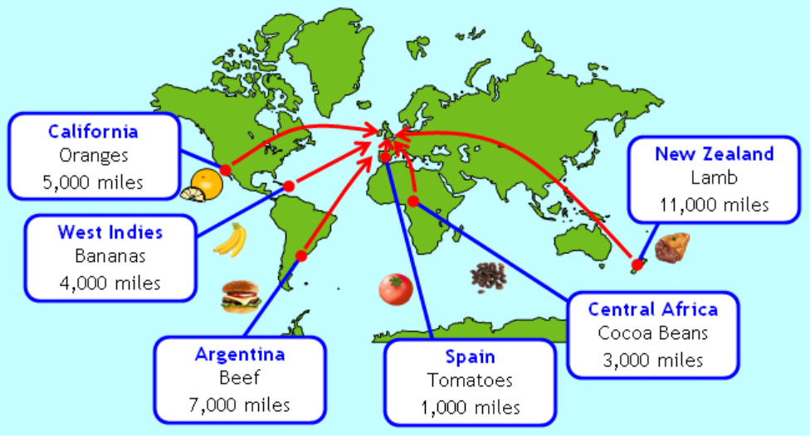
Task 3- Food Miles
Notes:
It is important to think about the impact on the environment and the amount of energy used up by importing foods from far away. It is important that we consider the economic implications of important but the impact it has on the environment is vast.
The practical activity was a way of demonstrating how much more energy is taken up by importing things from further afield.
The further the import, the more impact this has on the planet- this is to be likened to the activity- the further the distance the more work and strain it put onto your body.
The more mindful we can be about where we get things from, the better it is for the environment. Similarly, the important message is that often, the closer things are made to home, the seasonal items available to us are often of better quality, more organic and better for us than some of the items from further afield. This is because it will be taking less time to get from farm to fork meaning that there will be less need for preservatives and the food will be fresher.

Slide 51
Task 4- Research project
There are lots of things you can do to make healthy food choices to impact the environment and the impact on the planet.
Watch this video and take some notes on the simple changes you could make.
What is food sustainability and why is it important? - BBC Bitesize
Notes:
Watch the first video and take notes about simple changed: saving food for snacks, reducing food waste, composting food, only buying what is needed and thinking about eating seasonal and local produce. Children to make notes.
They can then use the further information and the articles on the page to find out more and think about how they want to present their findings and how they can ‘spread the word’.
Children may decide they want to research their own food carbon footprint/create a podcast and record it with key information/ produce a newsletter item to be sent home/ create a news bulletin to film/ develop a poster or information leaflet for other people within school/ write a letter to the local council trying to persuade them to encourage food waste collection and the reasons and benefits for this.
They can then use the links to find out more information and create a project to promote positive change and share the facts they have learned.

