Slide 1
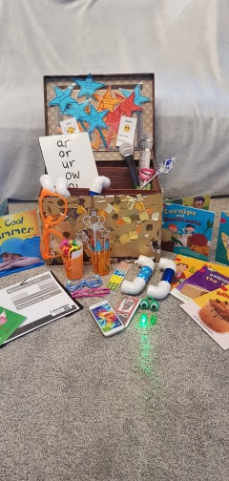
Guided Reading Treasure Chest

