Slide 1
Cold Weather Alerts
Social care guidance

Slide 2
Cold Weather Alerts – Action Cards
What
Early warning system
When
Why
Improve service delivery
Advice & guidance
1st November to 31st March
Support staff & clients

Slide 3
What are Cold Weather alerts
The Weather health alerting system is provided by the UK Health Security Agency (UKHSA) in partnership with the Met Office.
Intended to provide early warning when adverse temperatures are likely to impact on the health and wellbeing of the population.
The Cold - health alerting system runs from 1 November to 31 March each year.

Slide 4
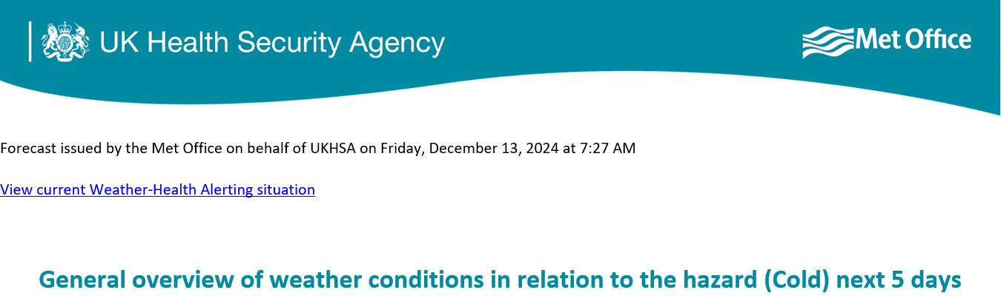
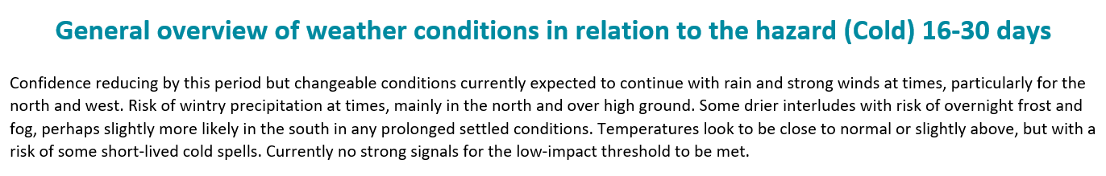
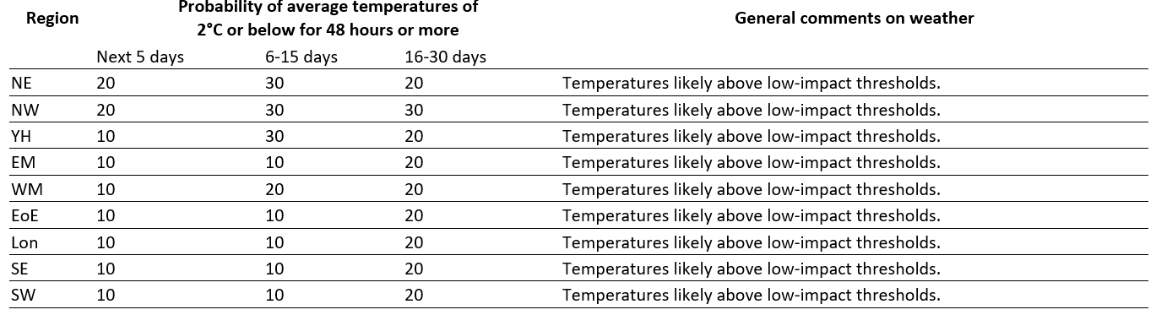
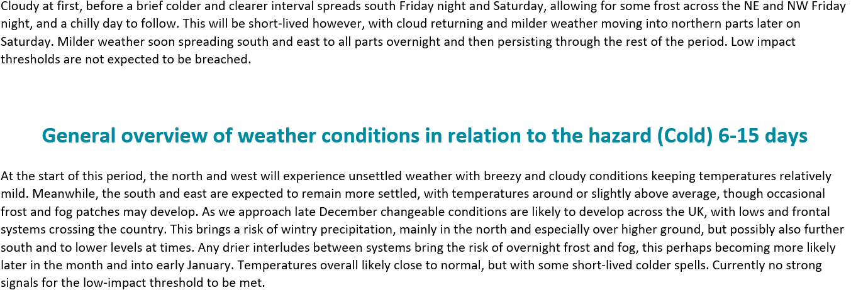
Example of Cold Weather planning advice

Slide 5
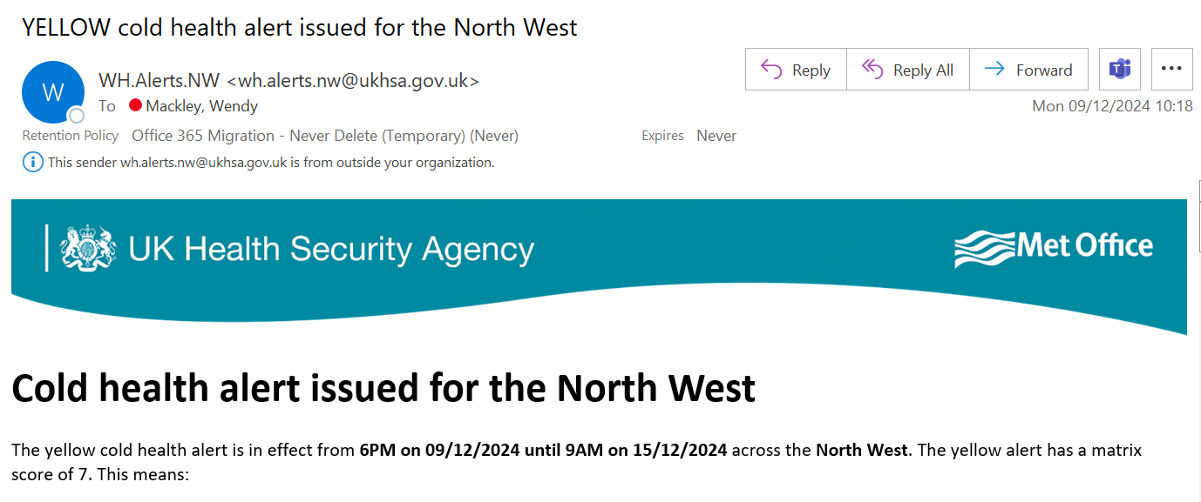
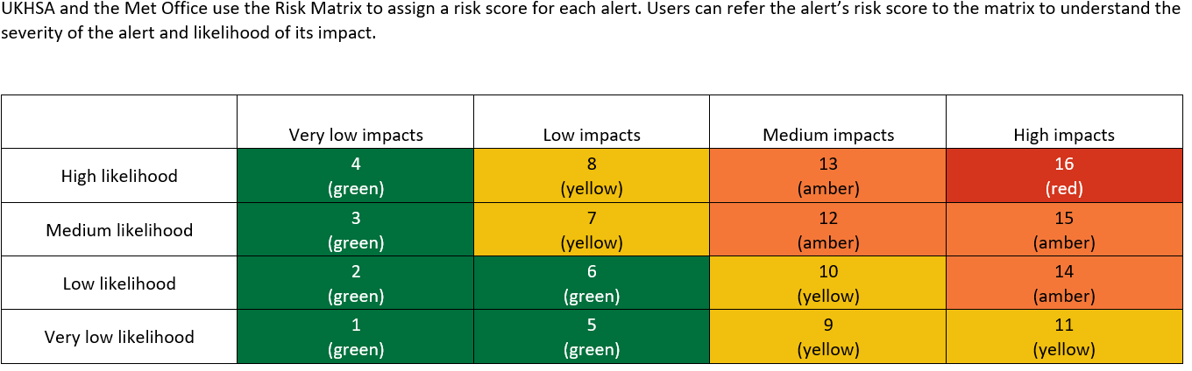
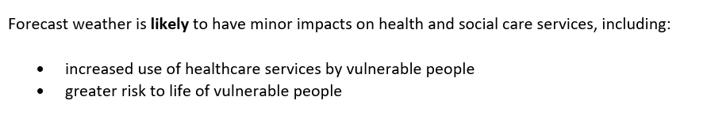
Example of a Yellow alert

Slide 6
How to sign up for alerts
Either go to:
www.metoffice.gov.uk/weather/warnings-and-advice/seasonal-advice/cold-weather-alerts and click on ‘signing up for alerts’
Or – click on the link below to take you directly to the registration form
Weather-Health Alerting system
May also wish to sign up for Met Office weather warnings
Met Office – Rain/Wind/Snow/Ice etc

Slide 7
Who are the action cards for
All managers –
Share with your team
Helps with planning service activity
Staff who work with vulnerable clients
Help them to be resilient
Staff – personal advice
Home workers
Travel

Slide 8
The different levels of response

Slide 9
Who is at risk
Whilst exposure to cold weather can affect ANYONE, some staff and/or service users are particularly at risk. These include: -
older people (aged 65 years and over)
anyone with long-term health conditions such as cardiovascular or respiratory disease, or a mental health condition
pregnant women
people at risk of falls
people who live alone and may be unable to care for themselves.
people who are housebound or have low mobility – even for a temporary period , eg. after an operation or accident
people living in deprived circumstances or those struggling with the cost of living.
young children (particularly those aged 5 and under)
people with learning disabilities

Slide 10
Why
There are many reasons for the increased risk of ill-health in cold weather. These include:
  • poor quality housing and particularly cold homes
  • higher frequency of circulating infectious diseases, such as flu and norovirus during the winter months
  • physical hazards such as snow and ice.

Slide 11
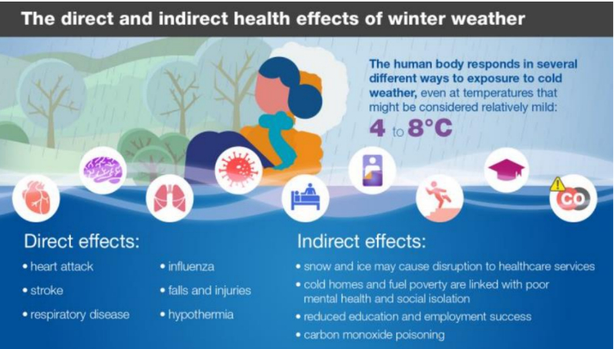

Slide 12
EXAMPLE ACTIONS
Managers
All staff to have sight of the Cold – Health Alert Action Card
Service Resilience Plans
Emergency contact details
Vulnerable staff?
Winter vaccines
Staff
Boiler serviced
Carbon monoxide detectors tested
Priority Services register for utilities

Slide 13
EXAMPLE ACTIONS
Managers
Remind staff of Cold – Health Alert Action Card
Maintain contact – home workers
Consider impacts on service delivery – client visits, falls etc
Staff
Keep an eye on the weather – Met Office alerts
Working from home – at least 18°C
Travelling – is your car winter ready, be cautious in car parks

Slide 14
Impacts/Actions
Follow any advice from the Strategic and Integrated Commissioning team
  They will receive information from the Resilience Team around corporate and multi agency actions and share if necessary
Refer to your organisational plans to mitigate business impacts (your resilience plan)
Use risk assessments
Communicate to staff e.g. awareness about self resilience / self care – winter travel kit etc

Slide 15
Impacts/Actions
Managers – follow your organisational resilience plans
Monitor impact on service delivery and escalate any concerns to the Strategic and Integrated Commissioning team
Support staff

Slide 16

Any Questions
healthprotection@lancashire.gov.uk

