Slide 1
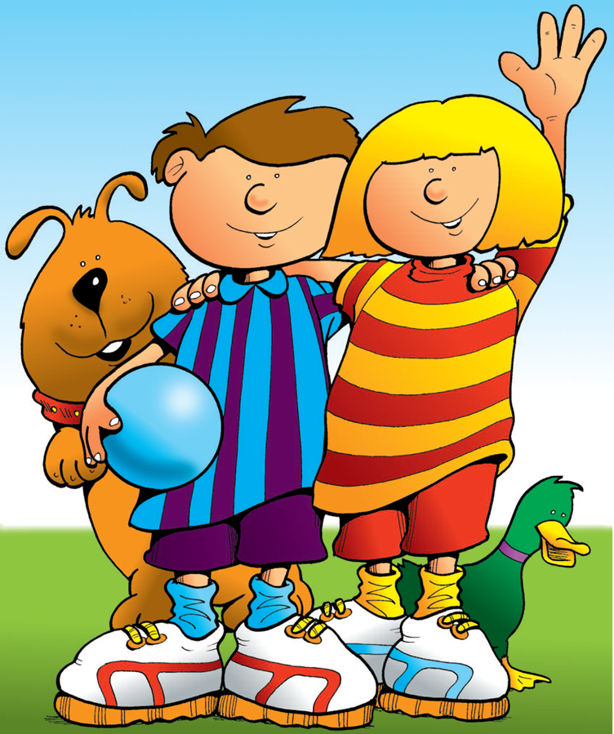

Let’s Be Safe
Out and About
A Road Safety & Play Safe Book from
Lancashire County Council

Slide 2
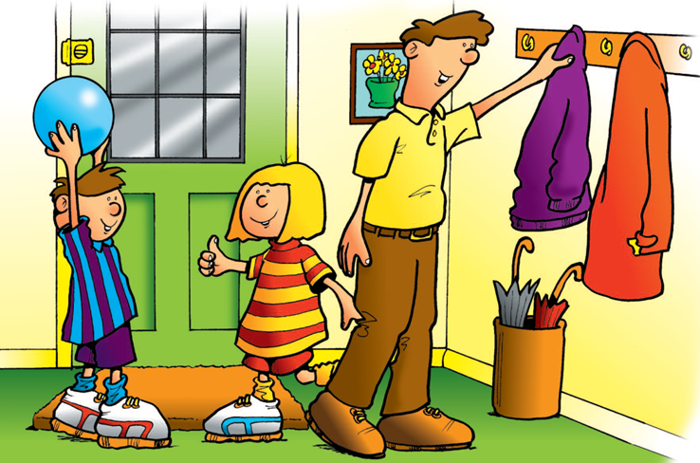
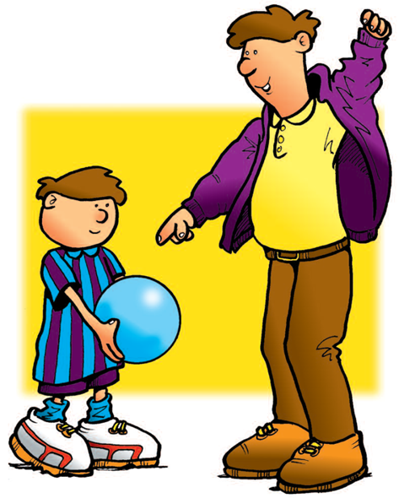
It was Saturday and the sun was shining. Darren and Jenny were excited. They knew that Dad was going to take them to the park.
Darren got his football. Dad told him to put the football in a bag to carry it to the park. “It could easily slip out of your hands. It could roll into the road and cause an accident,” said Dad.

Slide 3
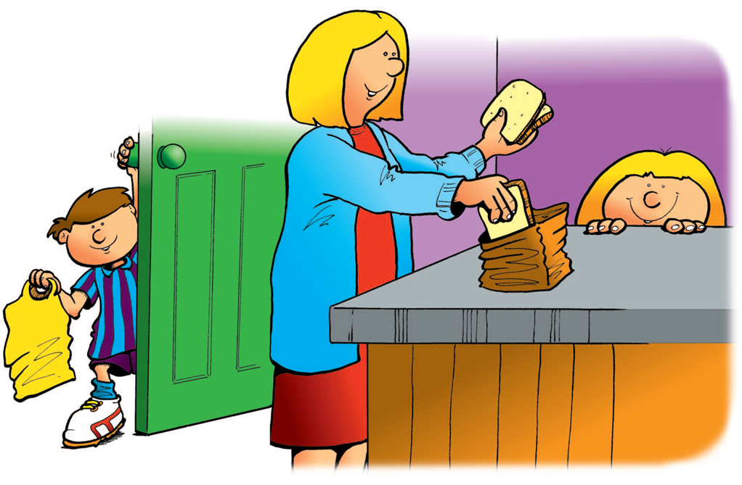
Darren got a bag to put the ball in. He looked to see if Jenny was ready.
Jenny had gone to ask her Mum if she could give her some bread to take for the ducks in the park.

Slide 4
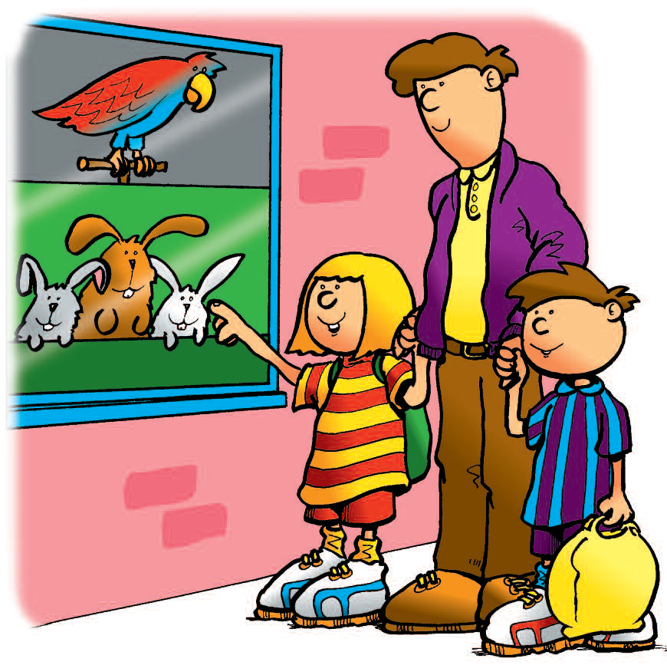
The way to the park was along a busy road. Dad reminded Darren and Jenny what they should do when walking near the road. He said they must always walk on the inside of the pavement and keep away from the kerb.
They must always hold hands with Mum or Dad or a grown-up who they know. Sometimes, as they walked along, there were things that they wanted to look at. They always asked Dad if they could stop and look.

Slide 5
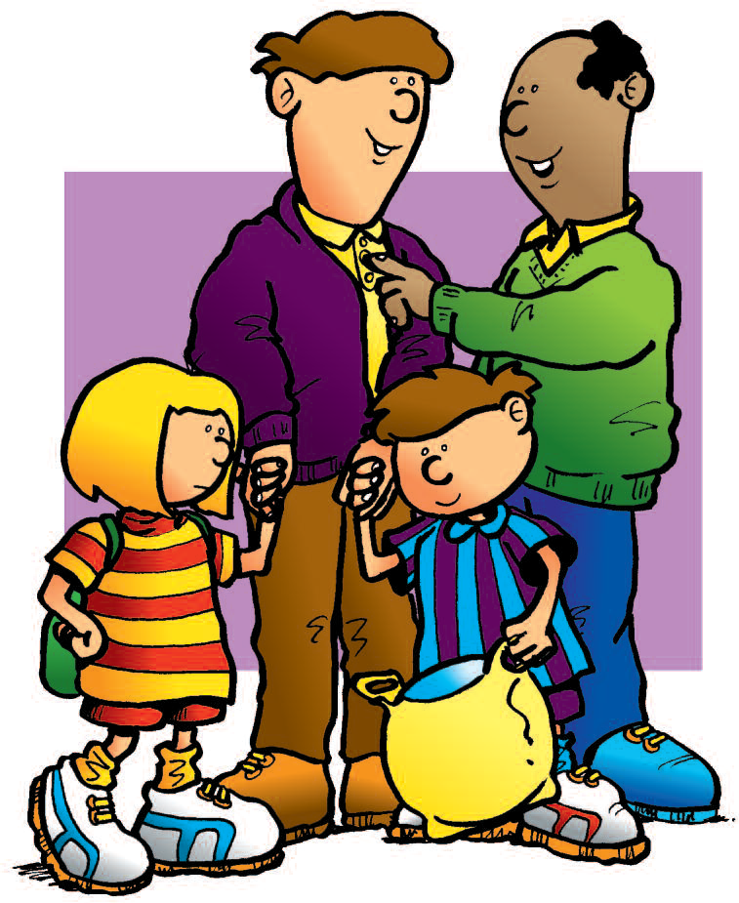
As they were walking down the street, they met their friend Sanjay’s dad, Mr. Ahmed.
Darren told Mr. Ahmed they were going to the park. “That sounds fun,” said Mr. Ahmed, “perhaps I could bring Sanjay to meet you there. “Great”, said Darren “we’ll see you there”. Dad and Mr. Ahmed carried on talking and soon Darren became tired of standing still. He looked at the football in the bag.

Slide 6
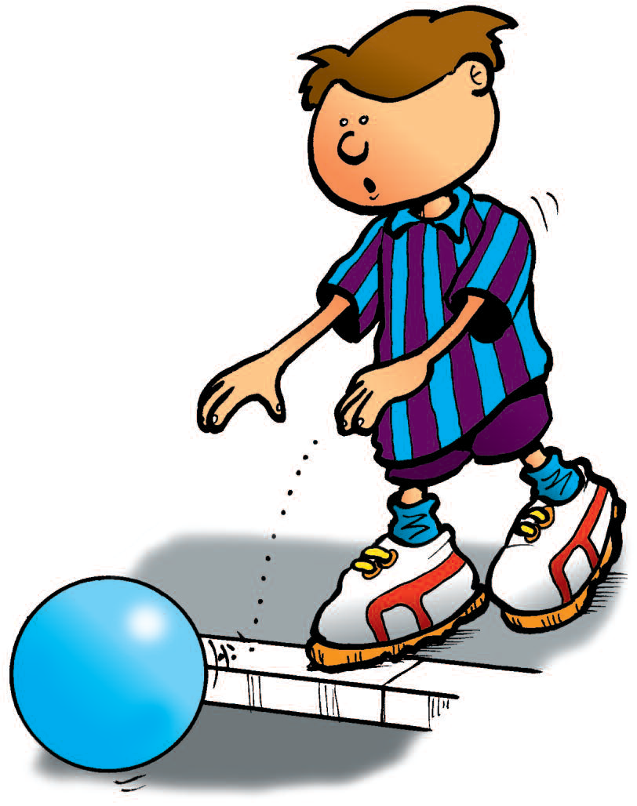
Darren forgot that he should not play near the road. “ I’ll just get the ball out of the bag. It will be alright.” He let go of Dad’s hand and pulled the ball out of the bag. He started bouncing it up and down on the pavement. He thought he was very good at catching the ball but suddenly he missed it. The ball rolled into the road

Slide 7
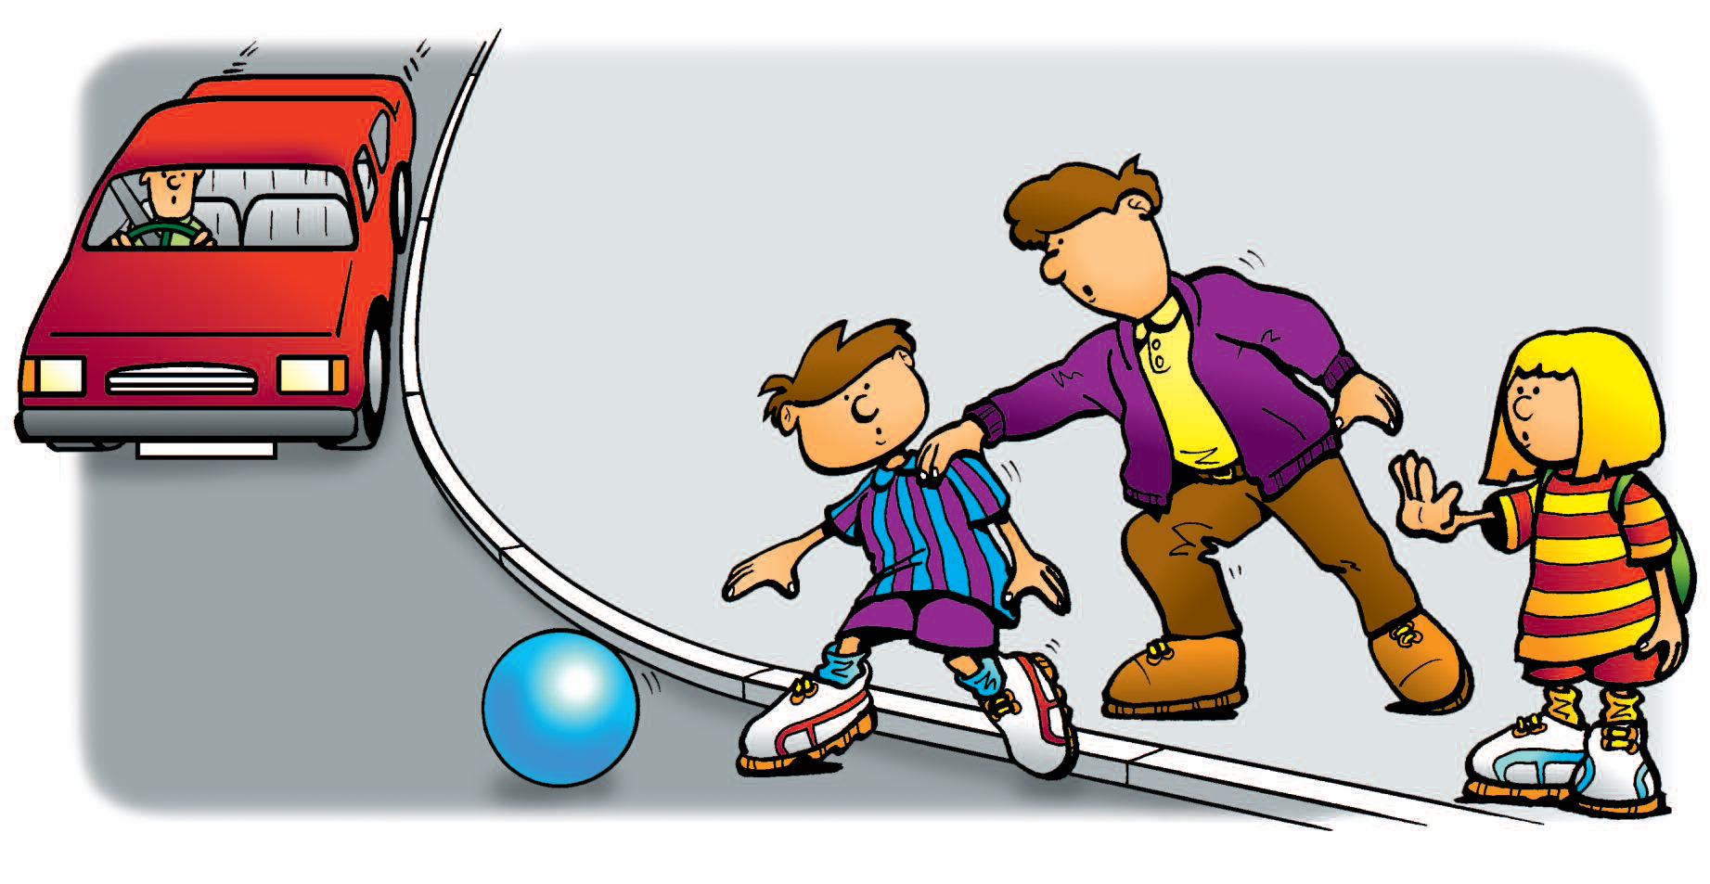
Darren set off after the ball. He was just about to step into the road when his Dad saw him. “Stop!” Dad shouted.

Slide 8
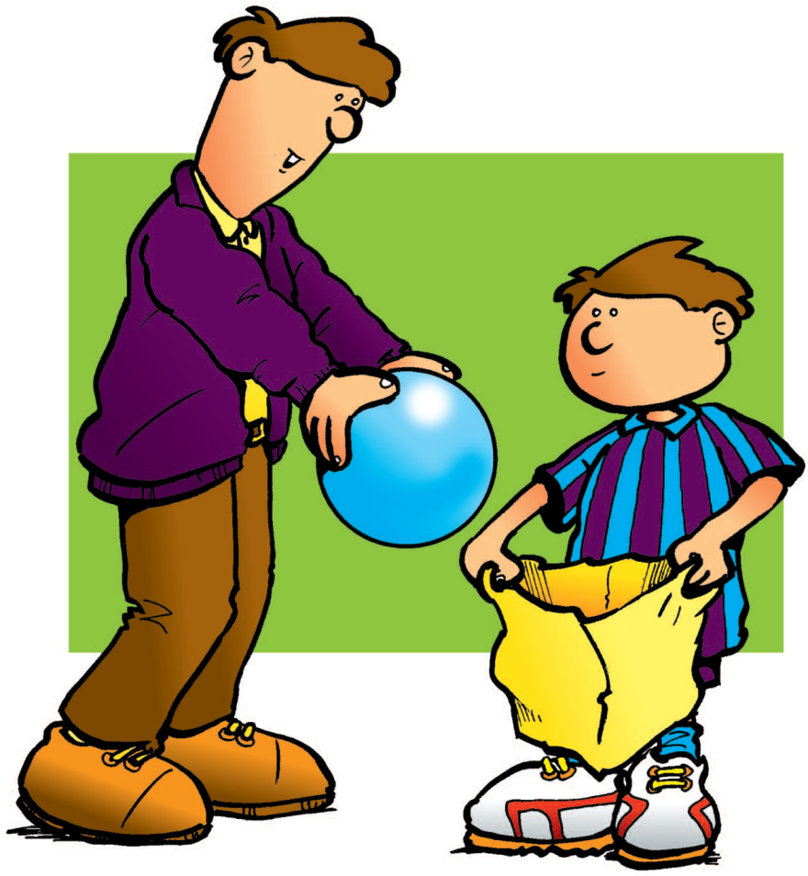
He grabbed hold of his shirt to stop him running into the road. “You must never do that,” said Dad. “Look, there’s a car coming. You would have been knocked over if you had run after the ball. You should not have got the ball out of the bag.” “I’m sorry, Dad,” said Darren. “I won’t do it again.” The ball had rolled down the road, so Dad waited until there was no traffic and then he went
to get it. “Now put the ball back into the bag and let’s go to the park.”

Slide 9
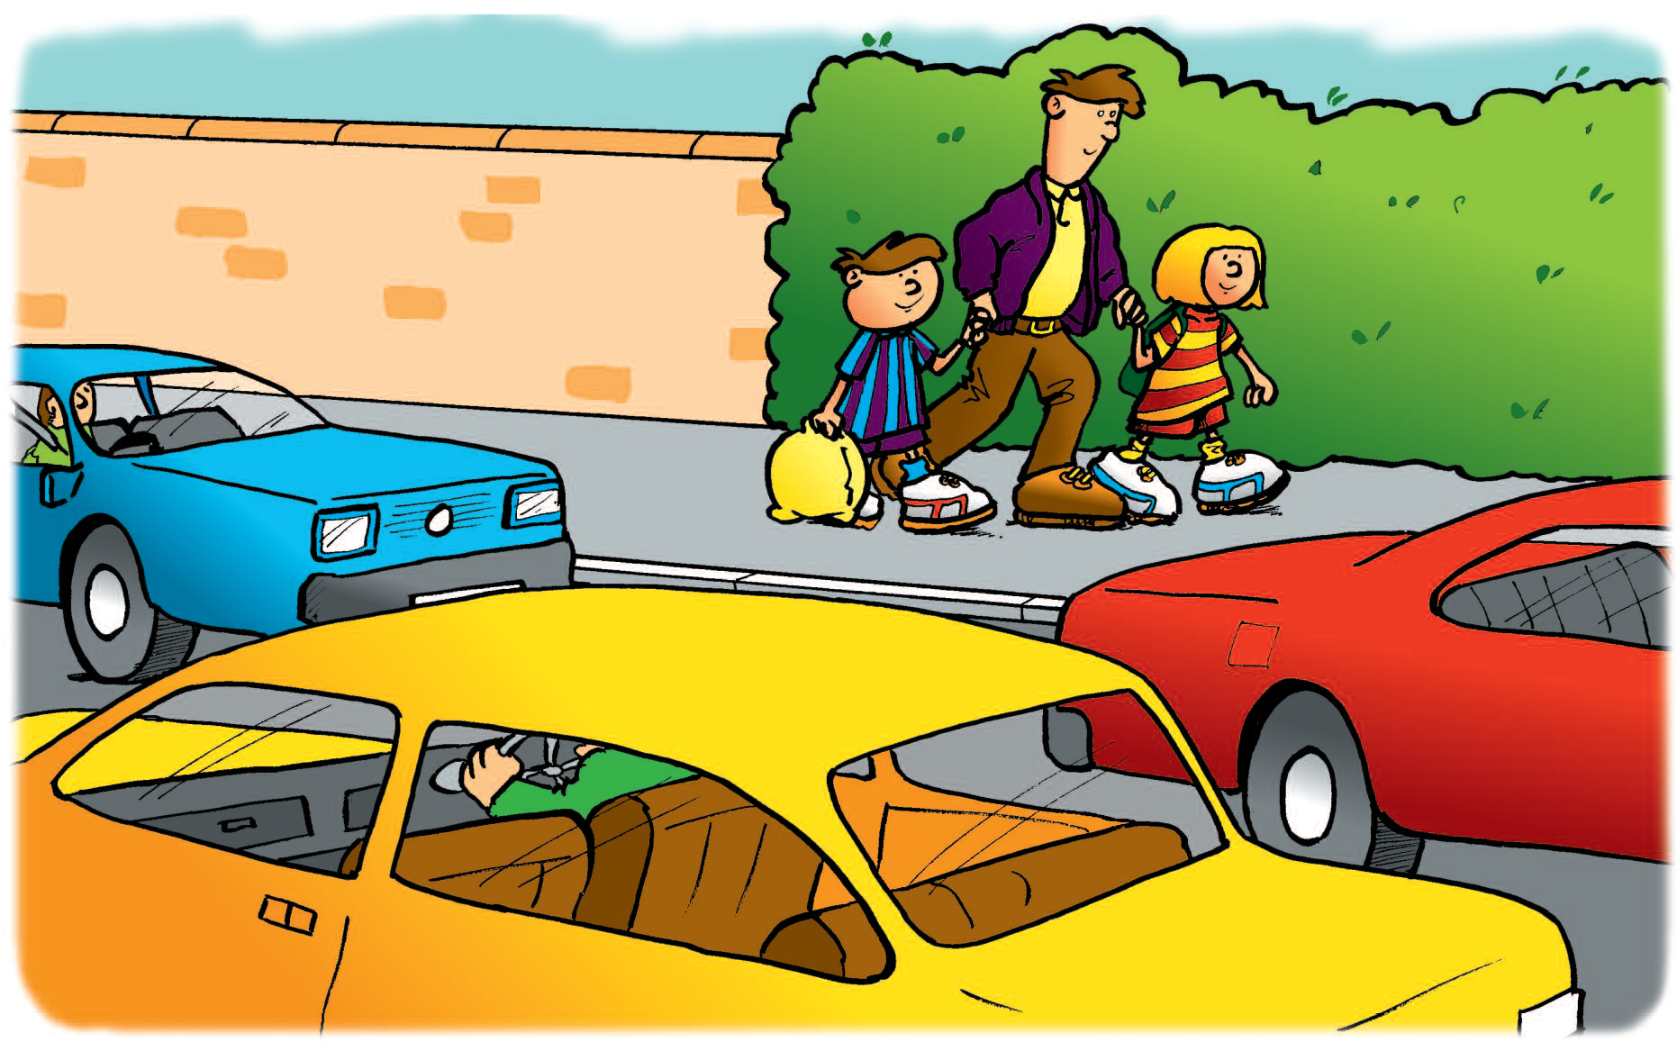
To get to the park they had to cross the road.

Slide 10
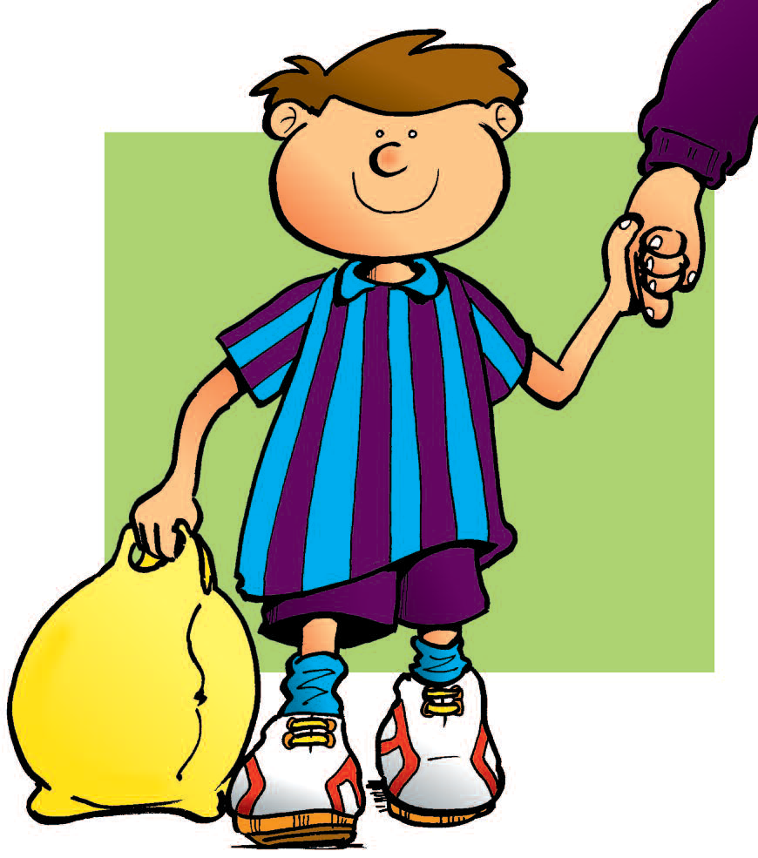
Darren had been learning about crossing the road at school. This is what he had been told. Always hold hands with Dad or Mum or a grown-up you know. Walk on the inside of the
pavement and keep away from the kerb. You must not play near the road.

Slide 11
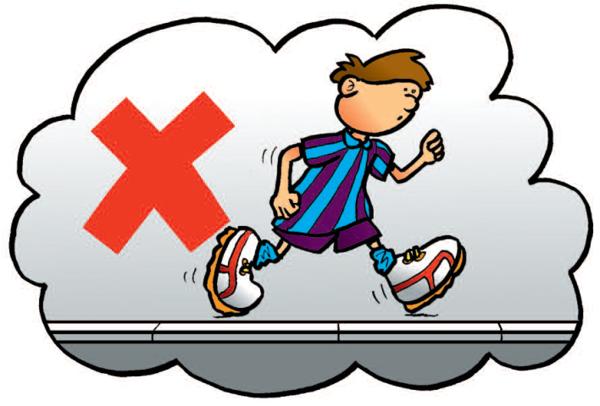
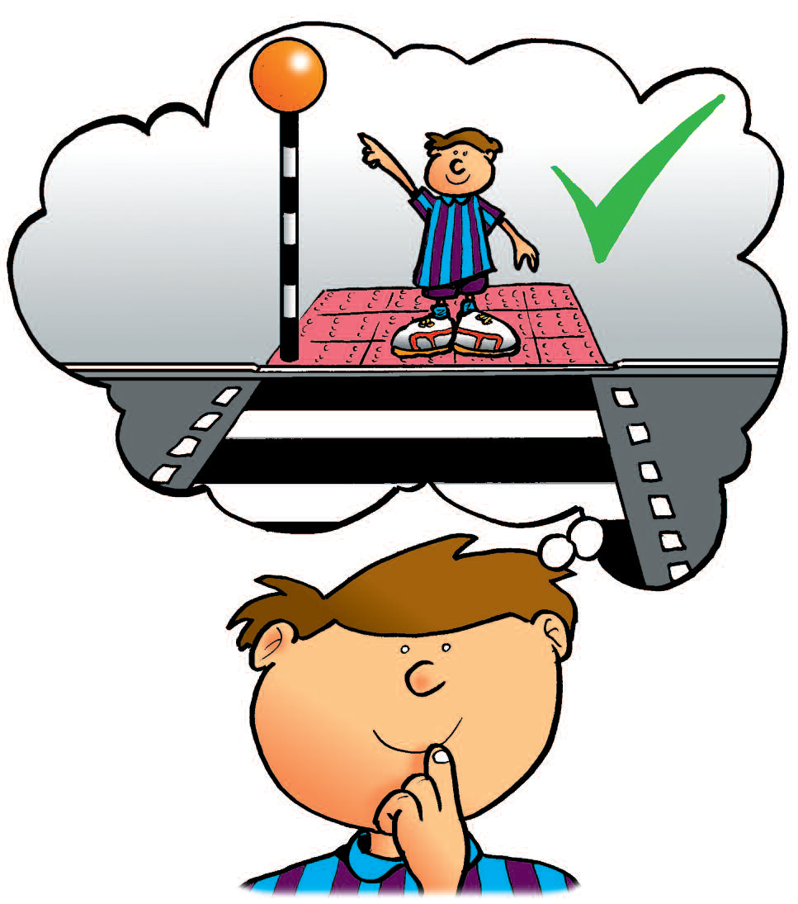
You must not run near the road and always look for a safe place to cross
A safe place to cross is a
zebra crossing. Another safe
place is a pelican crossing.

Slide 12
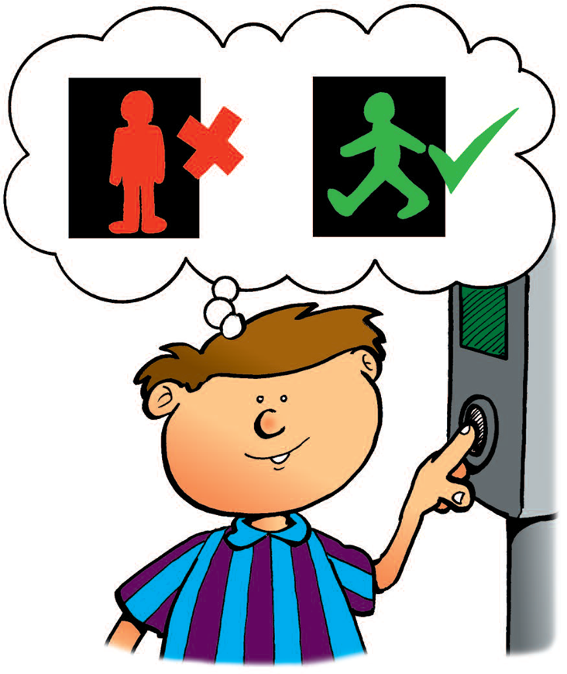
There was a pelican crossing on the busy road which Darren, Jenny and Dad had to cross to get to the park.
When they got to the pelican crossing the red man was showing on the traffic light. Darren remembered what he had been told about how to use a pelican crossing.

Slide 13
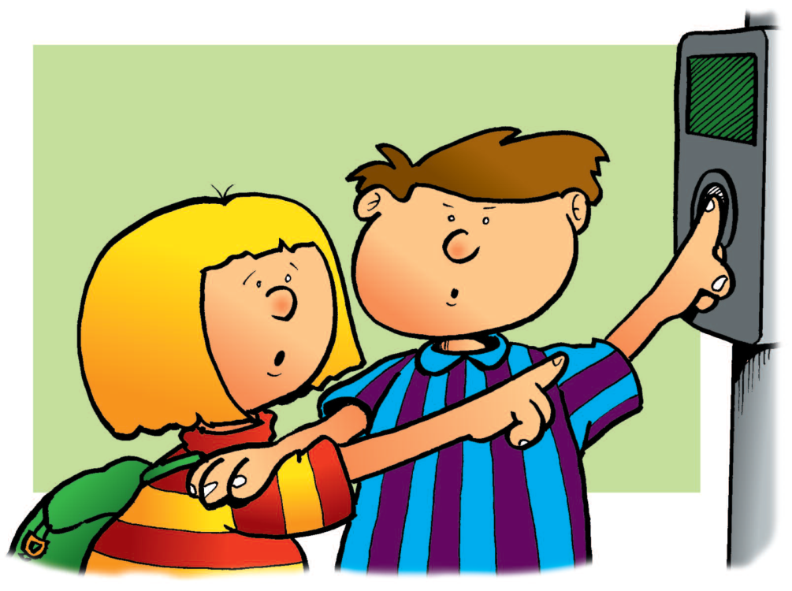
“We must not cross now,” said Darren, “it’s dangerous. If we try to cross when the red man is showing we could get knocked over. We have to press the button on the box and wait for the green man to show.”
Darren and Jenny started pushing each other trying to get to press the button on the pelican crossing. “Stop it,” said Dad,” you will push each other into the road. Darren, you press the button this time and Jenny can press it on the way back.”

Slide 14
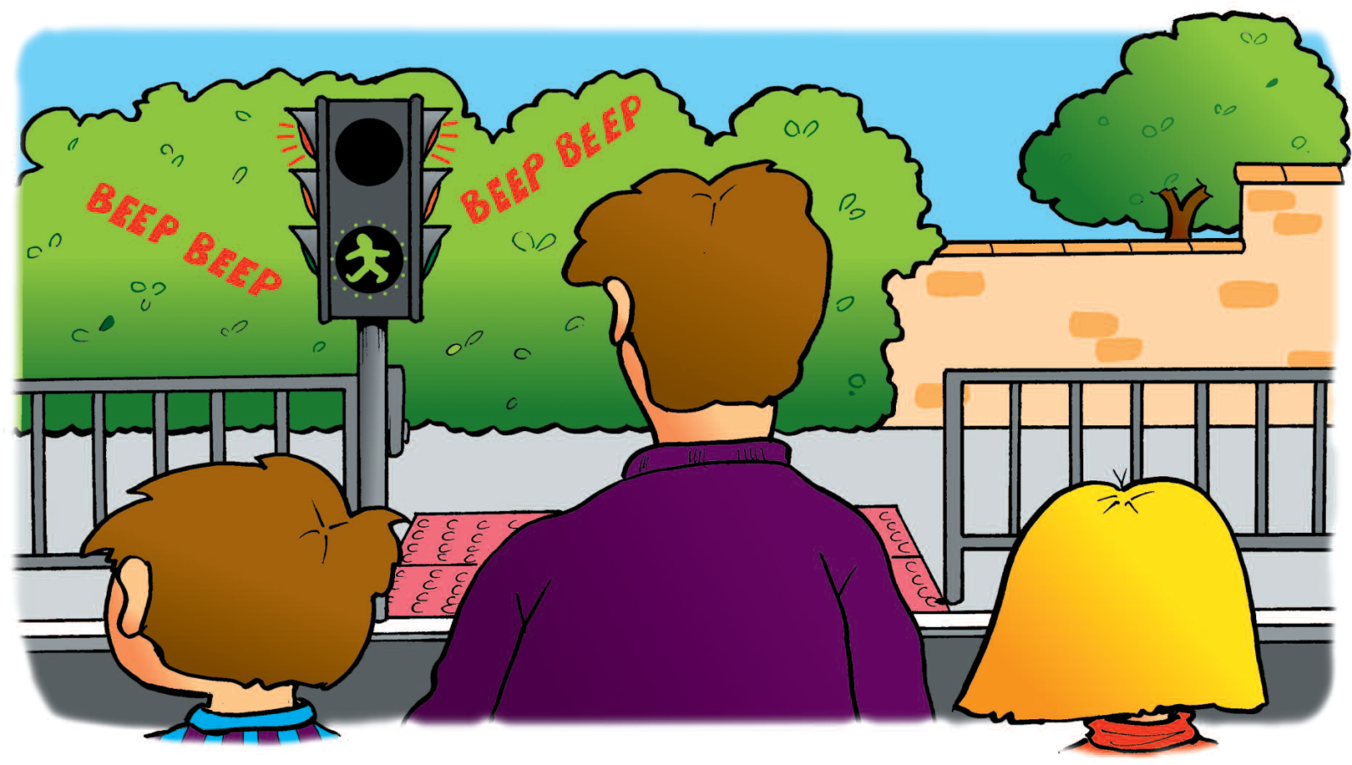
So, Darren pressed the button and they waited until they could see the green man. There was also a bleeping noise.
“That’s to help blind people to know when it’s safe to cross the road,” explained Dad. “We must make sure that the cars have stopped before we set off across the road.”

Slide 15
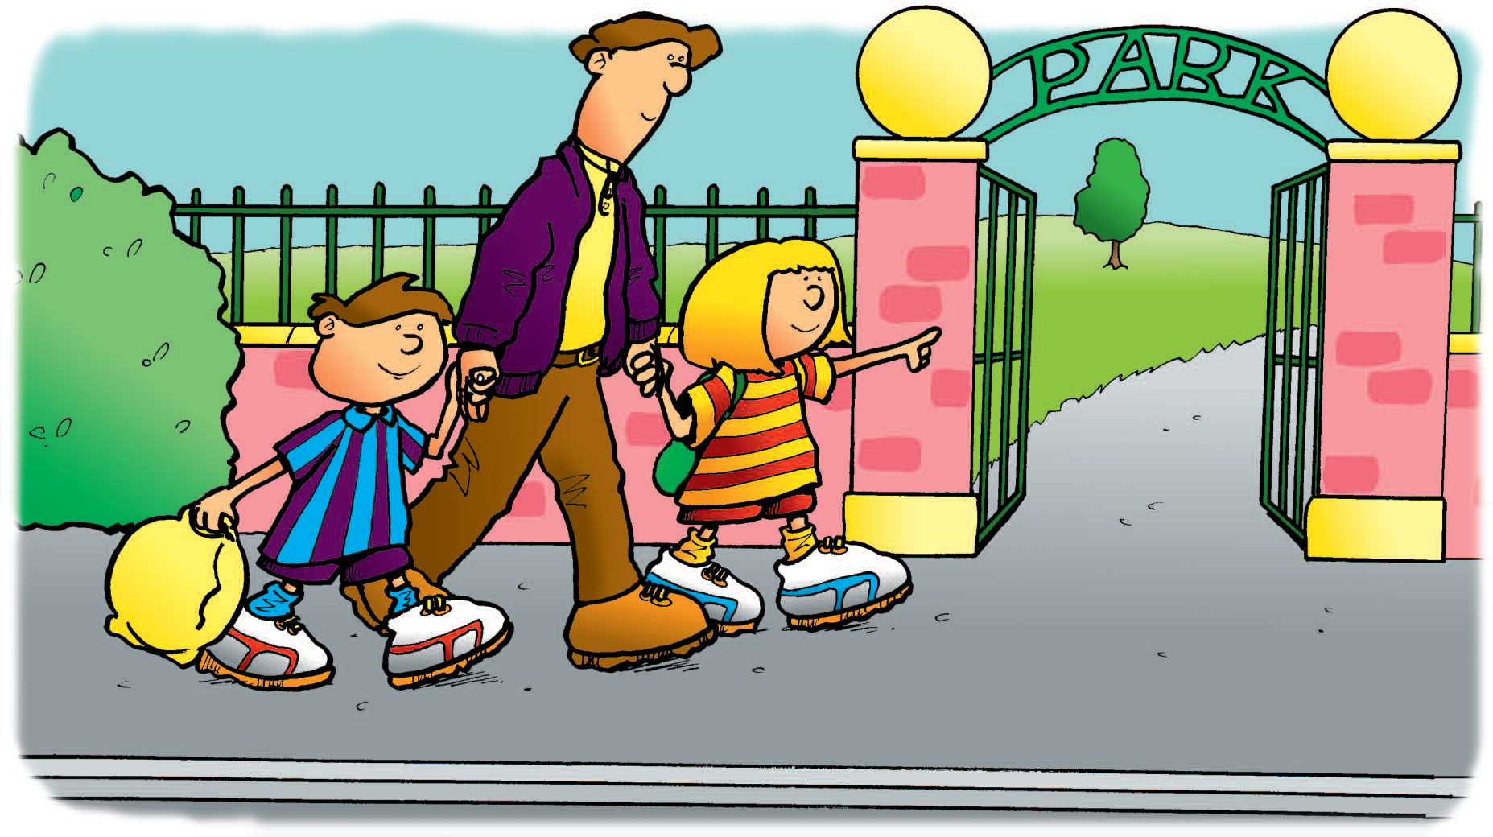
They held Dad’s hands and made sure the cars had stopped. Then they crossed the road. Still holding hands, they walked to the park.

Slide 16
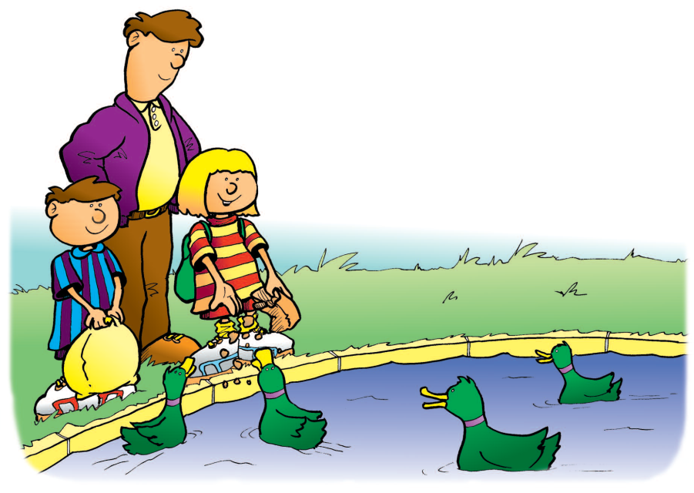
Now they should be able to play safely
until it was time to go home. The park
was very big with lots of open space
where Darren and Jenny could play.
There were lots of things that they liked
to do in the park. There was a large
pond and they usually went there first.
There were always some ducks on the
pond. The ducks swam towards them
calling noisily. Jenny got the bread out
of her bag and started throwing pieces
to the ducks.

Slide 17
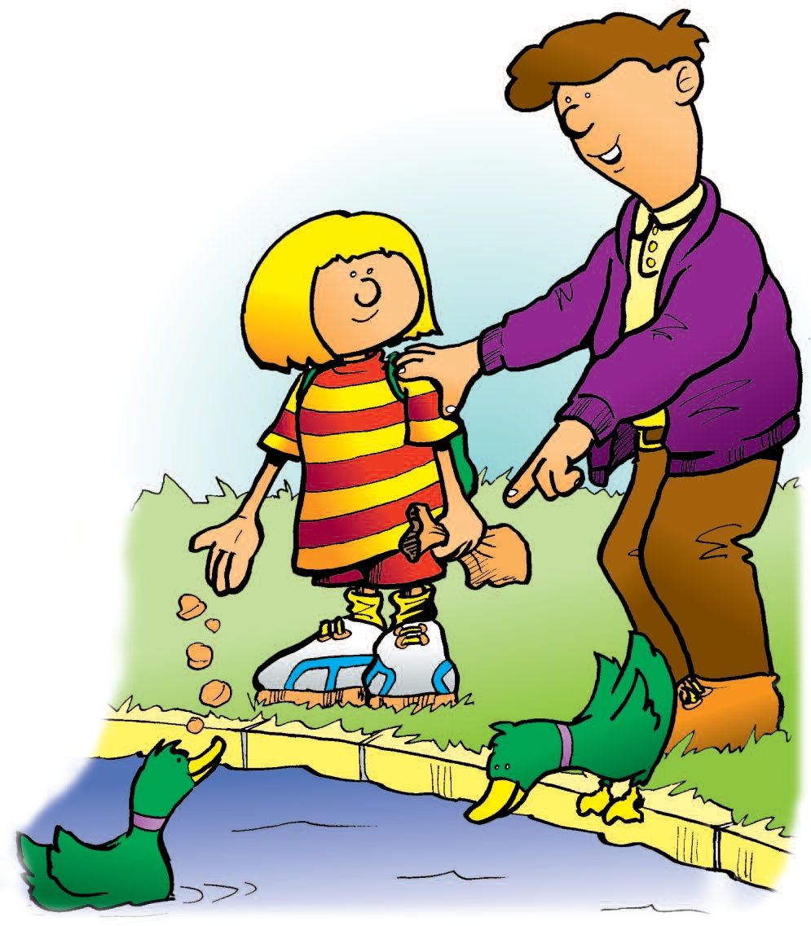
Dad had to watch her carefully and remind her to keep well away from the edge of the pond. “It wouldn’t be very nice if you fell into that water,” said Dad. “It’s quite deep and cold and muddy. Playing near water can be dangerous even if you don’t think it is.”

Slide 18
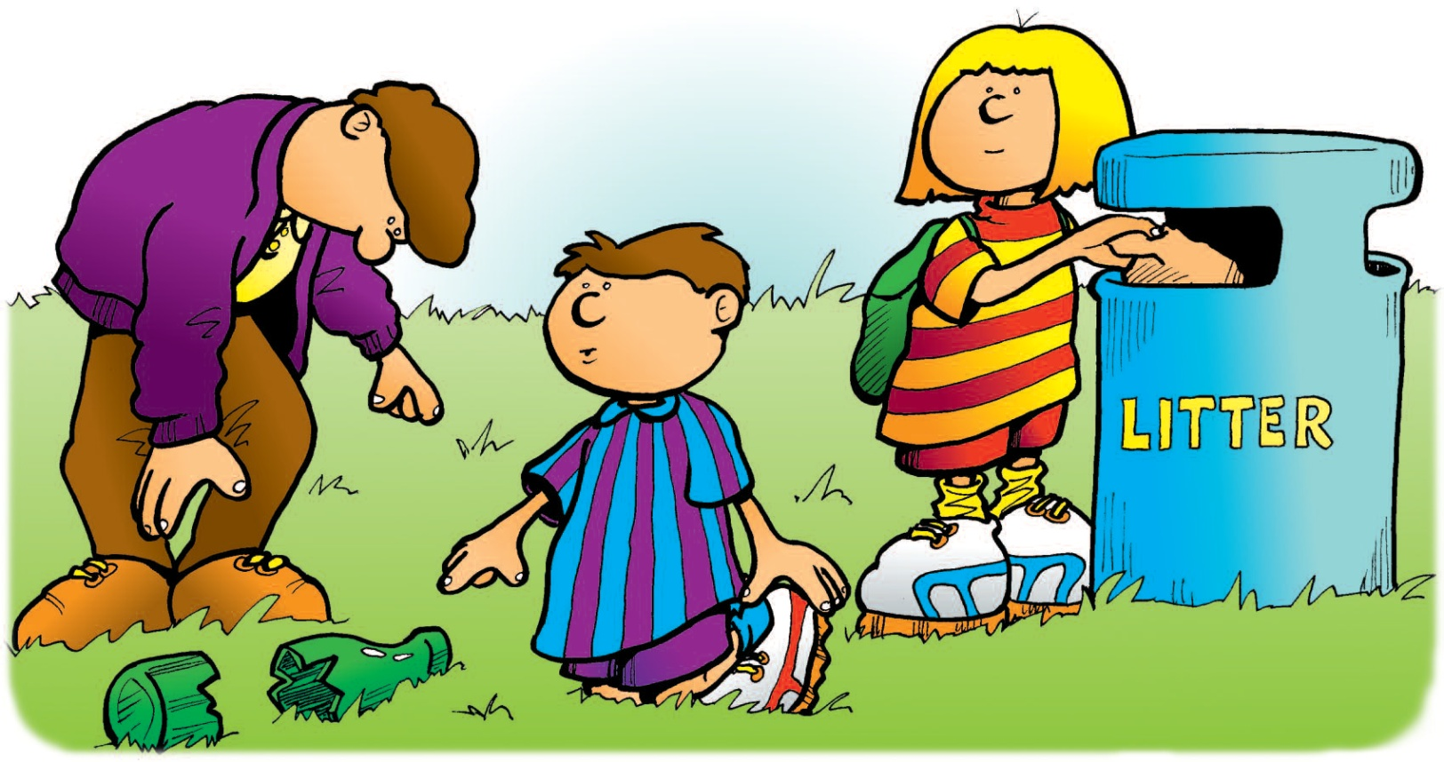
When all the bread had gone Dad reminded Jenny to put the empty bag into the rubbish bin to help keep the park tidy. Some people had not put their rubbish into the bin. Darren and Jenny found a broken bottle on the ground. They told Dad who carefully picked it up and placed it in the bin.

Slide 19
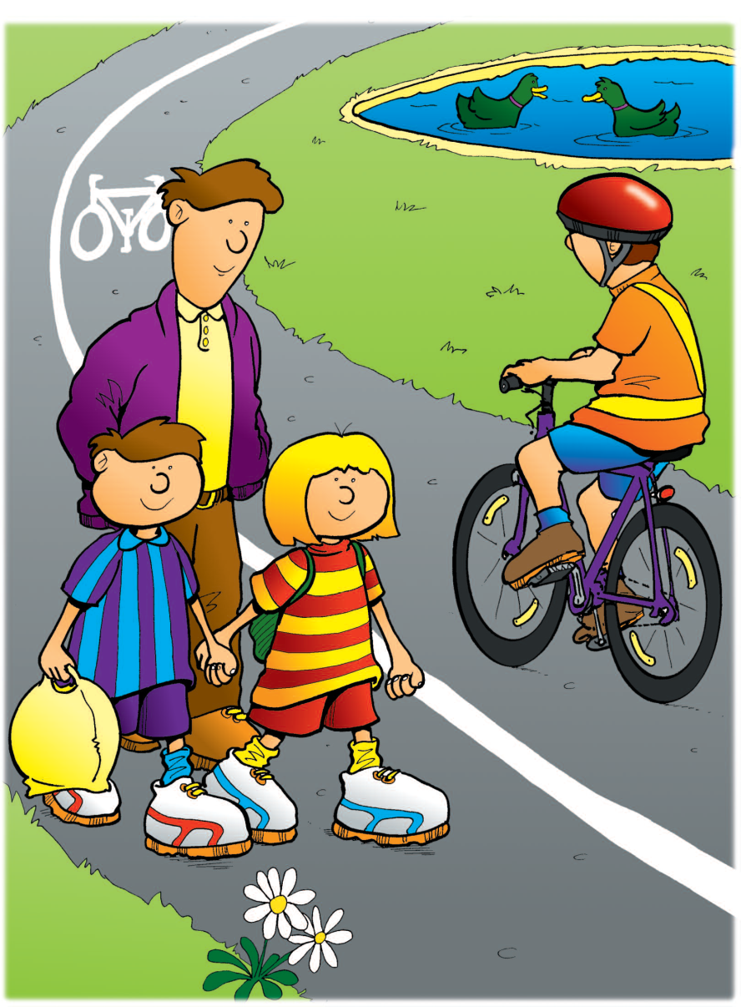
From the pond they set off towards the playground. They
walked along the path and were careful to keep to one side
in case someone came along riding a bike.
People were allowed to ride bikes in this park.

Slide 20
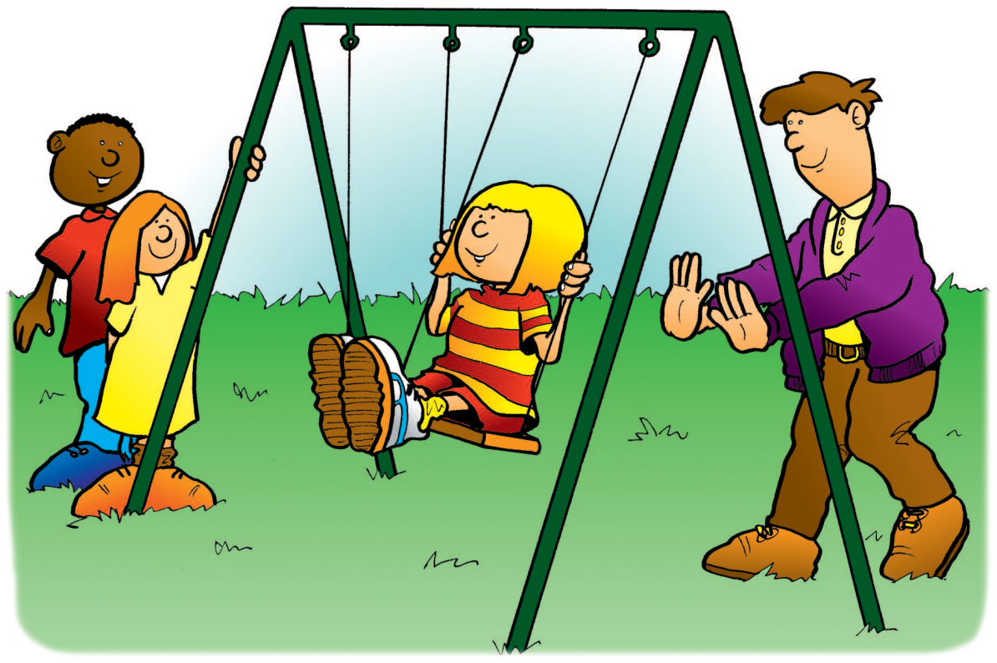
They came to the playground. There were lots of things to play on. Jenny liked to go on the swings. She asked Dad to push her to make her go high. “Hold on tightly,” said Dad, “and remember you must not get off until the swing has stopped.”
While he was pushing the swing Dad made sure that none of the other children in the playground came too close. They could get a nasty bump on the head if the swing or
Jenny’s feet hit them.

Slide 21
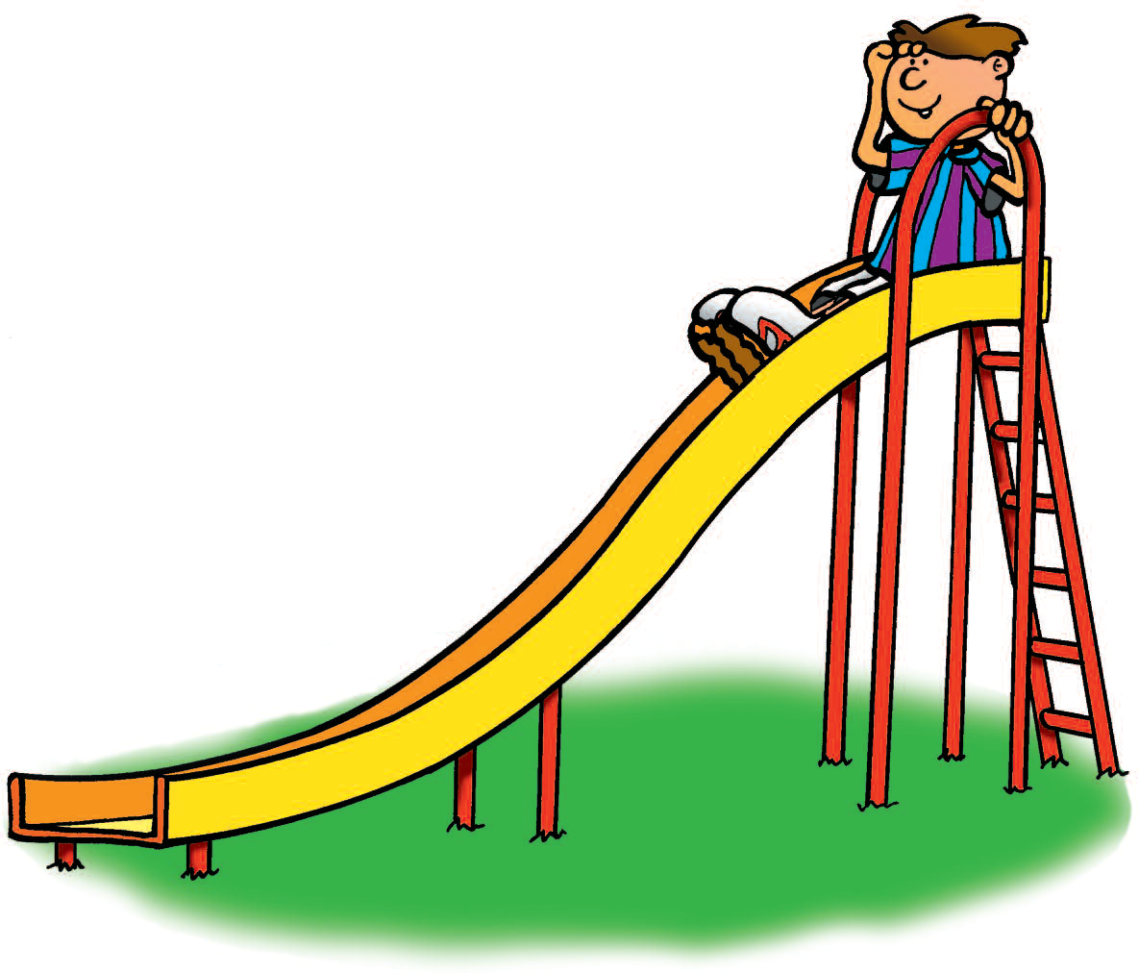
While Jenny was on the swing Darren climbed up onto the slide. “Look at me,
Dad. I can see lots of things from up
here!” he shouted. “Now be careful,”
said Dad. “Just think about what you
are doing up there. And hold on tightly
when you slide down.” Darren whizzed
down the slide.

Slide 22
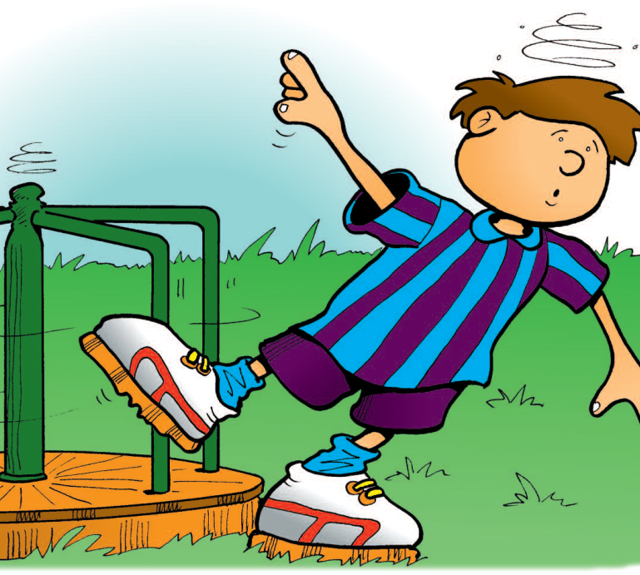
“That was great,” he said. “I’m going to do that again.” He climbed up the slide again. After sliding down several times Darren went onto the roundabout. He made himself dizzy spinning around and around. He nearly fell over because he tried to get off before it had stopped.
He soon felt better and ran off to Dad and Jenny. “Come on, let’s play football now,” he said.

Slide 23
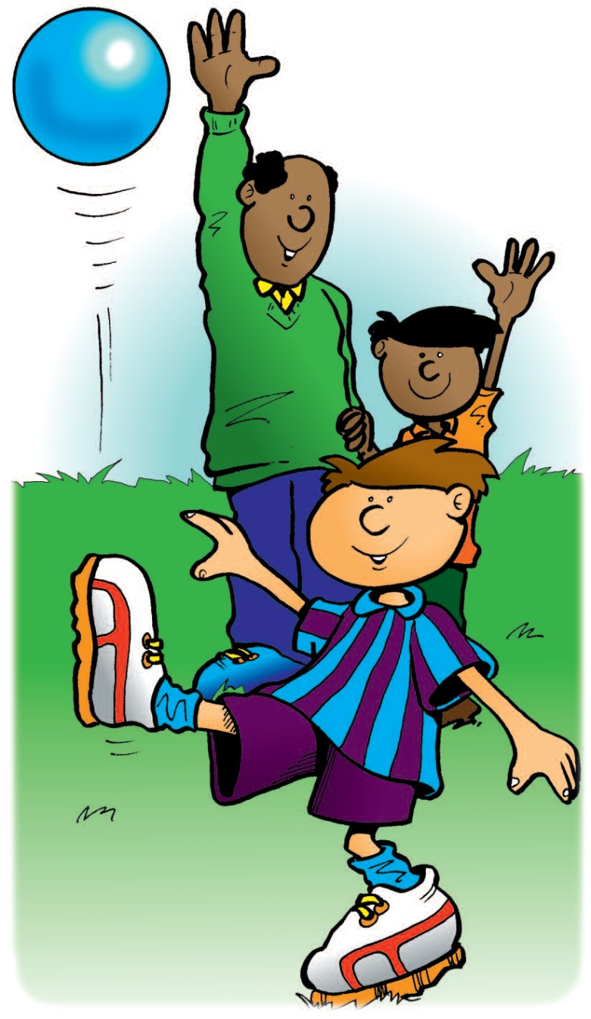
Just then Mr. Ahmed and Sanjay came towards them.
“Oh, you’re just in time”, said Darren, “we’re going to play football”.
There was a lot of space to kick the ball around. They had lots of fun. It was nice to be able to play without having to worry about the ball rolling into the road. Darren liked to see how high he could kick the ball.

Slide 24
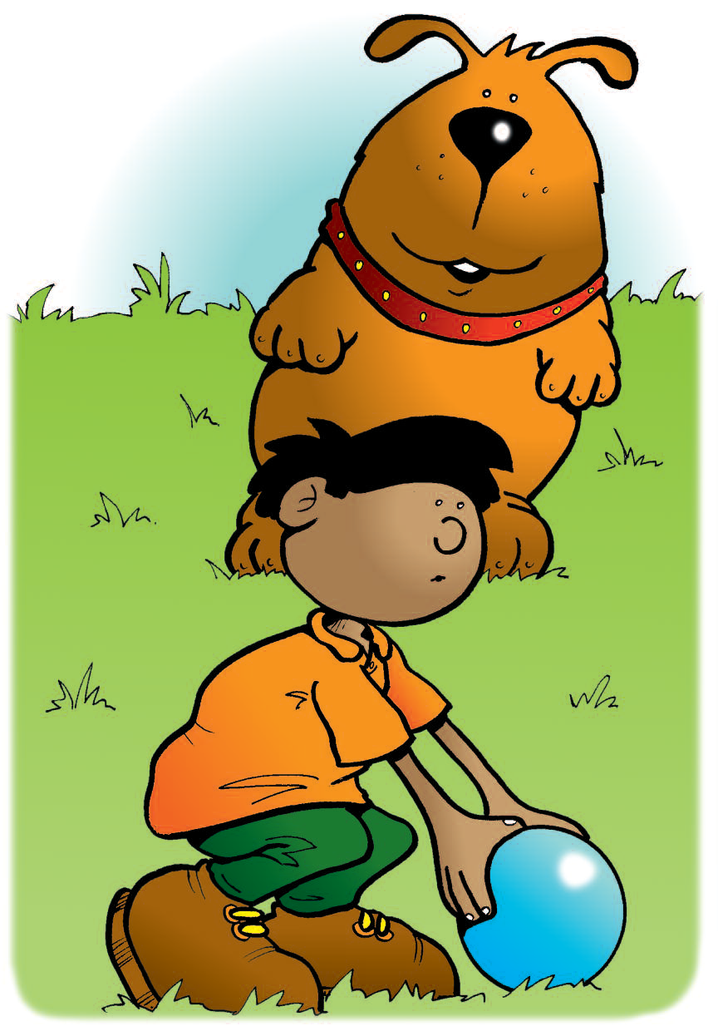
Just as Sanjay was running to pick up the ball a big dog came dashing towards him.
People often took their dogs for walks in the park. This dog was not on its lead. Sanjay didn’t like it too close to him.

Slide 25
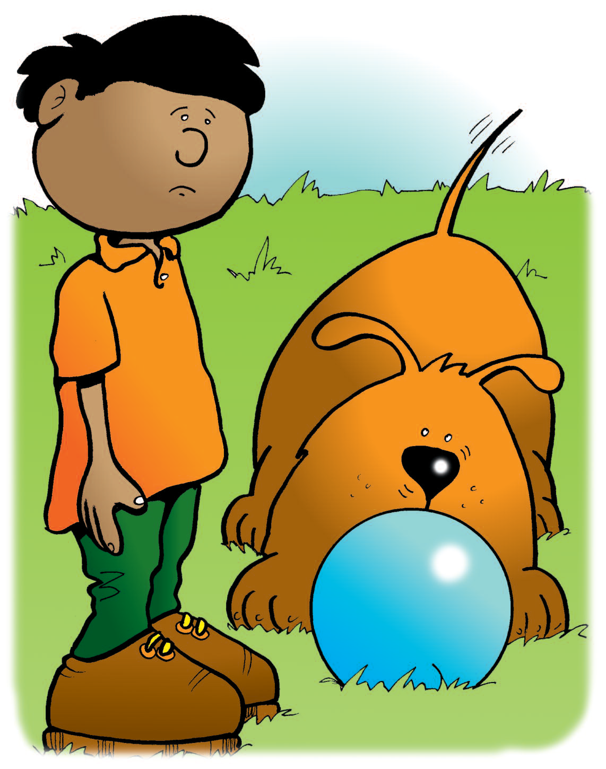
“Stand still, Sanjay,” shouted Mr. Ahmed. “The dog only wants to join in. It will soon go away.” The dog sniffed at the ball a few times then decided that it wasn’t as much fun as it had seemed. He wagged his tail and went off to sniff at something else. Sanjay was glad when the dog ran off.

Slide 26
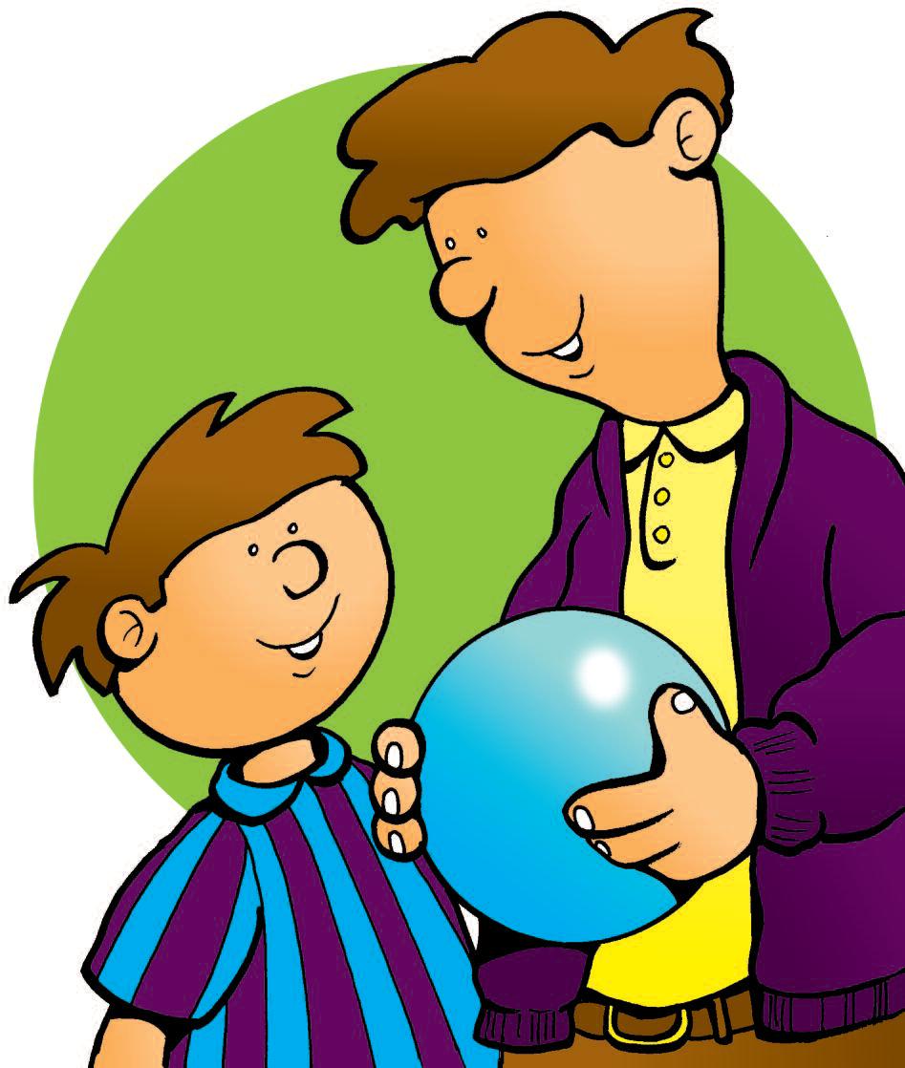
Jenny, Sanjay and Darren carried on playing football until they began to feel tired and hungry. “Can we go home now?” said Jenny. “I’m really hungry.” “Good idea,” said Dad. “Put your football back into the bag, Darren.”

Slide 27
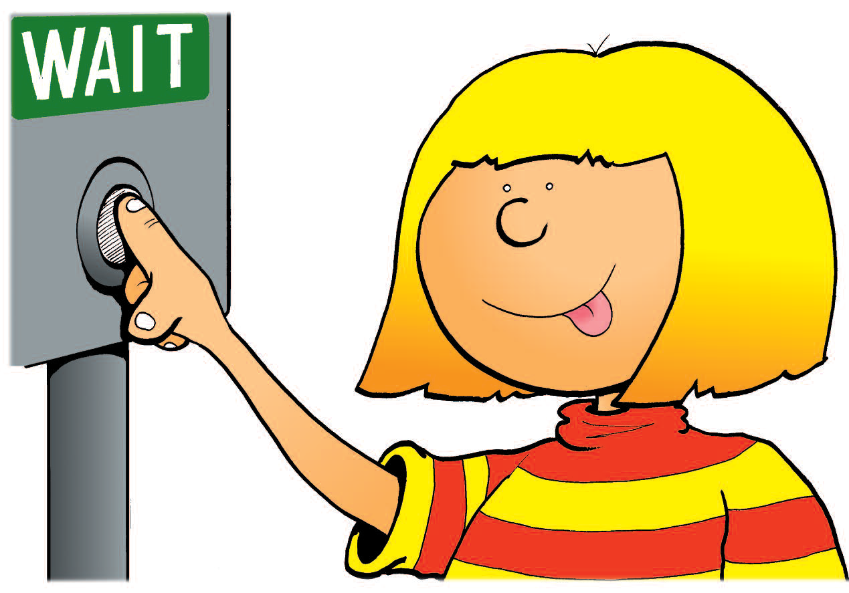
They said goodbye to Sanjay and his dad. “See you at school on Monday,” said Darren.
They went home the same way
they came. They crossed the road at the pelican crossing. Jenny made sure that she pressed the button to make the green man appear.

Slide 28
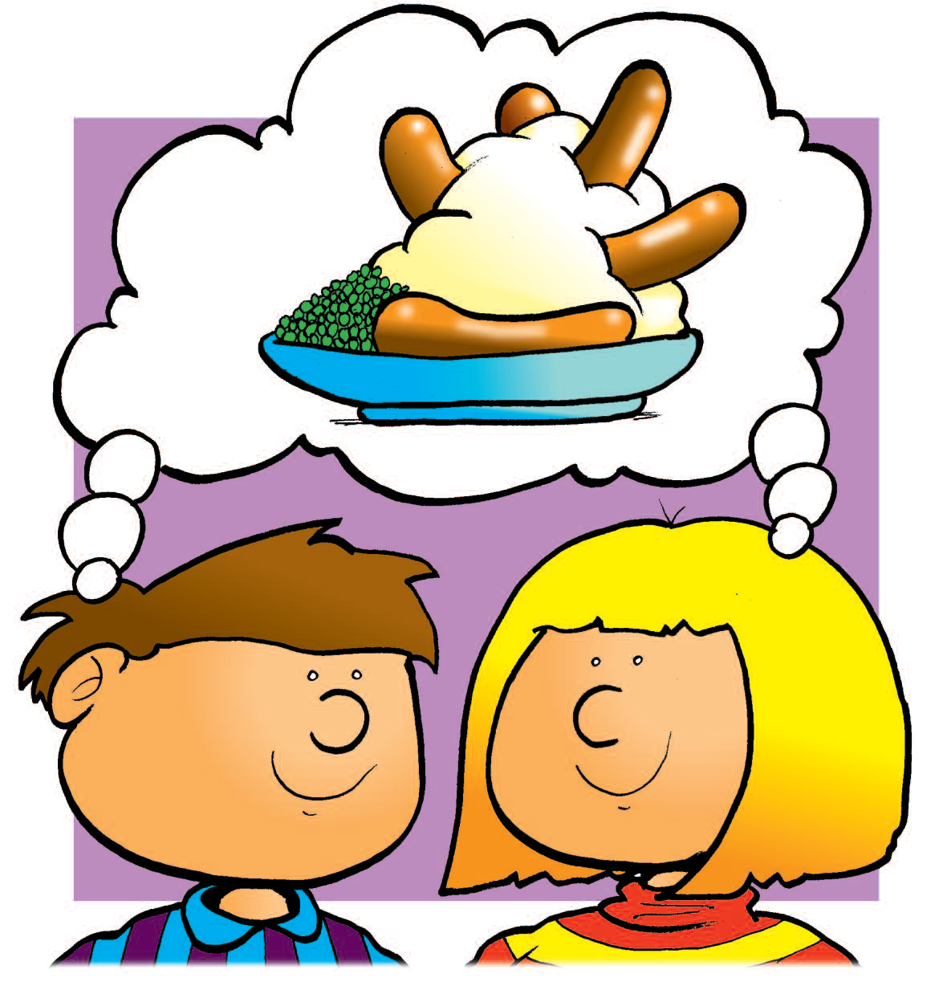
They were too tired to bother looking in the shops on the way back. They just wanted to get
home for tea.

Slide 29
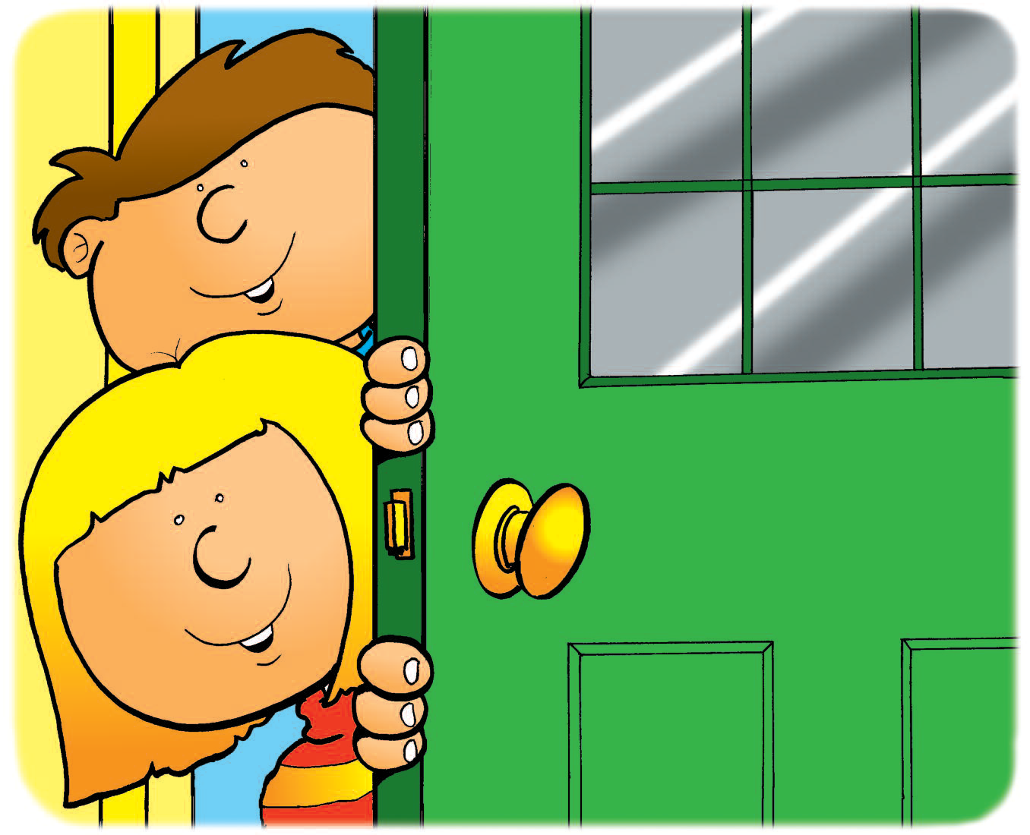
“What’s for tea mum?” they both shouted together when they went in their house.
“We’ve had a great time.
Thanks Dad.” It really had
been a good day.

Slide 30
The End
Lancashire County Council
Road Safety – Education and Engagement
roadsafetyeducation@lancashire.gov.uk

